Slide 1
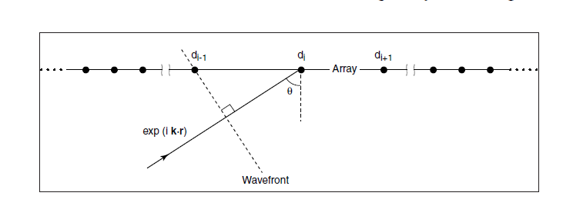
Beamforming

Slide 2
Noise
Where the noise come from?
A random process n(t, ω)

Slide 3
Array gain

Slide 4
Detection
False alarm probability
Detection probability

Slide 5
Linear Beamforming

Slide 6
The reason to use linear beamforming
Maximum likelihood explanation

Slide 7
MVDR method
The reason?
Implement issues

