Slide 2
Bioconversion of Aquacultural Waste to Organic fertilizer using
Microbial Optimization Technique
By
MGBECHIDINMA, CHIAMAKA LINDA
(Student ID: 21934207)
Supervisor: Prof. Zhang Chunfang
December, 2019

Slide 3
OUTLINE
Research Background
Scientific Motivation
Literature Review
Research Gap
Research Aim and Objectives
Significance of the Study
Experimental Design
Expected Result
Gantt Chart
References

Slide 4
RESEARCH BACKGROUND
High percentage of waste is generated from aquacultural practice (Aranganathana et al., 2019).
Aquacultural waste are rich in nutrient (Aranganathana et al., 2019).
Aquacultural waste composting is feasible (James et al., 2019).
Composting is one of the most effective methods of recycling organic waste with possible use in agriculture (Zhu et al., 2019).

Slide 5
SCIENTIFIC MOTIVATION
China's aquaculture industry is growing dramatically in recent years and now accounts for 69% of global aquaculture production
(Mo et al., 2018)
Figure 1: Showing the Top 5 Aquacultural Producing Countries (Source: Worldatlas.com)

Slide 6
SCIENTIFIC MOTIVATION
Effect of chemical fertilizer
Surface water pollution
Ground water pollution
The major constituents of fish bones are mineral substance and crude protein, mainly hydroxyapatite Ca₃(PO₄)₃OH and collagen proteins.
Figure 2 and 3: Showing Algal bloom and fish bone mineral structure respectively

Slide 7
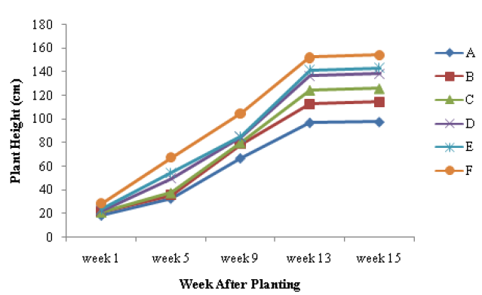
LITERATURE REVIEW
Novianantya et al. (2017) examined the improvement of sweet potato yield using mixtures of ground fish bone and plant residues.
Figure 4. Plant height Description : A (control), B (25 kg biofertilizer /ha), C (35 kg biofertilizer /ha), D (5 t/ compost ha), E (5 t compost / ha and 25 kg biofertilizer /ha), F (5 t compost /ha and 35 kg biofertilizer /ha)

Slide 8
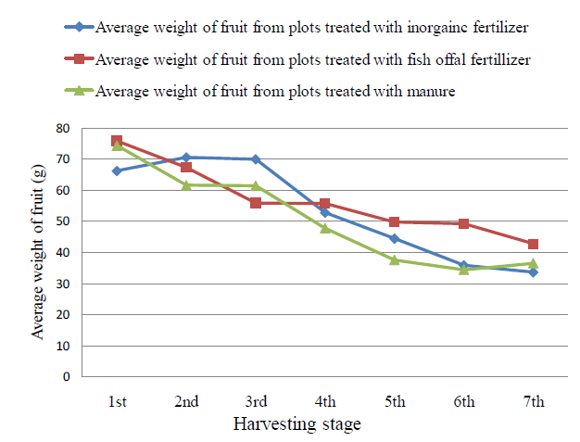
LITERATURE REVIEW
Lema and Degebassa, (2013) compared the effect of chemical fertilizer, fish offal’s fertilizer and manure on marketable yield and other parameter of tomato.
Figure 5. Average weight of fruits in gram collected from six plants with an area of 1.8 m².

Slide 9
SCIENTIFIC PROBLEM
Aquacultural waste has been one of the problems having the greatest impact on the environment as increasing aquacultural practices have detrimental effects on the marine environment thereby becoming an issue of public concern.

Slide 10
RESEARCH GAP
Knowledge in the area of organic fertilizer production from aquaculture waste using mixed samples and microbial optimization technique is limited.

Slide 11
RESEARCH GOAL
AIM
The aim of our research is to compost aquacultural waste using micro-organisms in order to obtain organic fertilizer.
OBJECTIVES
To run a physiochemical characterization on aquacultural waste sample in order to determine the major components of the sample.
To isolate and characterised micro-organisms from the sample in order to determine the physiological property of the targeted microbes.
To subject the aquacultural waste to an optimized, controlled, composting system for bioconversion purpose.

Slide 12
RESEARCH SIGNIFICANCE
Viable means of recycling aquacultural waste and producing a quality organic fertilizer would be understood.
Successful composting of aquacultural waste would greatly reduce the volume of fisheries byproducts.
Following the studies, the commercialization of organic fertilizer made from aquacultural waste would be feasible.

Slide 13
RESEARCH SIGNIFICANCE
SOIL APPLICATION
As soil conditioner
As bio-pesticide
Plant growth promoter
Organic agricultural product
ENVIRONMENTAL BENEFIT
Waste to valuable product
Reduce synthetic fertilizer
Prevent pollution
Boost marine life
Remediation of soil
AQUACULTURAL WASTE
MICROBIAL
COMPOSTING
TECHNIQUE
ECONOMIC BENEFIT
Cost saving
Commercialization
ECONOMIC BENEFIT
Cost saving
Commercialization

Slide 14
CONCEPTUAL FRAMEWORK
STEP 3
Bioconversion process by composting
STEP 2
Isolation and Characterization of Micro-organisms
STEP 1
Physiochemical Characterization on Aquacultural Waste Sample

Slide 15
RESEARCH DESIGN
Collection of Aquacultural Waste
Sorting Process
Shredding Process
Biochemical Analysis
Physicochemical Characterization
Isolation of Microorganisms
Composting
Optimization Procedure
Molecular Analysis
Shredding Process
Crude Organic Fertilizer
Figure 6: Showing the experimental design

Slide 16
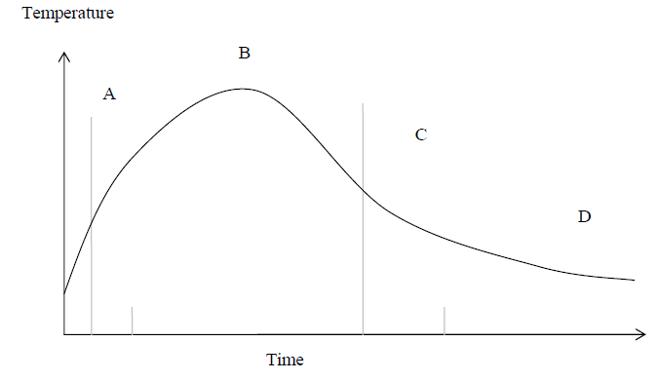
EXPERIMENTAL PROCEDURES
Raw Material
H₂0
Heat
Co₂
Finish Compost
Fish Waste
H20
Bulking agents
Microorganism
Organic Matter
Minerals
H20
Microorganism
Compost Site
Illustration of phases in composting.
A = mesophilic phase;
B = thermophilic Phase;
C = mesophilic phase;
D = curing phase.
Oxygen O₂
Figure 7: showing the composting process

Slide 17
EXPECTED RESULTS
Our results will show if single or co-composting of aquacultural waste like fish bones and calcareous shells would provide stable and eco-frirendly organic fertilzer required for growth and yield of agricultural produce.
These results would provide an answer to the impending local problem associated with the prohibition of dumping aquacultural waste into the sea and algal bloom formation.

Slide 18
REFERENCE
Aranganathana, L., Rajasreea, S. R., Sumana, T. Y., Remyaa, R. R., Gayathria, S., Jayaseelana, C., Karthiha, M. G., Gobalakrishnan, M. (2019). Comparison of molecular characteristics of Type A humic acids derived from fish waste and sugarcane bagasse co-compost influenced by various alkaline extraction protocols. Microchemical Journal, 149:104038.
James P. Morris1 , Thierry Backeljau1,2 and Gauthier C. (2019). Shells from aquaculture: a valuable biomaterial, not a nuisance waste product. Reviews in Aquaculture, 11: 42–57
Zhu, L., Wei, Z., Yang, T., Zhao, X., Dang, Q., Chen, X., Wu, J., Zhao, Y. (2019). Core microorganisms promote the transformation of DOM fractions with different molecular weights to improve stability during composting. Bioresource Technology, 9: 12257.

Slide 19
RESEARCH TIMELINE

Slide 20
THANKS FOR YOUR KIND ATTENTION

