Slide 1
Bibliographic review of nutrients, Primary Production and phytoplankton community in the Pacific Arctic
Nicola Sabata

Slide 2
Part 1. Where do nutrients in the Pacific Arctic come from?
Part 2. What controls the phytoplankton blooms?
Part 3. PP and community differences between open water, under-ice and ice phytoplankton

Slide 3
Part 1
Where do nutrients in Pacific Arctic come from?

Slide 4
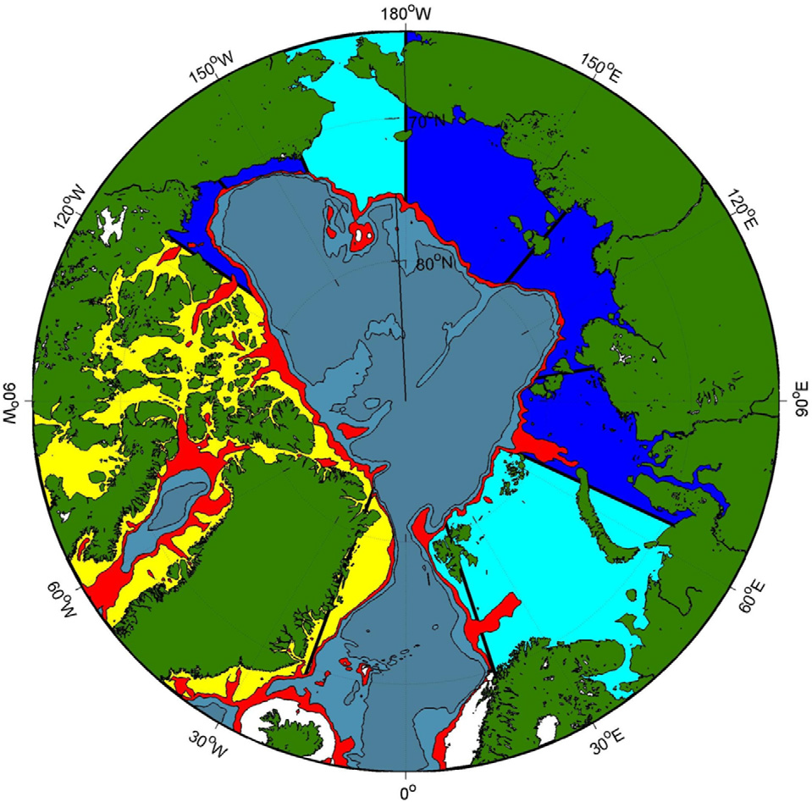
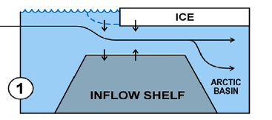
Advection of Pacific Water (PW) though Bering Strait
Bering and Chukchi shallow inflow shelves
Pacific inflow
0.8 Sv
1/3 Arctic freshwater
Source of heat
Nutrient rich
Carmakc and Wassmann, 2006. The spatial distribution of shelf types in the Arctic Mediterranean.
Notes:
Bering strait is the only gateway of pacific water to arctic
1/3 AO freshwater (Stratification)
Source of heat ( Onset ice melt)
Most nutrient rich waters entering the arctic

Slide 5
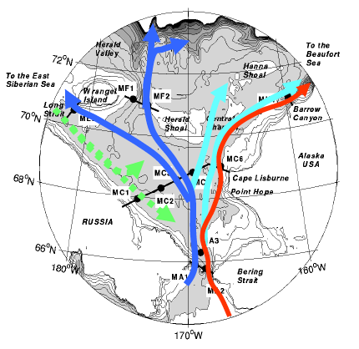
Summer waters
Anadyr Water (AW)
S 33 saltier
T 0-10ºC colder
High nutrient (N>15uM)
N>20uM in summer!!!
Among highest PP in the world
Bering Sea Water (BSW)
Moderate parameters
Alaska coastal water (ACW)
Developed annually from freshwater
S<31.5 fresher
T 2-13ºC warmer
Low nutrient (N<10uM)
Siberian Coastal Current (SCC)
Cold, fresh, seasonal
Low nutrient
Woodgate et al, DSR, 2005, http://psc.apl.washington.edu/Chukchi.html

Slide 6
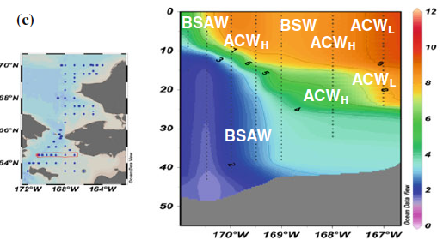
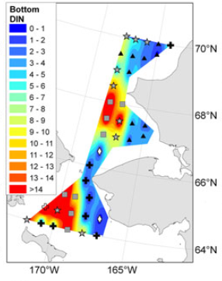
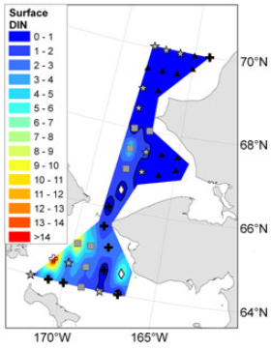
Summer water signature
Strong vertical and horizontal temperature gradient (2-12ºC)
Temperature and nutrient correlation
Eisner et al., 2013
Bottom
Surface
Strong east-west gradient of productivity across Chukchi sea
(Danielson et al., 2017; Giesbrecht et al., 2019)
Notes:
Figures from Einser et al., 2012
East-west gradient of productivity across Chukchi (Hill et al., 2005)

Slide 7
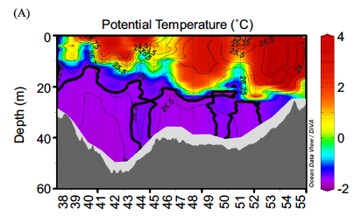
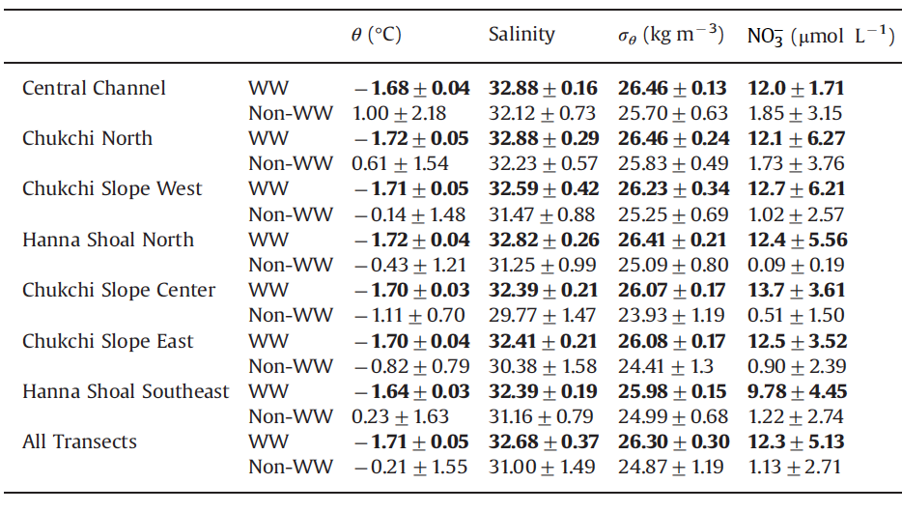
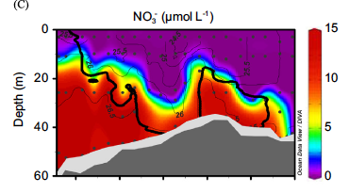
Winter Water (WW)
Lowry et al., 2015
Near-freezing, dense water
High nutrient[N]=10-20uM!!!
10-fold higher than adjacent waters
Notes:
Lowry et al., 2015. Influence …....
Sea ice formation → brine rejection→ near-freezing, dense water
[N]=10-20uM in non coastal shelf waters of Chukchi sea!!!
benthic remineralization + Bering source
(10-fold higher than adjacent waters)
Winter: advection to Chukchi sea
Summer: mixing with PW and/or heating
→ remnant (RWW)
End summer: transported to Arctic Basin

Slide 8
Part 2
What controls phytoplankton blooms?

Slide 9
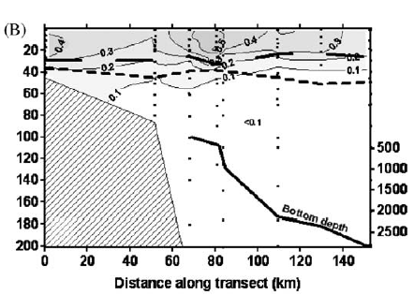
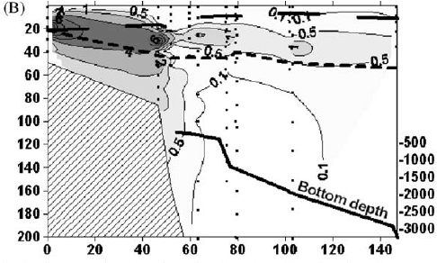
Bottom up control at shelves
Pacific inflow and topography
(Lowry et al., 2015)
Ice conditions
Spring
Summer
Stratification
Light limitation
Nutrient
Limitation
Nutrient depeltion
Hill et al., 2005
Surface bloom
SCM
Shallower mixed layer
and deeper euphotic zone
Notes:
High nutrient, enough light → early spring surface bloom (Selz et al., 2017; Lowry et al., 2015)
Ice formation + wind mixing → automn bloom ? (Pickart et al., 2017; David et al., 2015)
Top down conrol in Basin but also in shelves, specially at summer in bergin sea (Griesbecht, 2019) → importance of zoo grazing

Slide 10
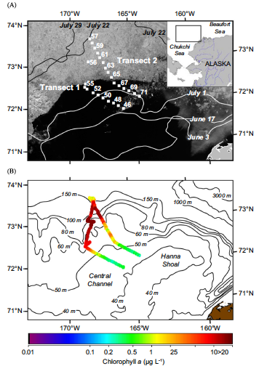
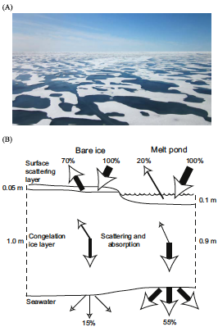
Thin ice and melt ponds
1m thick ice with 30-40% melt ponds provides enough light for phyto to bloom
Massive under-ice phyto bloom (Eastern Chukchi July 2011)
> 100km!
55%
Arrigo et al., 2014
Notes:
Arrigo, 2014. Maps of the northern chukchi sea showing the distribution of sea ice Eastern Chukchi on July 2011 and the location of stations sampled during ICESCAPE 2011 criuse.
b) Bathymetry of the study area overlaid surface chla conc calculated from the fluorescence
Under ice blooms not observed in bering sea maybe because absence of extensive networks of melt ponds (Szymanski, 2015)
Arrigo, 2014 hypothesized that melt ponds can transmit sufficient light through the thinner Arctic
ice cover and sustain primary production, even when the ocean is fully ice-covered

Slide 11
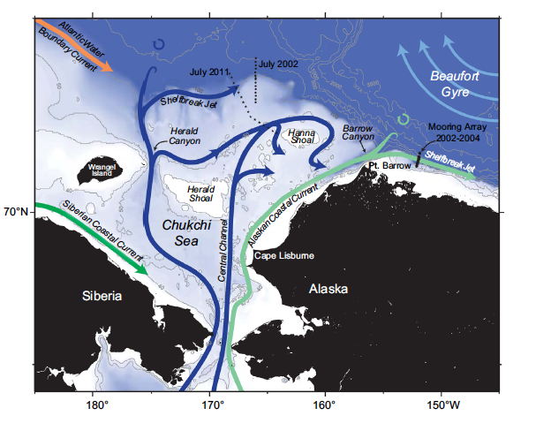
Upwelling in shelfbreak
Study transect
Under-ice "megabloom" at shelfbreak
Largest Chla values among global ocean
(Spall et al., 2014)
Easterly winds
Spall et al., 2014
In general, upwelling is not key factor for high PP in AO, except for shelfbreak areas
(Codispoti et al., 2013)
Notes:
Map spall et al., 2014
Ice does not play a critical role in upwelling event

Slide 12
Part 3
PP and community differences between open water, under-ice and ice phytoplankton

Slide 13
Temporal and spatial phytoplankton community
Communities are rarely clearly separated “floristically, temporally and spatially”
(Selz et al., 2017)
Seeding?
Ice algae
10% of annual PP in shelves (Szymanski and Gradinger,, 2016)
Pennate diatoms: Fragilaropsis spp., Nitzschia frigida, Melosira arctica
Under-ice
>80% ice cover
Marginal Ice Zone (MIZ)
<80% ice cover
Open water
Centric diatom-dominance (i.e Thalassiosira sp, Chaetoceros sp.)
Adaptation
Similar inventory but different proportions of each species in ice and under-ice blooms
(Szymanski and Gradinger, 2016)
Notes:
iCE ALGALE: Bloom from early march-mid or late may
Chaetoceros, fragi, thalassio diatom genra dominate core of Bloom (“hotspots” of specific taxa) These 3 are the major contributors to PP and carbon biomass (Both et al., 2002)

Slide 14
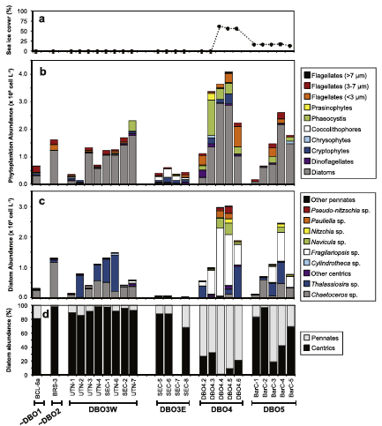
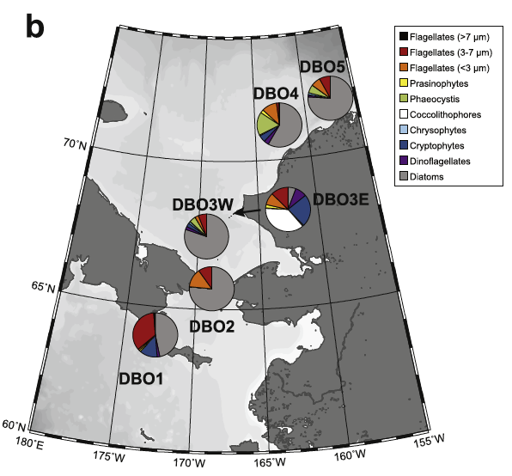
« Hotspots » of PP and Phytoplankton community
Large diatom dominance except for
Coccolithophorids at East
Highest abundance and presence of Fragiliaropsis sp in ice region
Pennate diatoms vs centric diatoms
5 Distributed Biological Observatory (DBO)
(Grebmeier et al., 2019)
Different size classes tend to dominate different conditions
Giesbrecht et al., 2019
Notes:
Esmentar hotspots,
Programa DBO a PAR region
East-west gradient ja comentat pel que fa a nutrients tambe s’observa pel que fa a la comunitat
Diatoms dominen a tot arreu excepte dbo3 est on cocos i altres talles petites dominen. (low nutrient adapted)
Clara consequencia de les masses d’aigua, acw poc rica en nutrients a l’est
Diatom abundance increases towards north (northwards propagation of bloom)

Slide 15
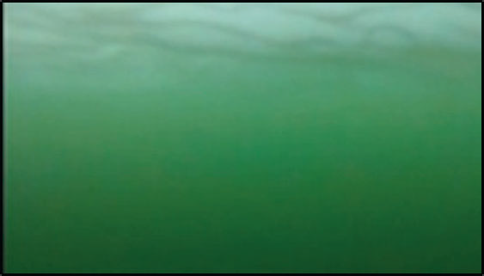
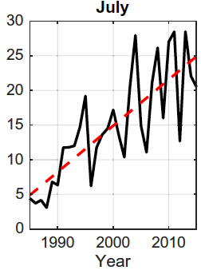
Under-ice blooms
Changing Arctic PP paradigm
Lowry et al., 2014
Ideal conditions over 30% AO in June and July (Horvat et al., 2017)
70% abundace in Chukchi Sea?
(Lowry et al., 2014)
Increasing by 7% per decade
Horvat et al., 2017
Under-ice PP underestimated by an order of magnitude?!
(Arrigo et al., 2014)
Notes:
If sub-ice blooms are common, then the annual amount of primary production and carbon fixation occurring beneath the sea ice in the Arctic Ocean may have been underestimated by an order of magnitude (Arrigo et al., 2014)
Events such as Chukchi bloom may be routine in modern Arctic (Horvat et al., 2017)
In july, these blooms increase 7% per decade (in average from <5% in 1986 to 21% over period of 2006-2015)
Scale= frequency (days per month)
Blue regions = never >80% ice concentration (which is the minimum ice to consider an under-ice bloom, less that this is considered as a MIZ)
Horvat is model study!

Slide 16
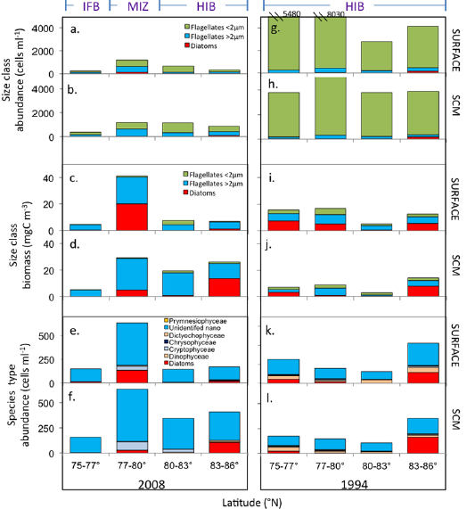
Shift to smaller phytoplankton size in ice-free waters?
Low ice 2008
Strong ice 1994
Freshening enhances oligotrophy
(Coupel et al., 2015)
Decrease in phytoplankton abundance and cell biomass of large cells
Higher production of nanoplankton
(Lanely and Sosik, 2014; Neeley et al., 2018)
Contradictory with PP increasing predictions
(Arrigo and van Djiken, 2015; Yool et al., 2015)
Coupel et al, 2012
Notes:
Decrease on diatoms and two size flagelates
(Local increase of abundance in MIZ)
total disappearance of the sea ice cover in the south of the Canadian basin likely explain the phytoplankton impoverishment and decrease in phytoplankton abundance and Chl a biomass of less large cells (diatoms and dinoflagellates) and picoplankton and higher production of nanoplankton (chrysophytes and prymnesiophytes).

Slide 17
Climate change and future scenarios
Impact of ice conditions?
Thinner ice, lower concentration, earlier retreat, more melt ponds
Light and stratification increase
Impact of Pacific water inflow?
Increase in Bering strait inflow
Nutrient increase
Impact of atmospheric forcing?
Increased wind and storms
Vertical mixing and upwelling increase
Differences between shelves and basin?
Oligotrophy vs eutrophy
Stratification vs upwelling
Importance of long-term consistent monitoring
Notes:
Thinner ice, lower concentration, earlier retreat, more melt ponds
Light and stratification increase
Timming (Longer and earlier prod season) and under-ice bloom increase → PP increase?
Phytoplankton community (Shift to smaller sizes) → PP decrease?
Impact of Pacific water inflow?
Increase in Bering strait inflow
Nutrient increase
High variability of transport volume→ Influence on phyto?
Impact of atmospheric forcing?
Increased wind and storms
Vertical mixing and upwelling increase
Competing effects between stratification and mixing
Importance of shelbreak zone
Woodgate, 2012 finds increase in Bering strait flow after 2008. PW nutrient rich should enhance PP ? → strong seasonal increase 0.3 – 0.5sv over 25 years (except for Alaska)
AW Increasing? (last arctic korean expedition 2019, not published)
variability of transport volume → difficult understanding effects of Bering strait flow on phyto production.
Increase in high latitude storms
Competing effects between stratification (higher freshwater by ice melt and river input) and mixing (higher wind)

Slide 18
Bibliography
Arrigo K.R., van Dijken J.L., 2015. Continued increases in Arctic Ocean primary production. Progress. Oceanogr. 136: 60-70
Arrigo, K.R., Perovich, D.K., Pickart, R.S., Brown, Z.W., van Dijken, G.L., Lowry, K.E., Mills, M.M., Palmer, M.A., Balch, W.M., Bates, N.R., Benitez-Nelson, C.R., Brownlee, E., Frey, K.E., Laney, S.R., Mathis, J., Matsuoka, A., Mitchell, B.G., Moore, G.W.K., Reynolds, R.A., Sosik, H.M., Swift, J.H., 2014. Phytoplankton blooms beneath the sea ice in the Chukchi sea. Deep-Sea Res. II 105, 1–16. https://doi.org/10.1016/j.dsr2. 2014.03.018.
Carmack, E., Wassmann, P., 2006. Food webs and physical–biological coupling on pan-Arctic shelves: unifying concepts and comprehensive perspectives. Progress. Oceanogr. 71, 446–477.
Codispoti, L.A., Kelly, V., Thessen, A., Matrai, P., Suttles, S., Hill, V., Steele, M., Light, B., 2013. Synthesis of primary production in the Arctic Ocean: iii. Nitrate and phosphate based estimates of net community production. Progress. Oceanogr. 1–25. https://doi. org/10.1016/j.pocean.2012.11.006.
Coupel, P., Ruiz-Pino, D., Sicre, M. A., Chen, J. F., Lee, S. H., Schiffrine, N., Li, H. L., and Gascard, J. C., 2015. The impact of freshening on phytoplankton production in the Pacific Arctic Ocean. Progress. Oceanogr., 131: 113-125
Danielson, S.L., Eisner, L., Ladd, C., Mordy, C., Sousa, L., Weingartner, T.J., 2017. A comparison between late summer 2012 and 2013 water masses, macronutrients, and phytoplankton standing crops in the northern Bering and Chukchi Seas. Deep-Sea Res. II 135, 7–26. https://doi.org/10.1016/j.dsr2.2016.05.024.
Eisner, L., N. Hillgruber, E. Martinson, and J. Maselko (2013), Pelagic fish and zooplankton species assemblages in relation to water mass characteristics in the northern Bering and southeast Chukchi seas, Polar Biol., 36(1), 87–113.
Giesbrecht, K.E., Varela, D.E., Wiktor, J., Grebmeier, J.M., Kelly, B., Long, J.E., 2019. A decade of summertime measurements of phytoplankton biomass, productivity and assemblage composition in the Pacific Arctic Region from 2006 to 2016. Deep Sea Res. Part II Top. Stud. Oceanogr. 162, 93–113.
Grebmeier J., Moore S.E., Cooper L.W., Frey K.E., 2019. The Distributed Biological Observatory: A change detection array in the Pacific Arctic-An introduction. Deep Sea Res, Part II Top. Stud. Oceanogr, 162, 1-7
Hill, V.,Cota,G.,Stockwell,D.,2005.Spring and summer phytoplankton communities in the Chukchi and eastern Beaufort Seas. Deep Sea Res.II52, 3369–3385

Slide 19
Bibliography
Horvat, C., Jones, D. R., Iams, S., Schroeder, D., Flocco, D., & Feltham, D. (2017). The frequency and extent of sub-ice phytoplankton blooms in the Arctic Ocean. Science Advances, 3(3), e1601191. https://doi.org/10.1126/sciadv.1601191
Laney, S.R.,Sosik,H.M.,2014.Phytoplankton assemblage structure in and around a massive under-ice bloom in the Chukchi Sea. Deep-Sea Res.II105,30–41, http://dx. doi.org/10.1016/j.dsr2.2014.03.012.
Lowry, K. E., Pickart, R. S., Mills, M. M., Brown, Z. W., van Dijken, G. L., Bates, N. R., & Arrigo, K. R. (2015). The influence of winter water on phytoplankton blooms in the Chukchi Sea. Deep-Sea Research Part II, 118, 53–72. https://doi.org/10.1016/j.dsr2.2015.06.006
Lowry K.E., van Dijken G.L., Arrigo K.R., 2014. Evidence of under-ice phytoplankton blooms in the Chukchi Sea from 1998 to 2012. Deep Sea Res, Part II Top. Stud. Oceanogr, 105, 105-117
Neeley, A.R., Harris L.A, Frey K.E 2018. Unraveling Phytoplankton Community Dynamics in the Northern Chukchi Sea Under Sea-Ice-Covered and Sea-Ice-Free Conditions. Geoph. Res. Let. 10.1029/2018GL077684
Szymanski, A., and R. Gradinger. 2016. The diversity, abundance and fate of ice algae and phytoplankton in the Bering Sea. Polar Biol. 39: 309–325. doi:10.1007/s00300-015-1783-z
Spall, M.A.,Pickart,R.S.,Brugler,E.T.,Moore,G.W.K.,Thomas,L.,Arrigo,K.R.,2014. Role of shelfbreak upwelling in the formation of a massive under-ice bloom in the Chukchi Sea. Deep Sea Res.II105,17–29, http://dx.doi.org/10.1016/ j.dsr2.2014.03.017.
Selz, V., Laney, S., Arnsten, A. E., Lewis, K. M., Lowry, K. E., Joy-Warren, H. L., et al. (2017). Ice algal communities in the Chukchi and Beaufort Seas in spring and early summer: Composition, distribution, and coupling with phytoplankton assemblages: Ice algal-phytoplankton coupling in Chukchi Sea. Limnology and Oceanography, 63(3), 1109–1133. https://doi.org/10.1002/lno.10757
Woodgate R., Aagard K., Weingartner T., DSR, 2005, http://psc.apl.washington.edu/Chukchi.html
Yool A., Popova E.E., Coward C., 2015. Future change in ocean productivity: Is the Arctic the new Atlantic. Jour. Geo. Res. 10.1002/2015JC011167

Slide 20
Thank you for your attention!

