Slide 1
Regulation and Mechanisms of Algal Inhibition from Fermentation of Crop Straw Enhanced by White-rot Fungi. By
Effiong, Kokoette Sunday
PROF. XIAO XI : Supervisor
7th January 2019 (RESEARCH PLAN)

Slide 2
GRAPHICAL ABSTRACT

Slide 3
OUTLINE
Scientific Motivation
Theoretical Background
Review of Related Literature
Research Gap
Research Questions
Research Aim and Objectives
Conceptual Framework
Experimental Design
Expected Outcome
Gantt Chart

Slide 4
SCIENTIFIC MOTIVATION
Fig 1 & 2: Picture of water infested with algal bloom versus an Ideal situation
Pollution from algal bloom remains one of the greatest environmental threat to our marine ecosystem.
Its effects on aquatic life and humans, as well as the high costs of cleaning up, necessitates the present research.

Slide 5
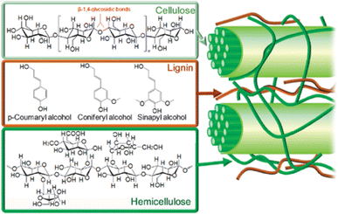
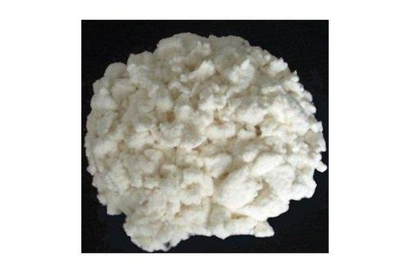
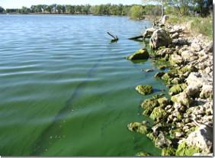
THEORITICAL BACKGROUND
resulting products for
Allelopathy is a biological phenomenon by which an organism produces one or more biochemicals
that influence the growth, survival, and reproduction of other organisms. These biochemicals
are known as allelochemicals and can have beneficial (positive allelopathy) or
detrimental (negative allelopathy) effects on the target organisms.
Advantages:
Inexpensive
No health threats to experts
No side effects
Total restoration of environment
N/B: Bioremediation can either be done by In situ or Ex situ
Fig.3: White-rot fungi & algal bloom

Slide 6
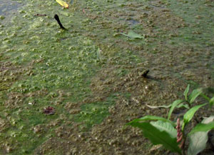
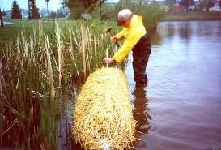
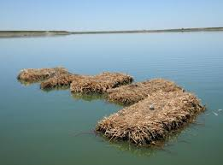
Has it been done before?
Filamentous algae forming mats on the surface of a small lake. (Courtesy of Sal Mangiafico, 2013)
Bales of hay fell into a farm pond in UK; pond water was found to contain less bloom in 1947.
Successfully used in a lake in Sydney, Australia in 2017.

Slide 7
REVIEW OF RELATED LITERATURE
Hanspi et al ( 2018) Carried out Isolation of a new Efficient Dye Decolorizing White rot Fungus Carrena sp.
Anne-Christine Ritschoff (1996) Investigated the Decay mechanism of brown-rot fungi.
Adinarayana Reddy and Trevor D’Souza (1994) Published a work done on physiology and molecular biology of the lagnin peroxidases of Phanerochaete chrysosporium.

Slide 8
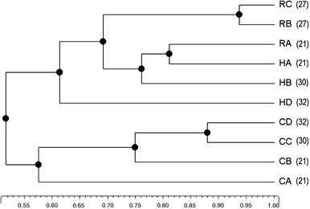
Larissa et al (2007) Investigated the impact of white-rot fungi on numbers and community composition of bacteria colonizing beech wood from forest soil.
This study investigated the composition of white rot fungi colonizing beech woods from forest soils.
Dendrogram showing the percentage of similarity in typical DGGE banding patterns of bacterial 16S rRNA gene PCR products obtained from wood blocks on soil with and without colonization by white-rot fungi
Notes:
Fig.1:

Slide 9
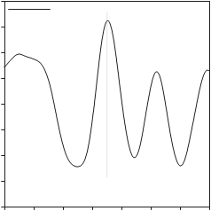
Karin Fackler et al(2007) Reviewed the Biotechnological Wood Modification with Selective White-rot Fungi and Its Molecular Mechanisms.
The paper reviewed the current work into selective lignin conversions, with emphasis on the contribution from other research groups from different laboratories.
When second derivative of the NIR spectrum of a spruce wood surface was exposed to C. subvermispora for three days. The depth of the fungal wood modification does not exceed 800µm.
12
9
surface
<200µm
0
6
600µm
3
<800µm
0
NIR 2nd derivative x106
-3
-6
-9
-12
6100
6050
6000
5950
5900
5850
5800
5750
Wave number/cm-1

Slide 10
Michael Gold and Margaret Alic (1993) Investigated the molecular biology of the Lignin-Degrading Basidiomycete Phanerochaete chrysosporium.
The study revealed the molecular biology of the Lingnin degrading basidiomycaete Phanerochaete chrysosporium
TPH degradation rate (%) and total PAH degradation rate (%) of each group, (b) GC-MS analysis of 16 PAHs of the experimental soil and 16PAHs biodegradation rate of the H group.

Slide 11
Guomong Zeng et al (2015) Studied algicidal efficiency and mechanism of Phanerochaete chrysosporium against harmful algal bloom species.
This study investigated the Flow cytometry analysis of three algal cultures
Cryptomonas obovata FACHB-1301 (a), Oscillatoria sp. FACHB-1083 (c) and Scenedesmus quadricauda FACHB-507 (e) and corresponding algal cultures treated with Phanerochaete chrysosporium ((b), (d), and (f), respectively).

Slide 12
RESEARCH GAP
Development has resulted in increase on pollutant levels in our water bodies the world over, bringing various types of nutrients, hence, causing blooms.
Although research in bloom inhibition using straw has been published with diverse modifications for its treatment, with very few using fungi to degrade the straw, there’s limited knowledge on what the constitution of the culture media should be to enhance the degradation process, thus prompting this research.
It promises be a more cost effective and environmentally friendly research than what the previous approaches have produced.

Slide 13
RESEARCH QUESTION
Is it possible to make algae bloom inhibition more instantaneous?
What cost effective way can be induced to ensure faster inhibition of algal bloom of a polluted water?
What is the fate of the secondary metabolites after bioremediation?
Is bioremediation truly the best solution to algal bloom pollution?

Slide 14
RESEARCH AIM AND OBJECTIVES
AIM
To improve algal inhibition from fermentation of crop straw enhanced by white-rot fungi.
OBJECTIVES
To set-up experimental models to show the potential of various nutrient levels that could enhance fast degradation of the crop straw
To study the microbial characteristics of the typical white-rot fungi in the inhibition process.
To deduce the fate of the secondary metabolite on other organisms after the entire process.

Slide 15
CONCEPTUAL FRAMEWORK
STEP 3
Practical application of the theory to the field
STEP 2
Carrying out several sample analysis using various analyzing machines.
STEP 1
Running a total of 5 Laboratory Experiments

Slide 16
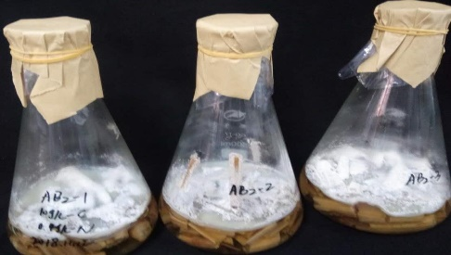
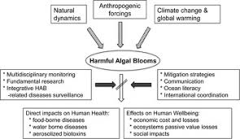
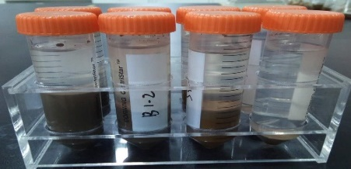
EXPERIMENTAL DESIGN
Sample collection at Straw farm
Stability Studies
temperature, nutrient, pH, Oxygen, etc
Characterization of Biosurfactant
Colony Characteristics of white-rot fungus showing degradation of crop straw
Foam indicator of Lingnin-degrading metabolites.
(A total of 8 experiments)

Slide 17
EXPERIMENTAL PROCEDURE
Wood straw will be collected from oil seed, rice and barley farmers, cut into 2mm size, washed, dried and preserved for culturing.
Fungi that will be used to degrade the straw will be purchased from a company in china
The fungi will be placed on potato dextrose agar(PDA) liquid medium for shaking culture at 120 rpm, at 25ºC, for 5 h’ and nutrients added.
The laccase activities will be defined and calculated using a total antioxidant capacity assay kit with rapid ABTS method.
All experiments will be conducted in triplicate. The control flasks will be prepared with the addition of 2% milli Q water.

Slide 18
Statistical analysis
The numbers of funfi CFUs and the total numbers of cells will be estimated per gram dry weight of straw, and log transformed using the formula log10 (n11).
The significance of treatment effects will be tested with the nonparametric Kruskall–Wallis test at a probability level of 0.05 because of high variability of fungi in some treatments e.g. oil seed straw by white-rot fungi.
The effect of colonization of wood straws by basidiomycetes on the relative abundance of different bacterial families in the randomly picked subsets of cultured bacteria will be tested for significance (P 0.05) with parametric or nonparametric (Kruskall–Wallis) ANOVA depending on their homogeneity.

Slide 19
EXPECTED OUTCOME
At the end of the research, expected include but not limited to:
It is expected that there is going to be a temporal relationship that exists between Lingninolytic activities: that H₂O₂ plays an integrated role in lignin degradation.
The nitrate, phosphate and trace metal concentrations in the medium is expected to regulate the Lignin degradation as well as H₂O₂ production in a similar fashion.
Less period required to accomplish the program.
Optimum remediation performance with low cost and more environmental friendly project executed

Slide 20
REFERENCES
Anne-Christine Ritschkoff (1996) Decay Mechanisms of Brown-rot Algae. Technical Research Centre of Finland, VTT publications. 268:67pp. Deepak Singh & Shulin Chen
C. Adinarayana Reddy and Trevor M. D'Souza (2014) Physiology and molecular biology of the lignin peroxidases of Phanerochaete chrysosporium. FEMS Microbiology Reviews 13:137-152.
MICHAEL H. GOLD AND MARGARET ALIC (1993) Molecular Biology of the Lignin-Degrading Basidiomycete Phanerochaete chrysosporium Microbial Rev. 57(3):605-622.
Guoming Zeng, Pu Wang , Ying Wang (2015) Algicidal efﬁciency and mechanism of Phanerochaete chrysosporium against harmful algal bloom species, algal research. 12:182-190.

Slide 21
Karin Fackler1, Cornelia Gradinger, Marieke Schmutzer, Crtomir Tavzes, Ingo Burgert, Manfred Schwanninger, Barbara Hinterstoisser, Takashi Watanabe and Kurt Messner (2007) Biotechnological Wood Modification with Selective White-Rot Fungi and Its Molecular Mechanisms. Food Technol. Biotechnol. 45 (3) 269–276.
Larissa B. Folman, Paulien J.A. Klein Gunnewiek, Lynne Boddy & Wietse de Boer (2008) Impact of white-rot fungi on numbers and community composition of bacteria colonizing beech wood from forest soil. FEMS Microbiol Ecol. 63:181-191.
S Z. Hanapi, S A Abdelgalil, R hatti-Kaul, R Aziz & H A El Enshasy (2018) Isolation of a New Efficient Dye Decolorizing White-Rot Fungus Cerrena sp. Journal of Science & Industrial Research. 77:399-404.

Slide 23
THANK YOU
FOR
LISTENING

