Slide 1
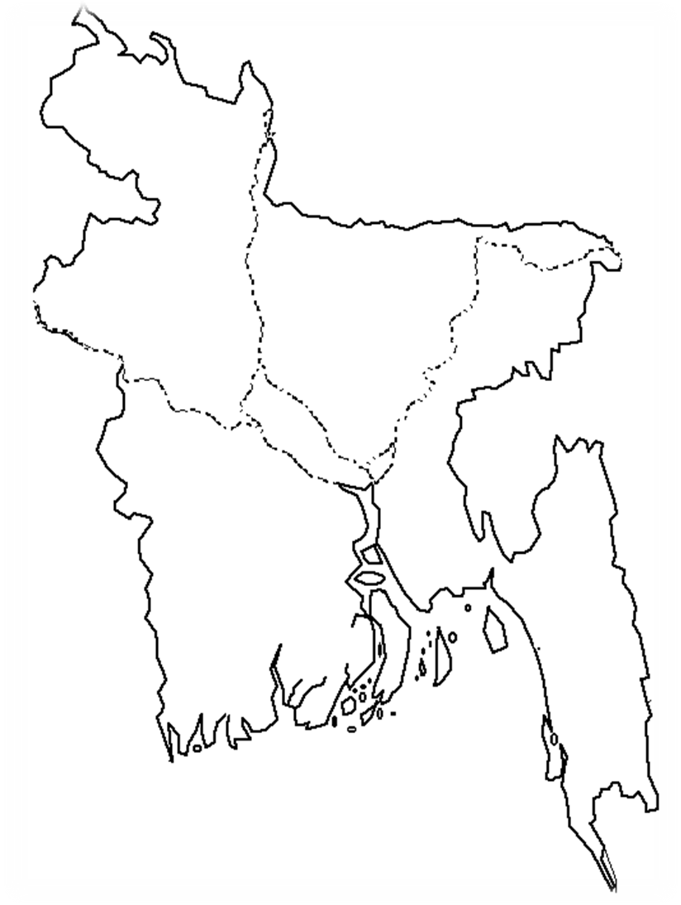
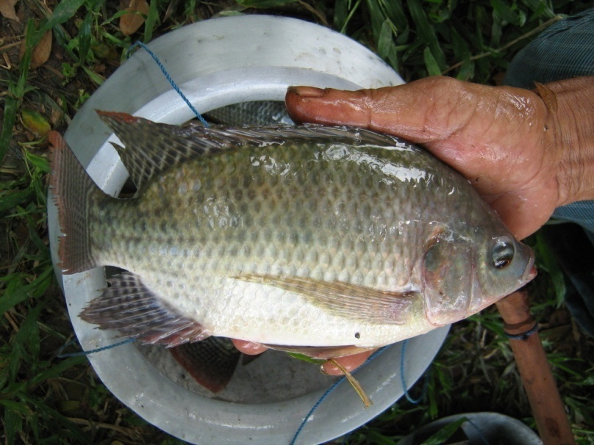
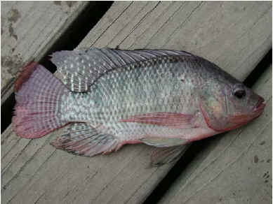
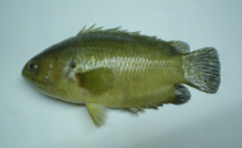
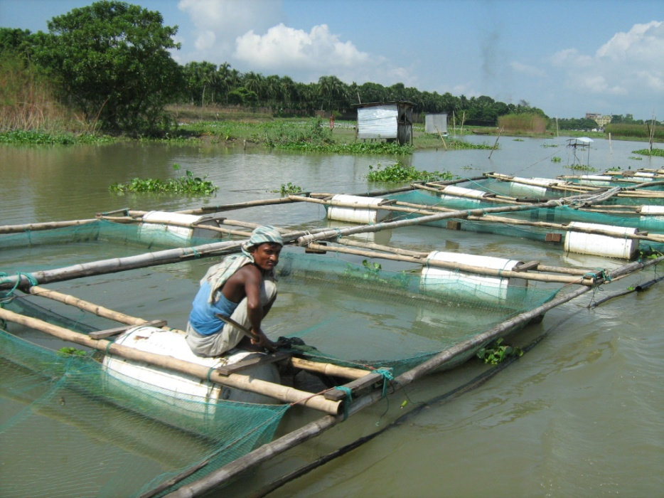
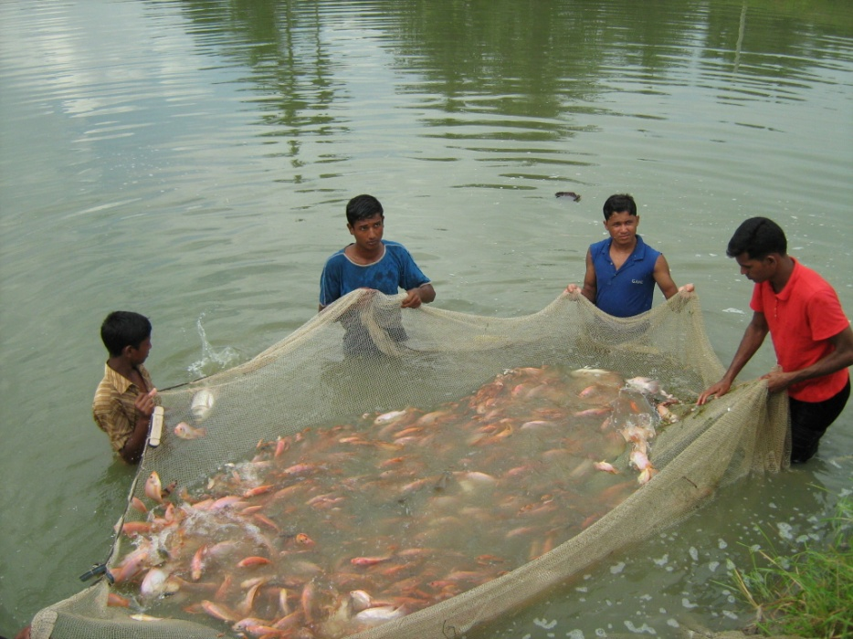
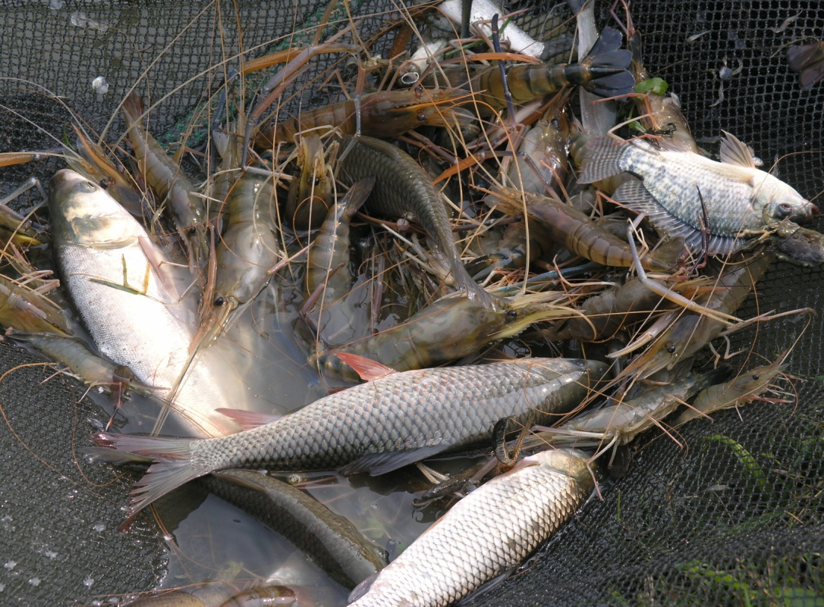
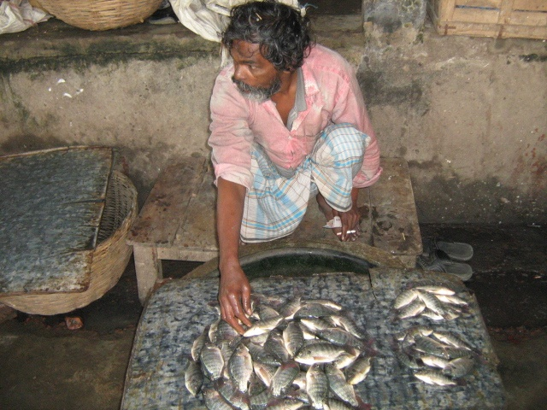
Tilapia (Oreochromis niloticus): Silent Booming in Bangladesh
Umar Bashir Ibrahim
Marine Sciences, Ocean College, Zhejiang University China
21934209@zju.edu.cn
Introduction
• This study is a part of a scoping study on four major commercially important aquaculture species, tilapia is one of them, traded into Europe under European Commission (EC) funded project on Sustaining Ethical Aquaculture Trade (SEAT).
• The history of tilapia in Bangladesh began with the introduction of Oreochromis mossambicus in 1954, and then Oreochromis niloticus (Fig 1) in 1974, with the expectation it could improve nutritional security¹. These attempts were relatively unsuccessful due to a lack of knowledge on their biology and culture technologies.
• Oreochromis niloticus (Chitralada) was again introduced in 1986, GIFT (Genetically Improved Farmed tilapia) strain in 1994 and 2005 by Bangladesh Fisheries Research Institute (BFRI)3 and the Chitralada strain reintroduced in 2007 by Chitralada Aqua Park Ltd.
• Private sector mono-sex (all male) tilapia hatcheries are now established at different locations supporting a gradual increase in its use as a food fish over the last 15 years.
Mymensingh
Pabna
Comilla
Fig 1: Oreochromis niloticus.
Objectives
• The objective was to assess the production & development trends, local & export market status, constraints and potentials of tilapia farming in Bangladesh.
Jessore
Chandpur
Khulna
Methods
• Tools: Literature review and rapid rural appraisal (RRA).
• Place visited: Comilla (Important for flood plain tilapia culture), Chandpur (For cage culture), Pabna (For monoculture), Khulna (Polyculture with shrimp and prawn), Jessore (Polyculture with carps), and Mymensingh (Polyculture with catfish and carps) districts. 24 tilapia farms (4 per district; 2 small: farm size ≤ 0.20 ha, 1 medium: farm size 0.21 to 0.80 ha and 1 large: ≥ 0.81 ha in each instance), 6 tilapia hatcheries (1 per district), 6 markets (1 per district) and 2 processing plants (in Khulna) were visited (Fig 2).
• Number and types of interviewees: 24 tilapia farmers, 6 hatchery owners, 18 retailers and 18 consumers (3 retailers and 3 consumers at each market) and 2 processors were interviewed individually.
• Duration: From September 2009 to April 2010.
Fig 2: Colored areas show research locations and arrows showing farm distribution from Mymensingh to seven divisions of Bangladesh.
Table 1: Difference between tilapia farming and other production systems in Bangladesh
Fig 3: Gradual enhancement in tilapia production (MT).³
 | O. niloticus | Pangasius spp. | Anabas spp. | Major Carps
Farming distribution | Country-wide | Few districts | Not widely | Country-wide
Water suitability | Fresh and brackish water² | Fresh water | Fresh water | Fresh water
Availability of seed | Country-wide | Jessore, Bogra, Mymensingh | Not widely | Country-wide
Types of farmers involved | Poor to better-off | Medium to better-off | Medium to better-off | Poor to medium
Susceptible to diseases | Highly resistant | Medium | High | Medium
Local market demand | High | Medium to high | High | High
Local market price (US$ kg⁻¹ ) and stability | Stable ( around 1.3 0) | Fluctuate (0.5-1.15) | Stable (around 2.30) | Stable (around 1.50)
Consumers’ preference | Medium to high | Low to medium | High | High
Types of consumers | Poor to better-off | Poor to medium | Medium to rich | Medium to rich
Culture period (month) | 4 | 12 | 4 | 12
No. of crops year⁻¹ | 2 | 1 | 2 | 1
Gross profit (%) for farmer | 82 | 23 | 57 | 51
Sector established (year) | 2000 | 1996 | 2005 | 1980s
Export potentiality to EU | High | High | Low | Low
Results
• Tilapia has several positive attributes (Table 1) among few commercially important aquaculture species in Bangladesh, and thus encourages the farmers for its rapid adoption.
• The growing number of mono-sex tilapia hatcheries made different positive impacts on traditional aquaculture practices.
• There was a rapid increase in national total production of tilapia from 2,140 MT in 1999-2000 to 66,767 MT in 2007-2008 (Fig 3).
• The trend in tilapia production is rapid (about 30% per year) suggesting that it may be the comparable aquaculture species in Bangladesh in near future.
• Monoculture in ponds showed highest tilapia production Kg ha⁻¹.yr⁻¹ (Fig 4), however most of the farmers prefer polyculture with other species.
• The main constraints of the sector are the lack of quality seed¹ and recent outbreak of unknown disease in cage systems (Fig 5) at Dakatia River in Chandpur and pond culture system in Chittagong.
• With the expansion of production, there is a growing interest observed at the level of private entrepreneurs in export market at trial basis.
Attributes
Species
Discussion
• Currently tilapia is cultured at various densities and combinations from mono- to polyculture in different containments (Fig 4). Recently red tilapia has also been introduced (Fig 6).
• Pangasius farmers culture tilapia as an alternative species to compensate when catfish domestic market price decline, while shrimp and prawn farmers stock tilapia to minimize the loss from diseases (Fig 7).
• At present, there are about 70 tilapia hatcheries³ with a total estimated production capacity of 700 million, whereas in 1992 there was only one mono-sex hatchery in Cox’s Bazar.
• About 446 commercial tilapia farms have been established all over the country over last 10 years. Moreover, currently tilapia is cultured in about 500 Pangasius farms in polyculture with Pangasius and carps³.
• Total production of tilapia in Bangladesh was 66,767 MT in 2007-2008, this contributed 6.64 % to national aquaculture production and 2.6 % to global total tilapia production³.
• Tilapia is consumed locally (Fig 8), export is negligible.
• Processing plants for tilapia is yet to be developed.
• Tilapia is marketed at a small size of 225 g on average, not suitable for filleting and export.
• Exporters are anxious about hormone (17-α Methyl Testosterone) treated mono-sex tilapia seed production and its consumers’ preference in EU.
Kg ha⁻¹.yr⁻¹.system⁻¹
* (MP: Monoculture in pond, MC: Monoculture in cage, TP: Tilapia with Pangasius, TCH: with Clarius/Heteropneustes, TA: with Anabas, TCP: with carps in pond, TCF: with carps in floodplain based culture, TSP: with shrimp/prawn, TCP: with carps and paddy)
Fig 5: Cage culture of tilapia.
Impact statement
• Understanding on the increasing trend of tilapia’s sex-reversal seed production, positive attributes at culture systems and its environmental impacts will contribute to the development of EAFI.
• Action research on culture of naturally produced male tilapia to avoid hormone treatment
• The broader understanding on the issues above will be contributing to the studies of other work packages (e.g. WP3-LCA) of SEAT project and policy development.
Acknowledgement
This work was carried out under SEAT project, co-funded by the European Commission within the 7th Framework Programme - Sustainable Development of Global Change and Ecosystem (Project no. 222889)
References
1.Bart, A., M.M. Haque and M.A. Wahab. 2004.Technological constrains and future of tilapia culture in Bangladesh. Abstract of a workshop held in BRAC inn, Dhaka, Bangladesh.
2.Beveridge, M.C.M. and B.J. McAndrew. 1999. Tilapias: Biology and Exploitation. Institute of Aquaculture, University of Stirling, Stirling, Scotland. 505 p.
3.Hussain M.G. 2009. A future for the tilapia in Bangladesh. AQUA Culture AsiaPacific Magazine. pp 38-40.
Fig 6: Red tilapia culture.
Fig 7: Tilapia with Prawn & Carps.
Fig 8: A retailer of tilapia.

