Slide 1
Underwater imaging & Associated Problems: A Review
Junaid Ullah
21834419

Slide 2
INTRODUCTION
1

Slide 3
INTRODUCTION
Sunlight cannot penetrate deeper than 1000 m
Deeper parts still not well explored
Far-ranging applications
Deep sea exploration
Underwater structure inspection
Identification of marine life
Monitoring the sea bed, etc.
Clearer images are required
Notes:
We know that the sunlight cannot penetrate any deeper than 1000 m from the ocean surface. The zone deeper than 1000 m is engulfed in complete darkness. One of the reasons that the deep ocean is not so well explored is this pitch-black atmosphere. For that purpose several underwater imaging techniques have been developed. And these techniques have far-ranigng applications. (READ LIST)
In order to do be able to do all that we must first acquire crisp and clear images.
Do you guys think that underwater imaging is any different than conventional imaging or photography? Answer is yes. There are a lot of problems associated with underwater imaging and all of those have to do with LIGHT.

Slide 4
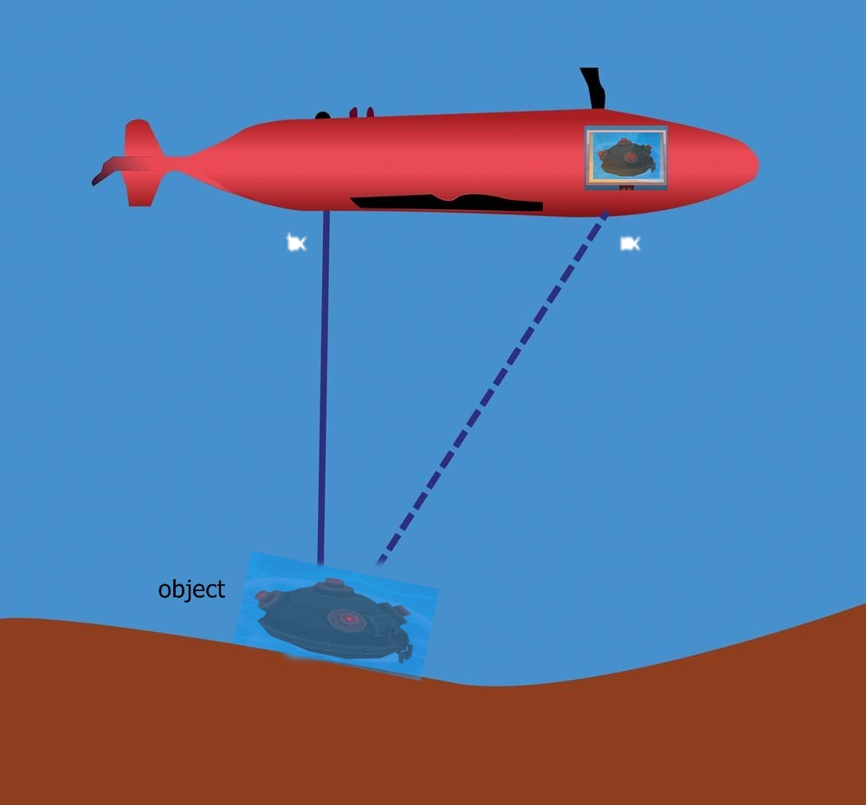
Transmitted light
Received Light
Notes:
This is a very crude model of an underwater imaging system.
A beam of light illuminates the object of interest and the camera captures the scene
Simple right?

Slide 5
ASSOCIATED PROBLEMS
2

Slide 6
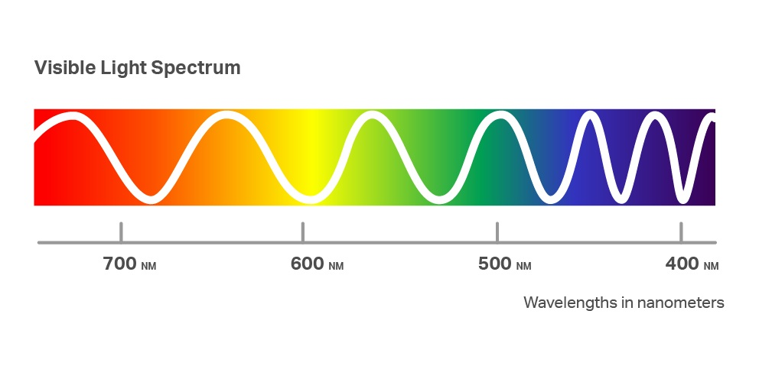
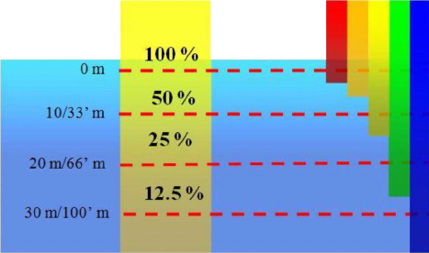
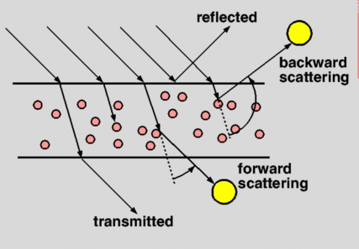
PROBLEMS
Reflection
Absorption
Scattering
Forward Scattering
Blurring, contrast reduction
Backward Scattering
Bright spots in the image
Light bounces off the particles suspended in water
Contrast is reduced
Visible light spectrum
Which color penetrates more?
Wavelength vs Energy
Color Loss, Darker Images

Slide 7
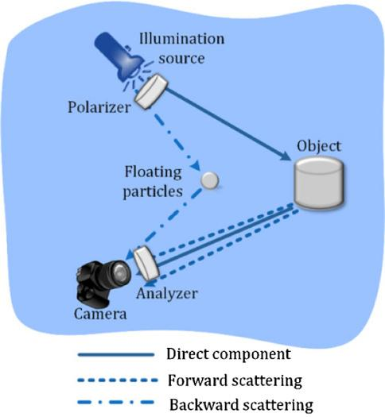

Slide 8
SOLUTIONS
3

Slide 9
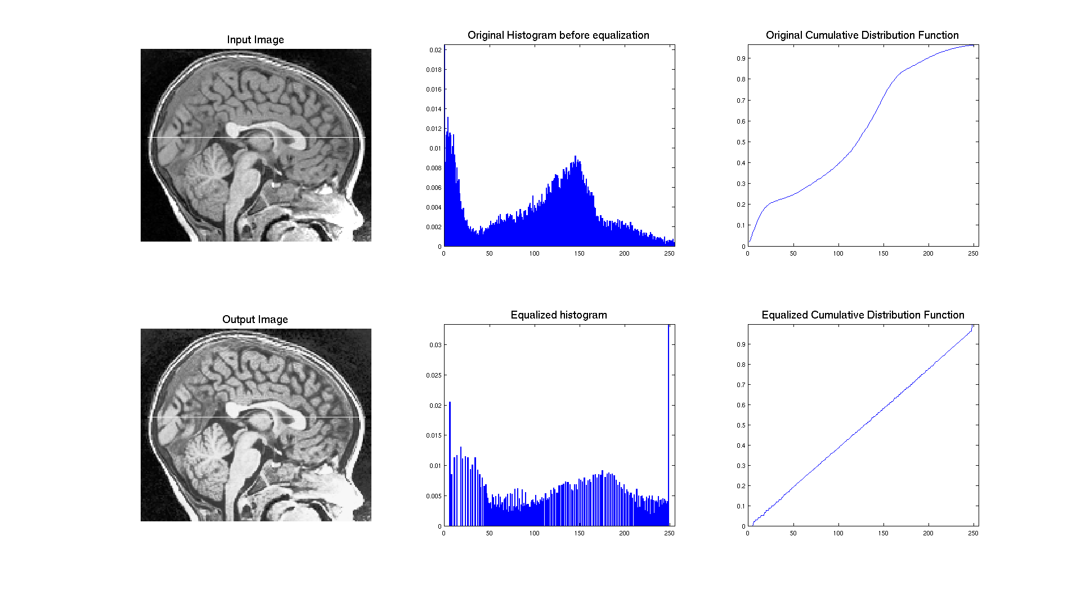
Histogram Equalization
Adjusting intensities to enhance contrast
Usually results in sharper images
Features in an image are enhanced
Notes:
HE usually applied on grayscale images
Pixels represents intensittes
Histogram is obtained
Cumulative prob of pixel intensities is obtained.
Equalization weight is applied
This increases the intenisty range.

Slide 10
UNSHARP MASKING
Image manipulation technique
‘Edges’ are highlighted
Results in sharper images
Backscatter is removed

Slide 11
UNSHARP MASKING
Blurring
Subtracting
Weighting Factor
Addition
Makes use of Gaussian filter to blur the image.
Obtained image is subtracted from the original image.
Results in an image with visible emphasis on edges.
The obtained change is multiplied with some weighting factor to highlight the change.
Lastly the obtained image is added to the original image to obtain an enhanced image.

Slide 13
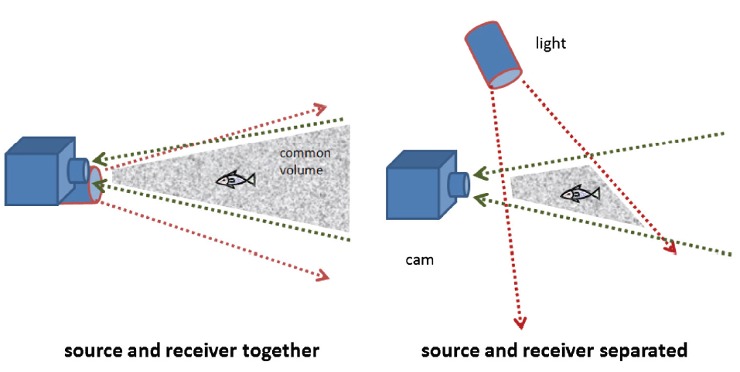
SEPARATION OF SOURCE & RECEIVER
Hardware implemented
Common volume between source and receiver reduced
Contrast of image reduced
Attenuation length increased
Notes:
Separation of light and camera helps to reduce backscattering to achieve a better image, due to weak side scattering and less common volume.
This is essentially the same principle as not using the high beams while driving in heavy fog, as strongly backscattered photons cast a bright veil, reducing the visibility to effectively zero in no time.

Slide 14
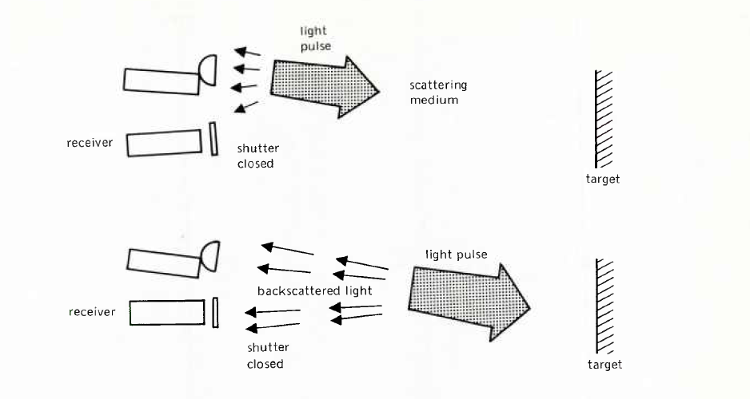
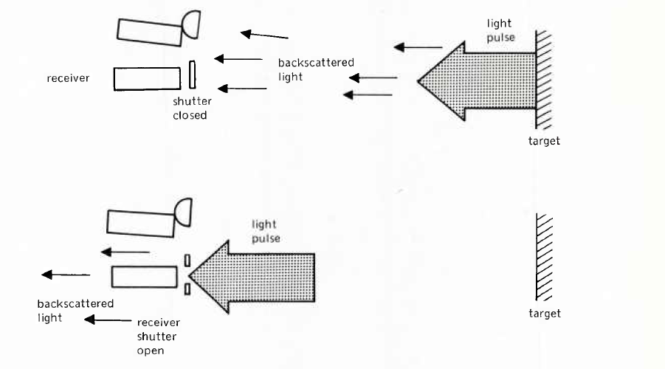
RANGE GATING

Slide 15
THANKS!
Any questions?
Still have questions? Email at:
21834419@zju.edu.cn

