Slide 1
Determination of BIOACTIVITY OF POLYSACCHARIDES PRESENT IN PHAEOPHYTA
USMAN DAWOOD BUTT
ID: 21934204
usman_butt@zju.edu.cn
Supervisor: Prof. Wu Bin
TECHNICAL READING & WRITING
Ocean College, Zhejiang University.
www.zju.edu.cn

Slide 2
TABLE OF CONTENTS
01
02
INTRODUCTION
OBJECTIVES
03
04
METHODOLOGY
EXPECTATIONS
Brief Background Information & Significance
My Aims For This
Experiments
Sample Preparation & Analysis
Results & Outcomes Expected By This Experiment

Slide 3
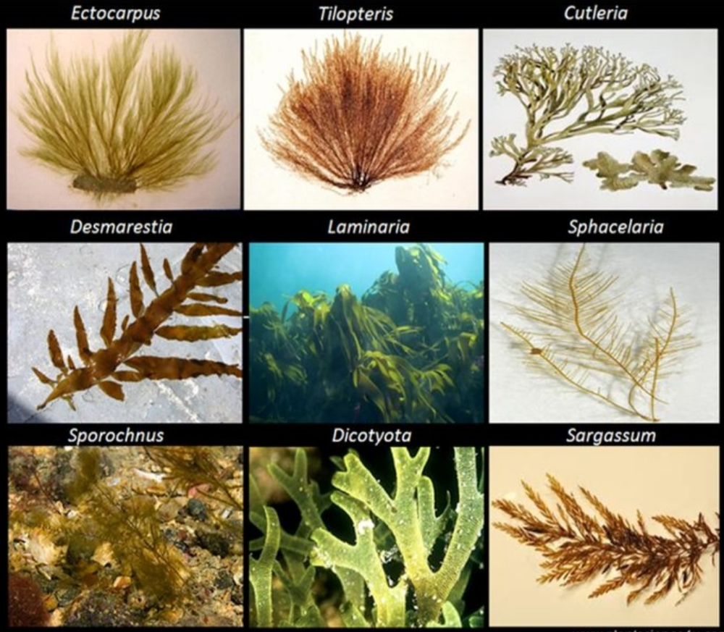
INTRODUCTION
Marine Algae are the most abundant resources in the ocean.
It is logical to consider that marine algae could be a key resource containing rich source of functional metabolites.
Classified into three functional groups based on their pigmentation and chemical composition.
Among Brown, Red and Green Seaweeds I will be focusing on Brown Seaweeds (Phaeophytes).
Because among approximately 1750 species very few has been focused and most of the species are yet to be studied.

Slide 4
HISTORY & SIGNIFICANCE
Some archaeological evidences shows that algae have been included in folk medicine as source of vitamins, amino acids, proteins, and carbohydrates for many thousands of years in Japan (13,000–300 BC), China (2700 BC), Egypt (1550 BC), and India (300 BC) (Fakoya et al., 2011).
It is also been revealed in recent studies that compounds present in Phaeophytes have many Pharmaceutical applications. Due to its bioactivity it has been used as nutraceutical purpose (Fitton et al., 2007).
Recently, it has been tried for cancer treatment (Kwak, 2014). In addition to this, it can also be utilized in tissue engineering (Jeong et al., 2013; Jin and Kim, 2011; Lee et al., 2012; Puvaneswary et al., 2015; Venkatesan et al., 2014a).
Some other Medical & Pharmaceutical uses of Phaeophytes: As Baulking Agents, In making of Capsules & Tablets, For Medicated Lotions & Creams & For Ulcer Products.
(http://www.nmnh.si.edu/botany/projects/algae/Alg-Prod.htm)

Slide 5
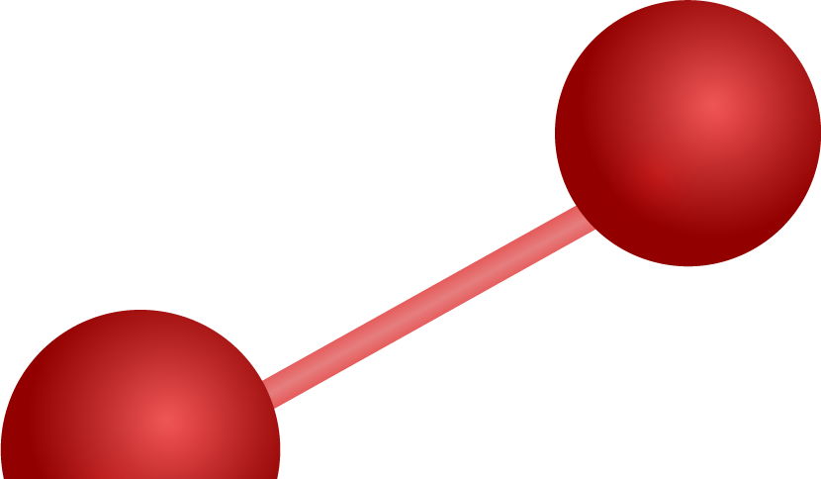
OBJECTIVES
1
2
3
Isolation of biologically active compounds from Algae
Determination of chemical structures of bioactive compounds
Study of biological activities of those compounds
4
Investigate anticancer, antitumor, hypolipidemic and antibacterial activities of those compounds.

Slide 6
METHODOLOGY
Step 1
Collection of Brown Algae
Step 2
Drying
Step 3
Pulverization
Step 4
Extraction
Hot Water – Assisted
Microwave – Assisted
Ultrasonic – Assisted
Enzyme – Assisted
Step 5
Purification
Ethanol Precipitation
Ion Exchange Chromatography
Size Exclusion Chromatography
Membrane Separation
PURIFIED POLYSACCHARIDE
(Cheong et al., Mar. Drugs 2017, 15, 388)

Slide 7
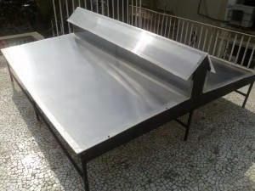
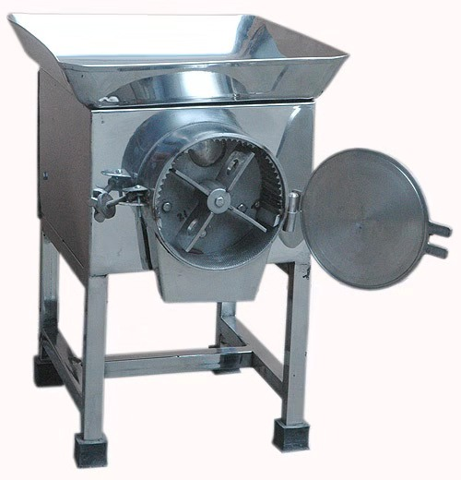
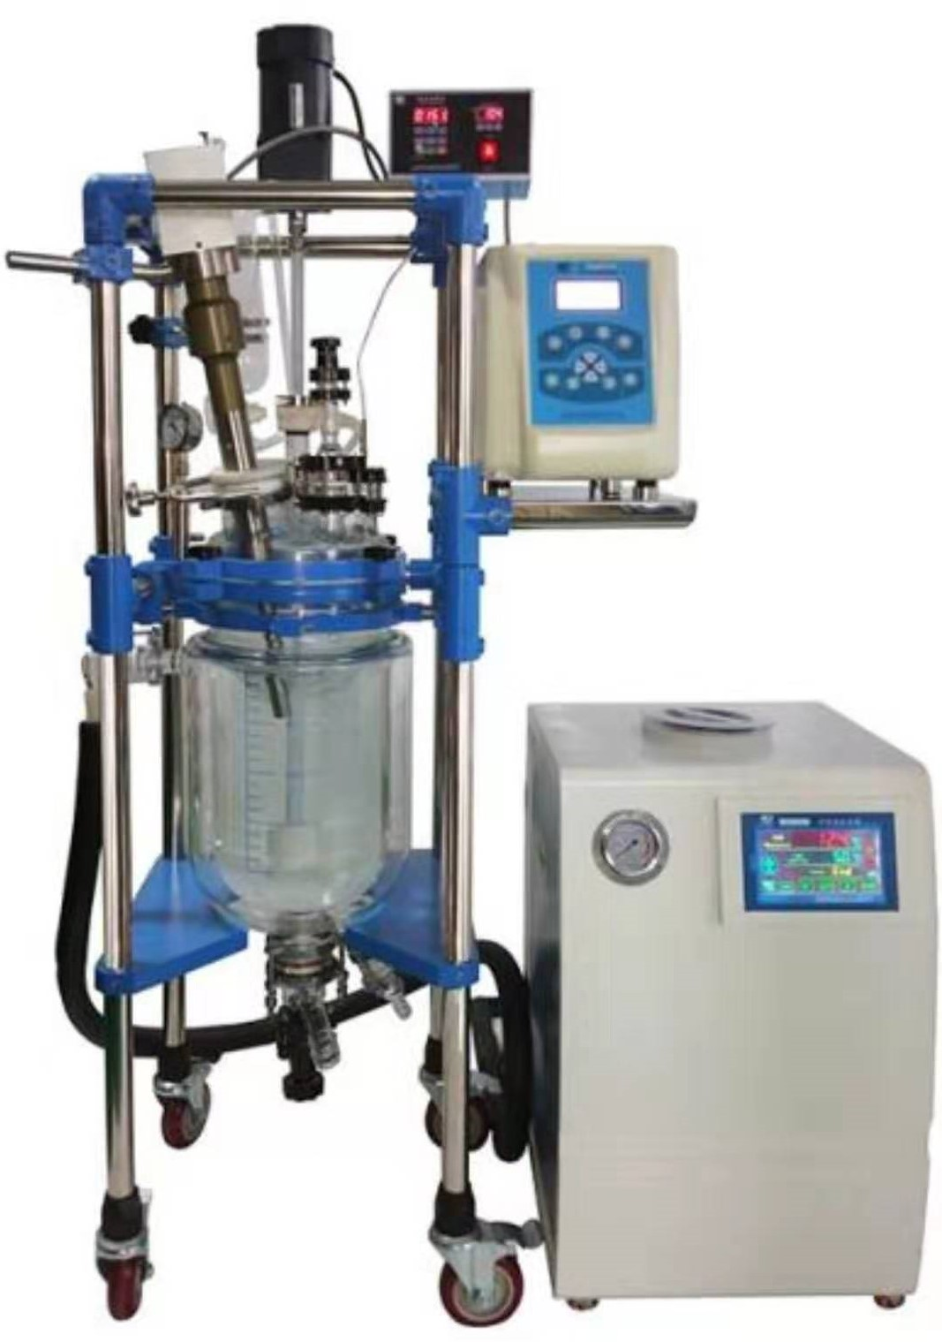
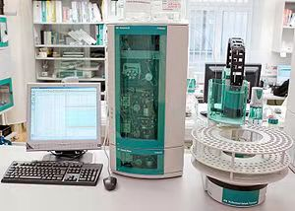
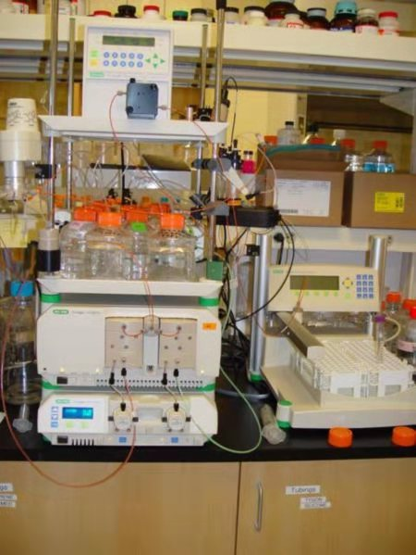
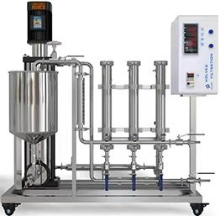
METHODOLOGY
MATERIAL REQUIRED FOR EACH STEP
STEP 1 (Collection)
Collection Bags or Boxes
STEP 2 (Drying)
Solar Conduction Dryer (Gives High Performance Than Open Sun Drying (Bheda & Shinde et al., 2018))
STEP 3 (Pulverization)
Pulverizer
STEP 4 (Extraction)
Ultrasonic Extraction Equipment
Different Enzymes (Disrupt the cell wall & improve extraction yields)
STEP 5 (Purification)
Ethanol
Ion Chromatographs
Size Exclusion Chromatographs
Membrane Separation Device

Slide 8
METHODOLOGY
PURIFIED POLYSACCHARIDE
Step 6
Structure
Molecular Weight
Monosaccharide Composition
Chain Conformation
Linkage Type
Step 7
Function
Anticancer
Antitumor
Antibacterial
Hypolipidemic
Final Step
Applications
Pharmaceutical Aspect
(Cheong et al., Mar. Drugs 2017, 15, 388)

Slide 9
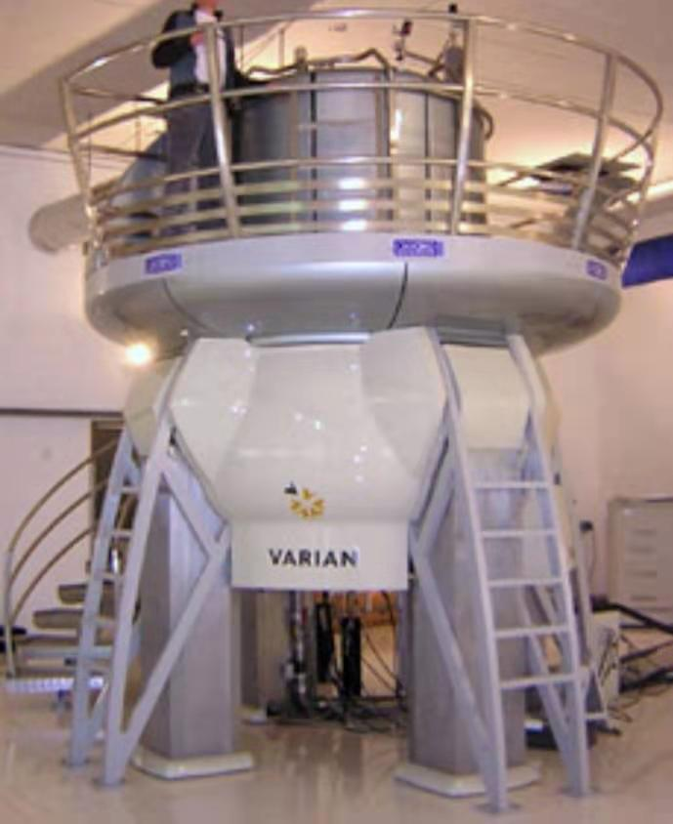
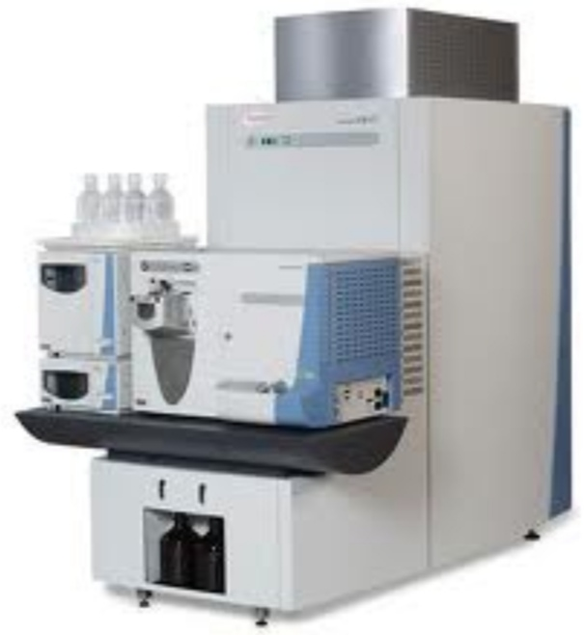
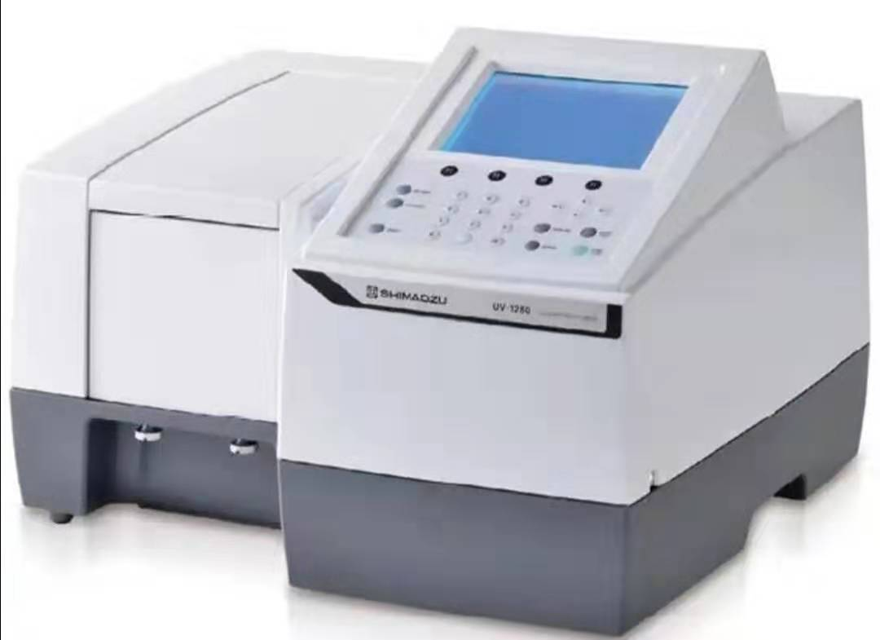
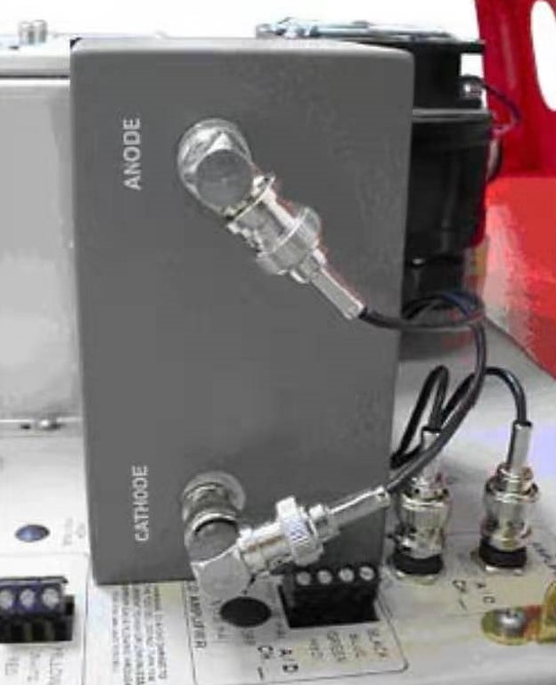
METHODOLOGY
MATERIAL REQUIRED FOR EACH STEP
STEP 6 (Structure Determination)
Nuclear Magnetic Resonance (NMR)
High Resolution Mass Spectroscopy (HRMS)
Infrared and UV Spectrophotometers
Electron Capture Detector (ECD)
STEP 7 (Functions)
By the structures we can than identify the Functions
FINAL STEP (Applications)
After the determination of functions we can identify its applications

Slide 10
EXPECTATIONS
1.
3.
2.
4.
Expecting discovery of novel compounds with bioactive properties during the experiment.
Determination of compounds with anticancer, antitumor, antibacterial & other biological applications.
Elucidation of the chemical structures of those novel bioactive compounds.
Publishing atleast two SCI papers at the end of this experiment.

Slide 11
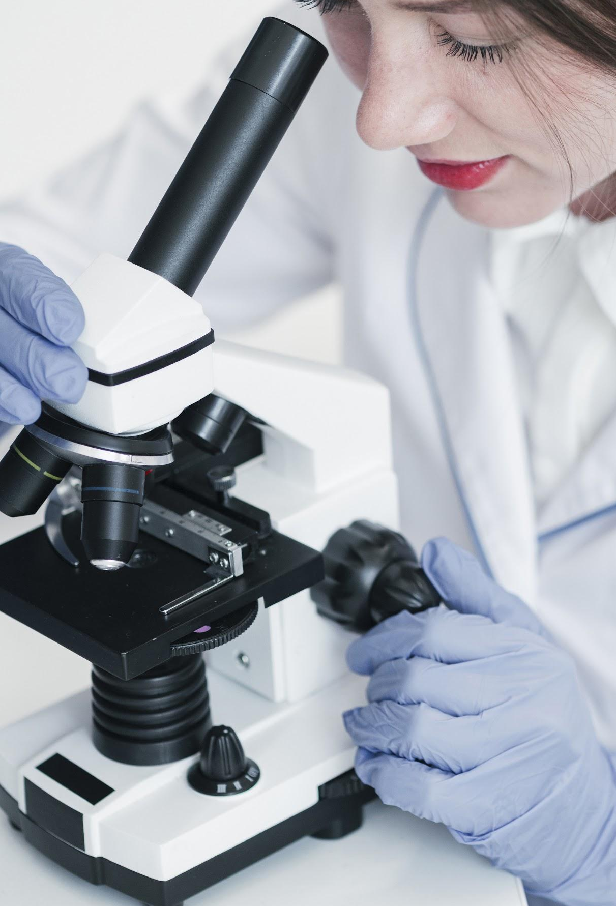
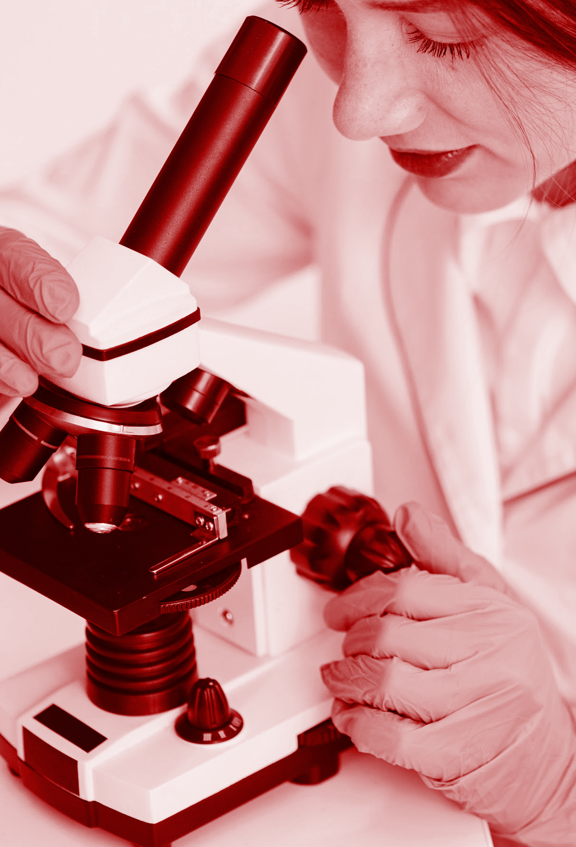
FUTURE PRESPECTIVE
Marine Algae have the advantages of strong adaptibility and high yeilds.
Considered as the most important source of many biologically active compounds.
Therefore it is of great significance to make better use of marine algae resources.
There is still no research on an industrial scale.
Furthermore, the chemico-physical properties, and molecular mechanism also need to be extensively investigated.

Slide 12
REFERENCES
De Jesus Raposo, M.F.; de Morais, A.M.; de Morais, R.M.S.C. Marine polysaccharides from algae with potential biomedical applications. Mar. Drugs. 2015, 13, 2967–3028.
Hamed, I.; Özogul, F.; Özogul, Y.; Regenstein, J.M. Marine bioactive compounds and their health benefits: A review. Compr. Rev. Food Sci. Food Saf. 2015, 14, 446–465.
Hahn, T.; Lang, S.; Uiber, R.; Muffler, K. Novel procedures for the extraction of fucoidan from brown algae. Process Biochem. 2012, 47, 1691–1698.
Chen, X.M.; Nie,W.J.; Yu, G.Q.; Li, Y.; Hu, Y.L.; Lu, J.S.; Lu, J.X.; Jin, L.Q. Antitumor activity of polysaccharides from Sargassum fusiforme. Food Chem. Toxicol. 2012, 50, 695–700.
Shu-Ying, X.; Huang, X.; and Cheong, K.L. Recent Advances in Marine Algae Polysaccharides: Isolation, Structure, and Activities. Marine Drugs. 2017, 15(12), 388.
Gomez, C.; Rivas, G.; and Sanchez, N.E. Marine Edible Algae as Disease Preventers. Advances in Food And Nutrition Research. 2011, 64, 29 – 39.

