Slide 1
Identification of Groundwater potential zones (GWPZS) using Remote Sensing (RS) and Geographical Information System (GIS) A Case Study of Dodoma City, Tanzania
Presenter: Sangana, Peter
Supervisor: Prof. Li Zilong

Slide 2
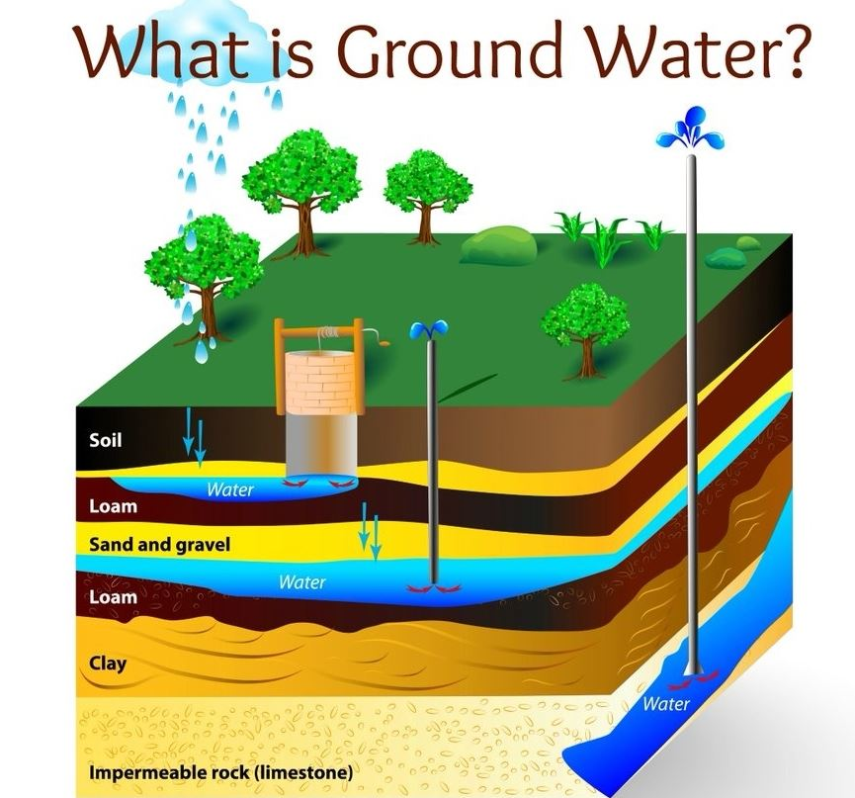
Introduction
https://srcity.org/857/Groundwater
GWPZS are areas where groundwater is highly likely to be accumulated.
Occurrence of groundwater in the area is highly influenced by geological and other conditions (drainage, lineaments, land use/cover, slope, soil type, rainfall amount etc

Slide 3
Introduction
GIS and RS
GIS integrates information on Multi-criteria influencing parameters.
RS provides data used to evaluate GWPZS
Study area
Dodoma City is in a drought prone, semi-arid region of central Tanzania (Figure 1)
It covers an area of 2,669 square kilometers,
It has a population of 600,000 people.

Slide 4
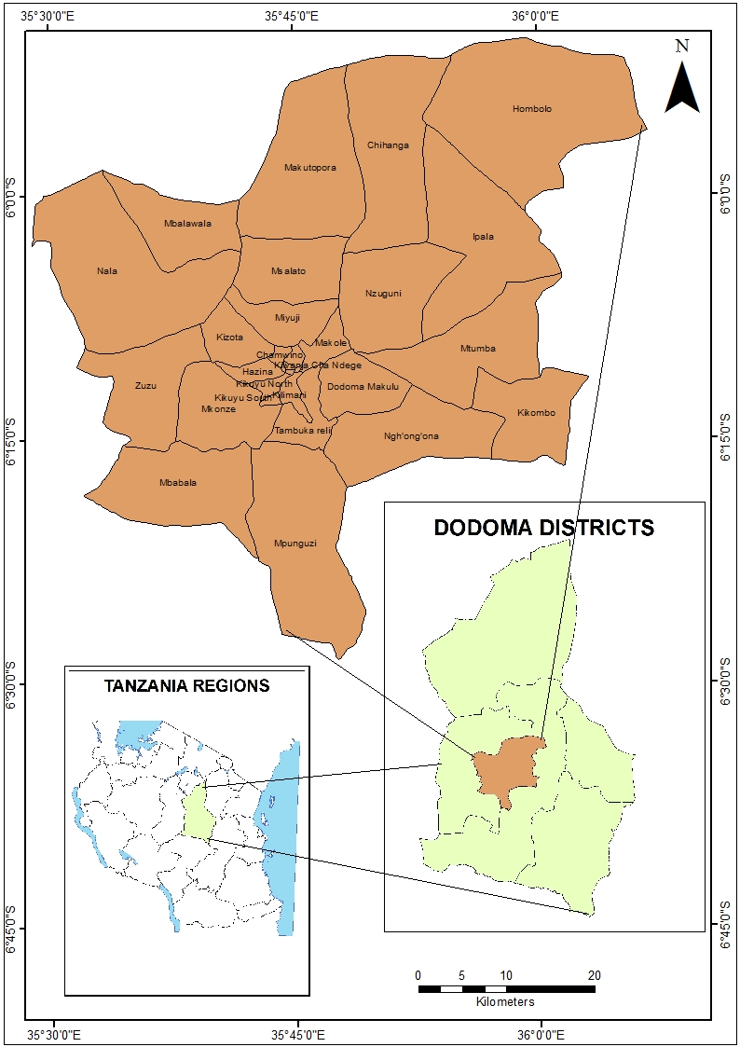
Introduction
Figure 1: Study area

Slide 5
Introduction
Problem Statement
500,000 inhabitants of Dodoma City depend in groundwater
The groundwater is being exploited by construction of shallow and deep wells
The area is explored with higher uncertainties due to lack of proper knowledge on the distribution and variation in GWPZS
It is important to investigate the suitable areas for groundwater extraction in order to increase the freshwater availability and curb the water scarcity

Slide 6
Introduction
Main Objective
The main objective of the study was to identify groundwater potential areas
Specific Objectives
To identify and prepare groundwater controlling parameters
To assess groundwater controlling parameters using GIS-MCDA process
To determine GWPZS through integration of various groundwater controlling parameters

Slide 7
Methodology
Figure 2: Methodology

Slide 8
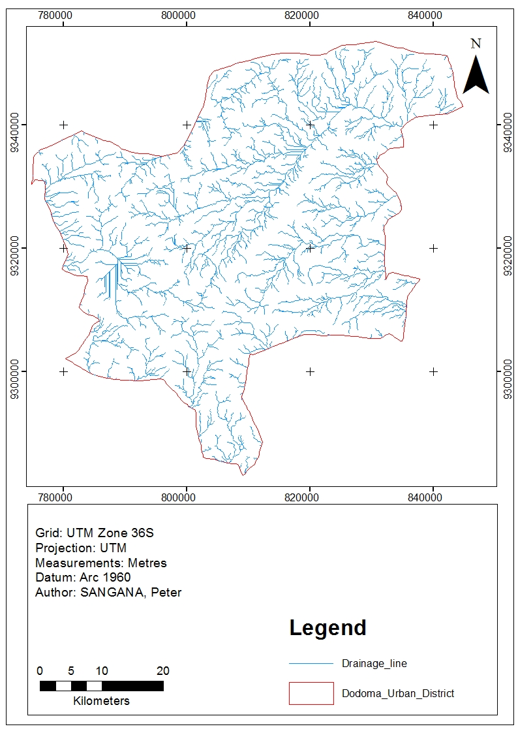
Results and Discussion
Drainage networks and density

Slide 9
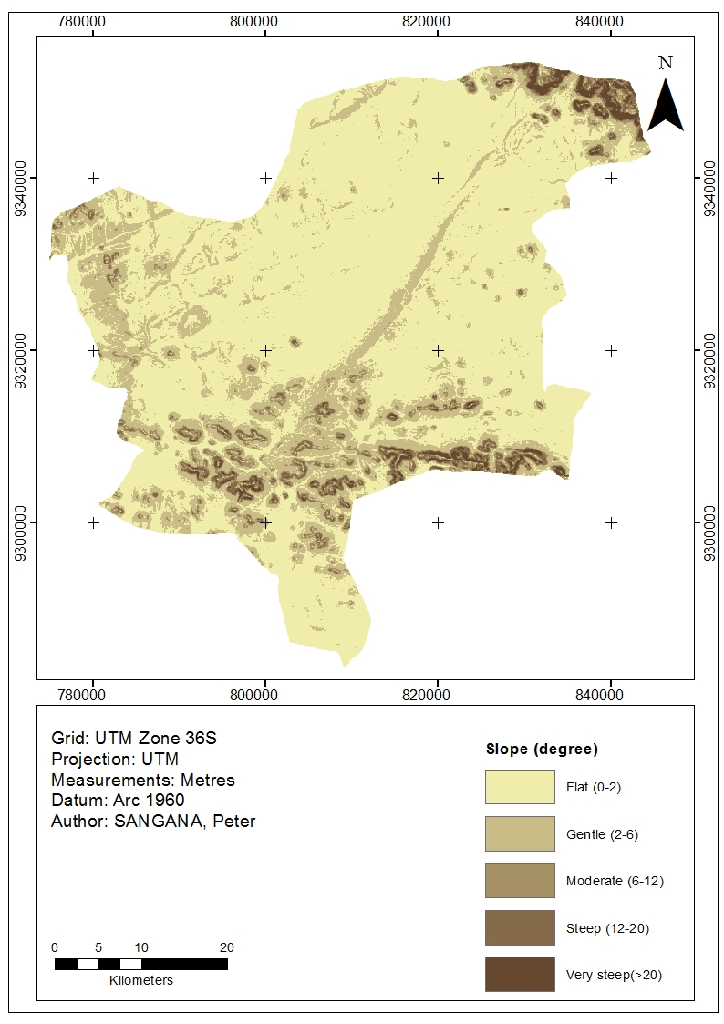
Results and Discussion
Slope amount

Slide 10
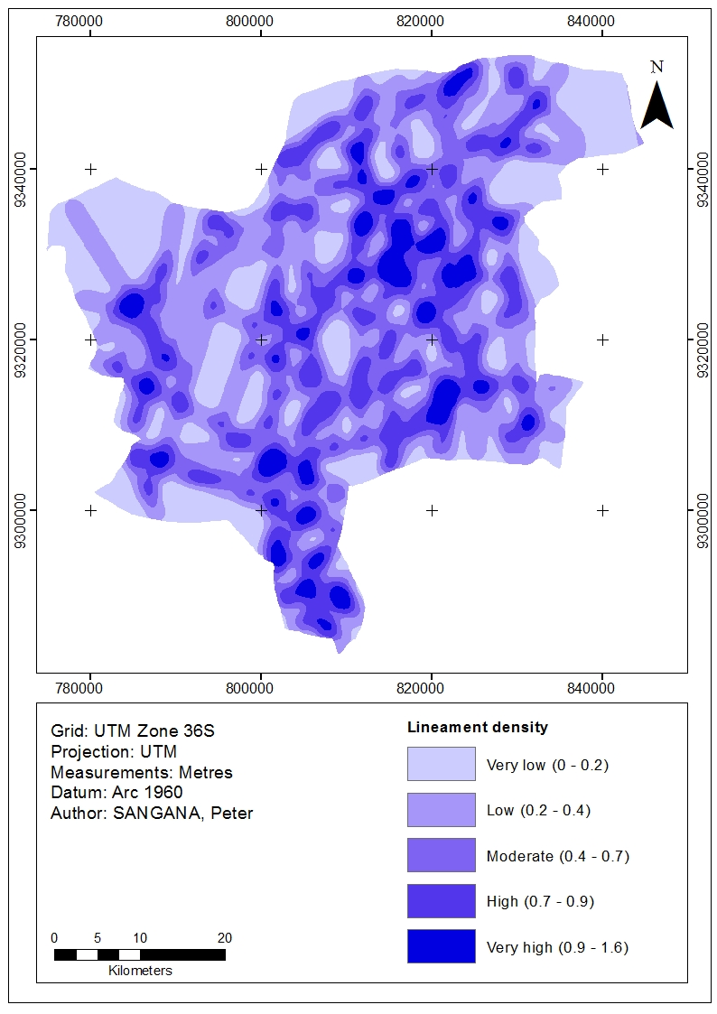
Results and Discussion
Lineament density

Slide 11
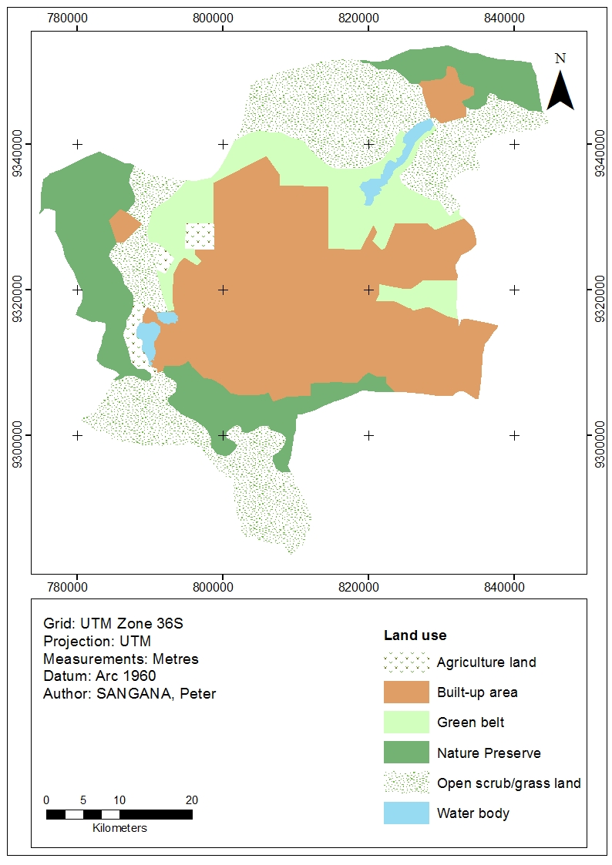
Results and Discussion
Land use land cover

Slide 12
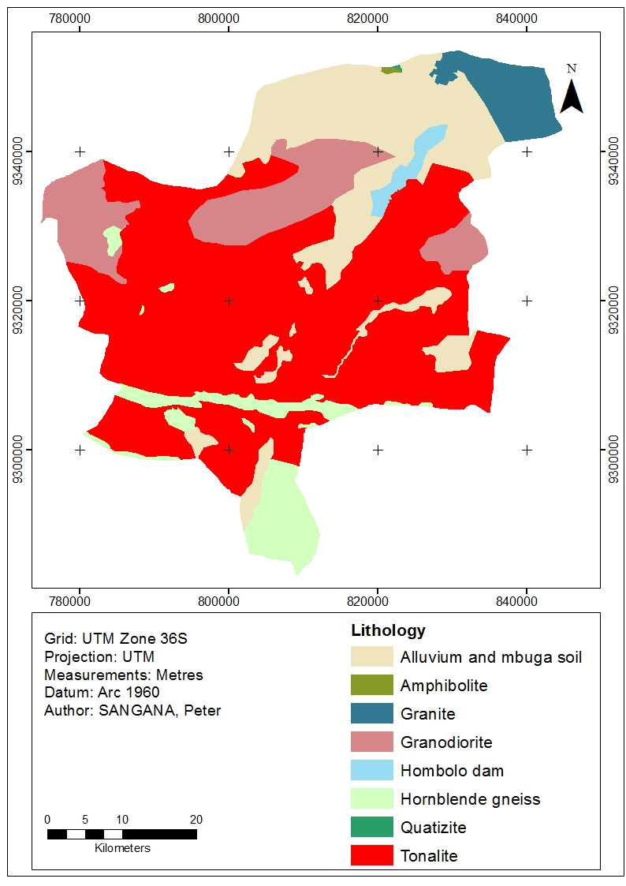
Results and Discussion
Lithology

Slide 13
Results and Discussion
Groundwater potential zones

Slide 14
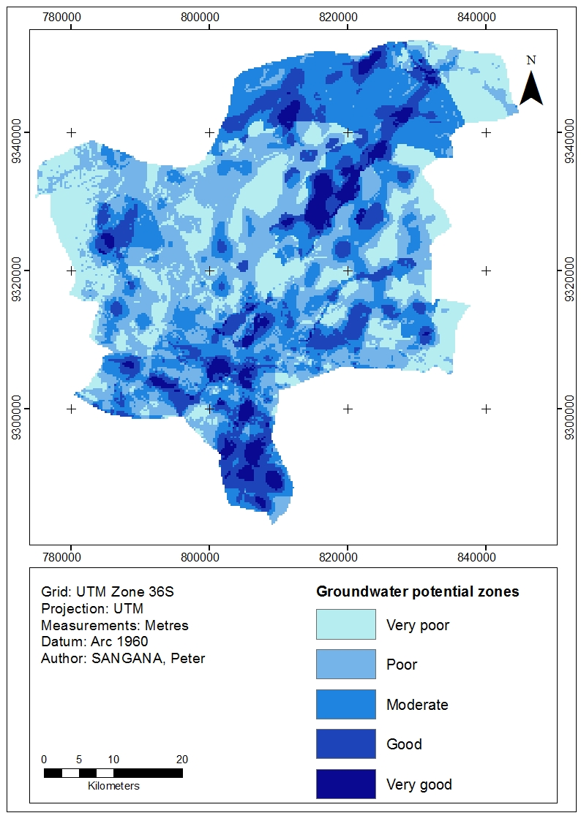
Results and Discussion
Groundwater potential zones

Slide 15
Conclusion and Recommendation
Conclusion
Lithology was found to have the highest influence on groundwater availability followed by lineament density, while the land use/cover was found to have the lowest weight
The resulting groundwater potential zones map was classified into 5 classes, namely; very good, good, moderate, poor and very poor
The poor zones were indicating the least favorable area for groundwater prospect; whereas very good zone indicates the most favorable area for groundwater prospect
This study provided the baseline information to local District authorities and planners about the potential sites for groundwater prospecting and exploration

Slide 16
Conclusion and Recommendation
Recommendation
The results can be integrated with various data of different scale and type from different organizations to solve a specific spatial problem
These procedures used can be adopted for other studies
Future work should focus in verifying and enhancement of the results by introducing more verified values for weights as well as exploring other factors that may contribute towards changing potential ground water zones
Since geology and lineament mainly control the distribution, occurrence and flow of groundwater, analysis of these parameters should be supported by high-resolution terrain data and satellite imagery

Slide 17
References
Abel, O., & Tijani, M. (2011). Integrated Remote Sensing and GIS approach to groundwater potential assessment in the basement terrain of Ekiti area south-western Nigeria. Materials and Geoenvironment, 58(3), 303-328.
Adiat, K., Nawawi, M., & Abdullah. (2012). Assessing the accuracy of GIS-based elementary multi criteria decision analysis as a spatial prediction tool—A case of predicting potential zone of sustainable groundwater resources. Journal of Hydrology, 440, 75-89.
Aggarwal, R., Kaur, S., & Juyal, D. (2009). Micro level assessment of water resources in bist doab tract of Indian Punjab. Agriculture Engineering, 46(3), 33-39.
Al Saud, M. (2010). Mapping potential areas for groundwater storage in Wadi Aurnah Basin, western Arabian Peninsula, using remote sensing and geographic information system techniques. Hydrogeology Journal, 18(6), 1481-1495.
Al-Adamat, A. (2003). Groundwater vulnerability and risk mapping for the Basaltic aquifer of the Azraq basin of Jordan using GIS, Remote sensing and DRASTIC. Applied Geography, 23(4), 303-324.
Coyle, G. (2004). The Analytic Hierarchy Process (AHP): Pearson Education Limited. Retrieved from http://www.booksites.net/download/coyle/student_files/AHP_Technique.pdf.
Dodoma Urban Water Supply and Sewerage Authority (DUWASA). (2002). Groundwater resource assessment for the City of Dodoma. Dodoma Urban.

