Slide 1
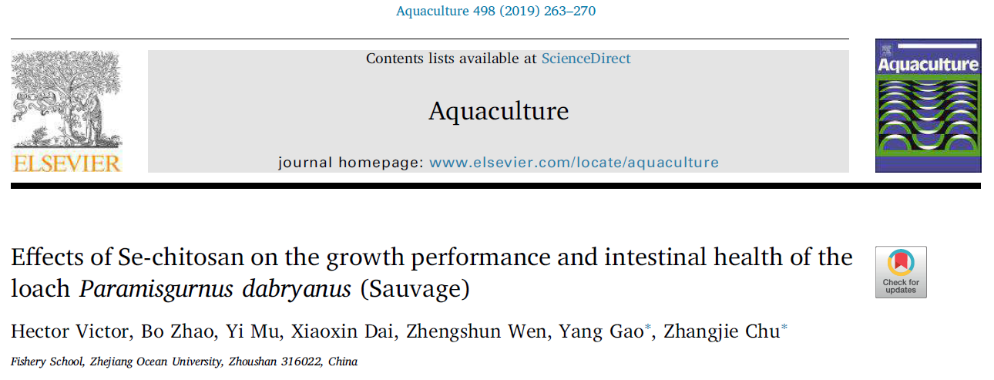
Effects of Se-chitosan on the growth performance and intestinal health of the
loach Paramisgurnus dabryanus (Sauvage)
Hector Victor, Bo Zhao, Yi Mu, Xiaoxin Dai, Zhengshun Wen, Yang Gao, Zhangjie Chu
专业：建筑学 @ 建筑设计及其理论
浙江大学

Slide 2
PPT模板下载：www.1ppt.com/moban/ 行业PPT模板：www.1ppt.com/hangye/
节日PPT模板：www.1ppt.com/jieri/ PPT素材下载：www.1ppt.com/sucai/
PPT背景图片：www.1ppt.com/beijing/ PPT图表下载：www.1ppt.com/tubiao/
优秀PPT下载：www.1ppt.com/xiazai/ PPT教程： www.1ppt.com/powerpoint/
Word教程： www.1ppt.com/word/ Excel教程：www.1ppt.com/excel/
资料下载：www.1ppt.com/ziliao/ PPT课件下载：www.1ppt.com/kejian/
范文下载：www.1ppt.com/fanwen/ 试卷下载：www.1ppt.com/shiti/
教案下载：www.1ppt.com/jiaoan/ PPT论坛：www.1ppt.cn
MATERIAL AND METHODS
1
INTRODUCTION
2
3
RESULTS
CONTENTS
4
5
CONCLUSION
DISCUSSION

Slide 3
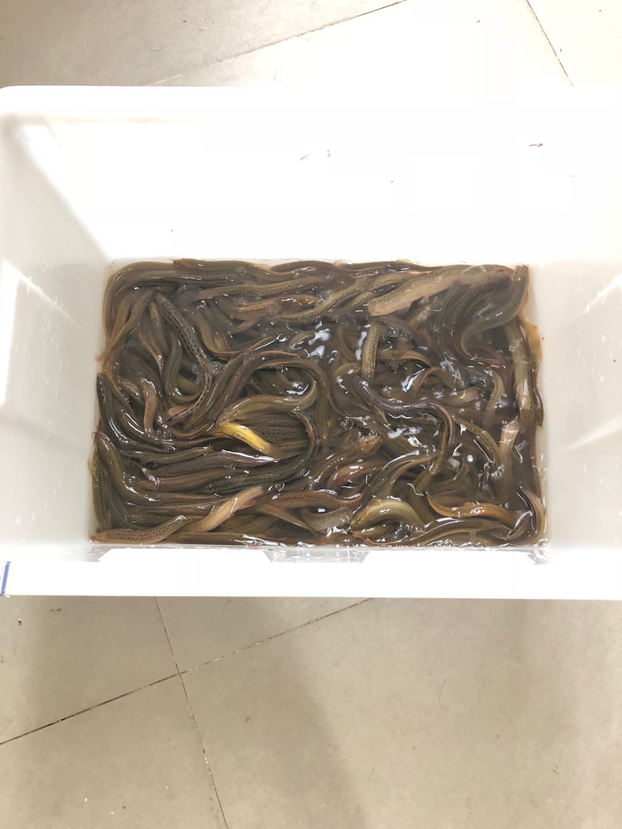
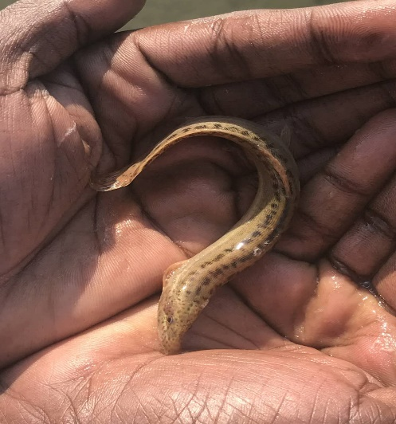
INTRODUCTION
Paramisgurnus dabryanus loach is a freshwater species
Order-Cypriniformes
Family-Cobitidae
Endemic to China
Selenium (Se) is an essential nutrient required for physiological function and cellular metabolism in animals and fish
Regulation of the antioxidant enzyme glutathione peroxidase (GPx), which protects both cellular and subcellular membranes from oxidative damage
第一部分

Slide 4
Chitosan is a cationic polysaccharide derived from chitin which is a
natural polymer of N-acetyl glucosamine.
commonly found in crustacean and insect exoskeletons as well as in fungal cell walls
Numerous biological properties, immunoadjuvant, excellent carrier of other ingredients, such as vitamins, unsaturated fatty acids and phytochemicals.
Fish intestinal health is strongly associated with immune function
Impaired intestinal immunity leads to pathogen translocation, inflammation and enteritis, possibly resulting in fish death
Enhancing and developing fish intestinal immunity is of great importance for aquaculture
Therefore, the objective of this study was to evaluate Se-chitosan as a potential dietary supplement for intestinal immunity enhancement for P. dabryanus.

Slide 5
MATERIALS AND METHODS
中国主要分布
1
Experimental design
2
Diet preparation, feeding and evaluation of growth parameters
3
Measurement of immunological parameters
4
Intestinal microflora assay
5
Statistical analysis

Slide 6
Experimental design
T2
1.2mg/kg
T3
1.8mg/kg
T4
2.4mg/kg
C 0mg/kg
T1
0.6mg/kg
T3
1.8mg/kg
T1
0.6mg/kg
C 0mg/kg
T4
2.4mg/kg
T2
1.2mg/kg
C 0mg/kg
T4
2.4mg/kg
T2
1.2mg/kg
T1
0.6mg/kg
T3
1.8mg/kg

Slide 7
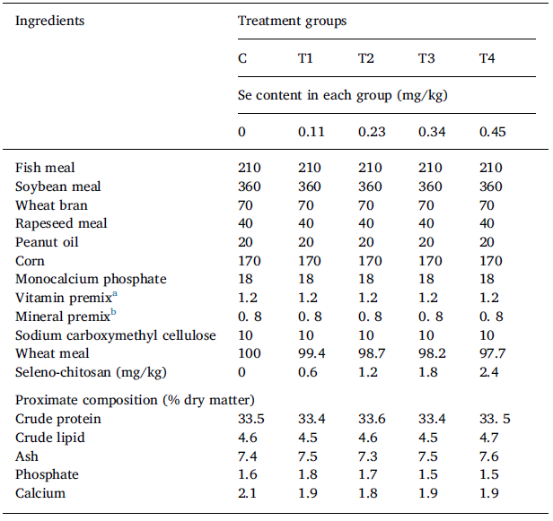
Diet preparation, feeding and evaluation of growth parameters
Table 1 Formulation and proximate composition of the experimental feeds (all amounts given in g/kg unless otherwise stated).
1.0 g chitosan + 100 mL 1% acetic acid = chitosan solution, 0.4 g Na2SeO3 + chitosan solution= Se-chitosan compound
The crude protein, crude lipid, ash, and moisture in the diets were determined by methods of AOAC (1995).
Crude protein was determined using the Kjeldahl method (N×6.25), after being analyzed with an Auto Kjeldahl System (K358/K355; BUCHI, Flawil, Switzerland).
Crude lipid was measured with a Soxhlet extraction using a Soxtec system HT (E-816; BUCHI, Flawil, Switzerland).
Ash was determined by combustion at 550 °C in a muffle furnace.

Slide 8
Survival rate (%)=100×(final number of loach/initial number of loach
SGR (%/day)=100×[ln (final mean body weight)−ln (initial mean body weight)]/time (days)
FCR=total dry feed consumption/net weight gain (%)
WG (%)=100×(final total weight-initial total weight)/initial total weight
P was determined with the phosphorus vanadium molybdate yellow colorimetric method.
Ca was determined using ethylenediamine tetraacetate disodium (EDTA-2Na).
Se content in the diets was determined with 2,3 diaminonaphthalene fluorometry using an atomic absorption spectrometer (HG-AFS; Varian Inc., Palo Alto, USA).

Slide 9
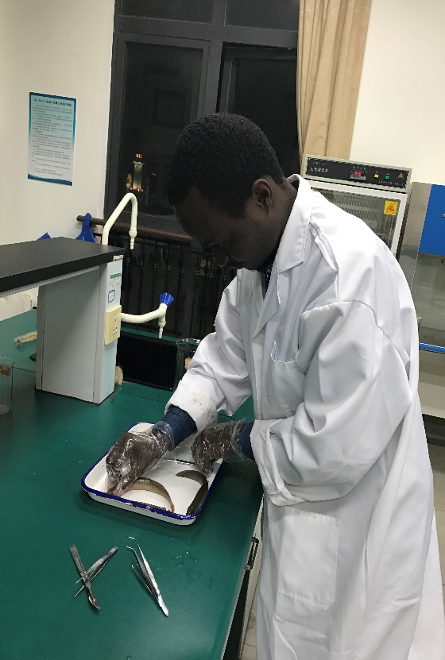
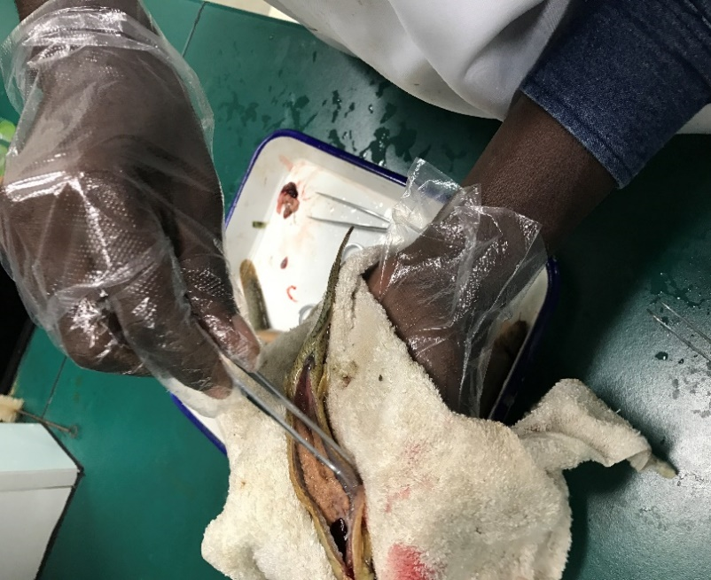
Measurement of immunological parameters
After 60-days,all fish were starved for 24 h, weighed by tank. 10 loaches selected randomly from each tank.
Selected fish were killed with an overdose of tricaine methanesulfonate (MS-222, 150 mg/L; Sigma-Aldrich, Shanghai,China). The surface of each fish was sterilized using 70% ethanol (BDH Middle East LLC., Dubai, UAE)
Intestinal samples were homogenized in 10 volumes (v/w) of ice-cold phosphate buffered saline (Procell Life Science & Technology Co., Ltd., Wuhan, China), and centrifuged at 3000×g for 20 min at 4 °C.
Alkaline phosphatase (ALP), acid phosphatase (ACP), lysozyme (LZM), and immunoglobulin M (IgM) were measured with ELISA kits (kits 48T/hj-17,285, 48T/hj-17,426, 48T/hj-17,234, and 48T/hj-17,367, respectively, Shanghai Changjin Biotechnology Co., Ltd., Shanghai, China), following the manufacturer’s instructions.

Slide 10
Intestinal microbiological assay
1
3
5
DNA concentration was determined using a Qubit 2.0 fluorometer-life tech instrument (Invitrogen, Carlsbad, USA). DNA integrity was verified using 2% agarose gel electrophoresis, and DNA concentration was measured with a NanoDrop (ND-2000, Thermo Fisher Scientific Co. Ltd., Shanghai, China). Extracted DNA was stored at −80 °C.
After PCR amplification of intestinal DNA, gel electrophoresis was performed to check for the desirable DNA bands. Target bands were removed from the gel and quantified with a Qubit2.0 DNA test kit (Invitrogen, Carlsbad, USA), following the manufacturer's instructions
5 fish per replicate were excised and the fat deposits surrounding the intestinal tract were removed. Gut contents squeezed out, collected, and pooled to extract microbial DNA (Obtaining the intestinal tract)
2
4
6
(PCR amplification) The PCR cycle conditions were as follows: an initial denaturation step at 95 °C for 5 min; followed by 27 cycles at 95 °C for 30 s, 55 °C for 30 s, and 72 °C for 45 s; and a final extension step at 72 °C for 10 min. The primer pair used were 515F (5′-GTGCCAGCMGCCGCGG-3′) and 907R(5′CCGTCAATTCMTTTRAGTTT-3′) and V4-V5 Universal primer
(DNA extraction) Microbial DNA was extracted from the fish intestinal samples using the E.Z.N.A. tissue DNA kit (D3396–01; Omega Bio-tek, Inc., Winooski, USA), following the manufacturer's instructions.
Deep Sequencing. Hiseq 2500 sequencing platform and paired-end technology.
All bands were paired-end deep sequenced on a HiSeq DNA sequencing platform by Genepioneer Biotechnologies Co., Ltd., Nanjing, China.

Slide 11
Statistical analysis
Growth parameters (final average weight, WG, SGR, and FCR),survival rate, and immunological parameters (LZM, ALP, ACP, and IgM) were compared with one-way analyses of variance (ANOVA)
Tukey’s test was used for multiple comparisons. We considered differences significant when P < 0.05. Data are presented as means ± S.D (standard deviation).
SPSS v19.0 (SPSS Inc., Chicago, USA) was used for all statistical analysis
Preprocessing was necessary before the intestinal microflora could be analyzed.
.

Slide 12
Sequence analysis was performed using UCLUST v1.1.579, assigning sequences with ≥97% similarity to the same operational taxonomic unit (OTU).
Analyzing alpha diversity indices of the intestinal samples. The Chao1 index and the ACE richness estimator were used to analyze community richness, Shannon and the Simpson diversity indices were used to analyze community diversity.
Paired obtained reads of Deep sequencing
03
01
Obtained paired-end reads were cleaned and purified before being assigned to samples based on unique barcodes
06
02
04
05
Based on the RDP taxonomic classifications, Fisher's exact test was used to analyze differences in rank abundance among the diets, considering P < 0.05 statistically significant.
OTUs were taxonomically classified based on the ribosomal database project (RDP) classifier, which efficiently clusters sequences with 97% similarity and a 0.80 confidence threshold

Slide 13
RESULTS
Growth parameters
Table 2: Effects of Se-chitosan concentration on the growth parameters of the loach Paramisgurnus dabryanus.
Each value represents the mean ± standard deviation of three replicates. Values in the same row with different superscripts are significantly different (P < 0.05).
1 WG (%)=final total weight−initial total weight/initial total weight×100.
2 SGR (specific growth rate)=[Ln (final mean body weight)−Ln (initial mean body weight)]/time×100.
3 FCR (feed conversion ratio)=dry feed consumption/net weight gain.
4 Survival rate (%)=final number of loach/initial number of loach×100.

Slide 14
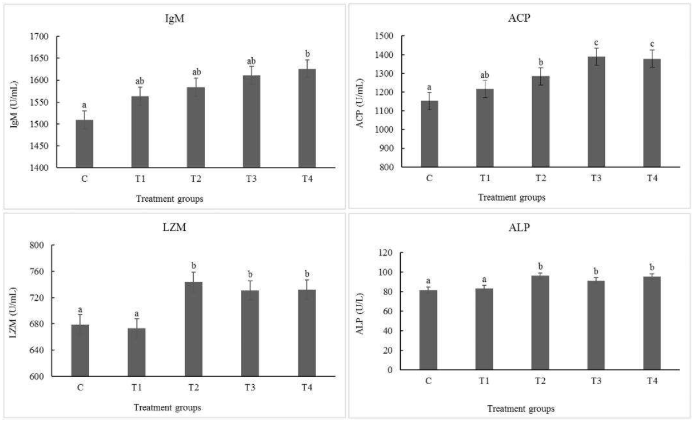
Intestinal immunological enzymes
Fig. 1. IgM, LZM, ACP and ALP of loach. Bars indicate means ± standard deviations of three replicates, with 10 fish per replicate. Bars labeled with different lowercase letters are significantly different (P < .05).

Slide 15
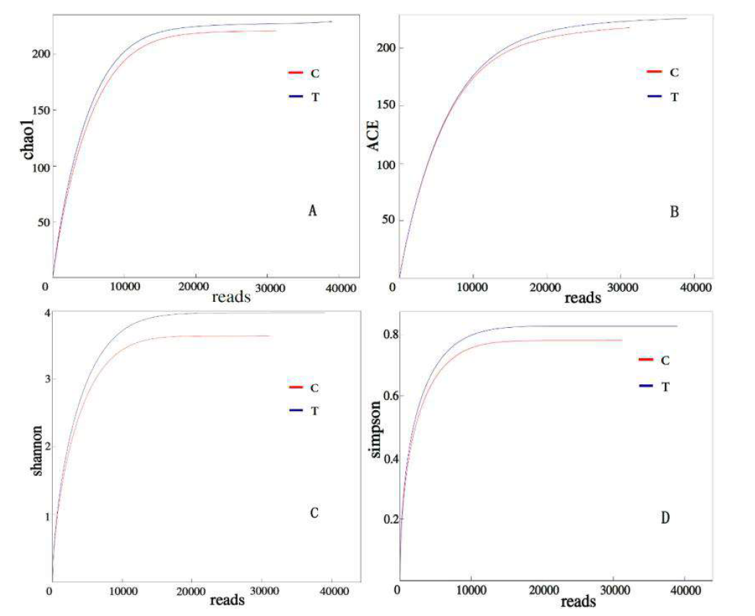
Intestinal microflora
Fig. 2. Alpha diversity curves. Chao1, ACE, Shannon, and Simpson indices

Slide 16
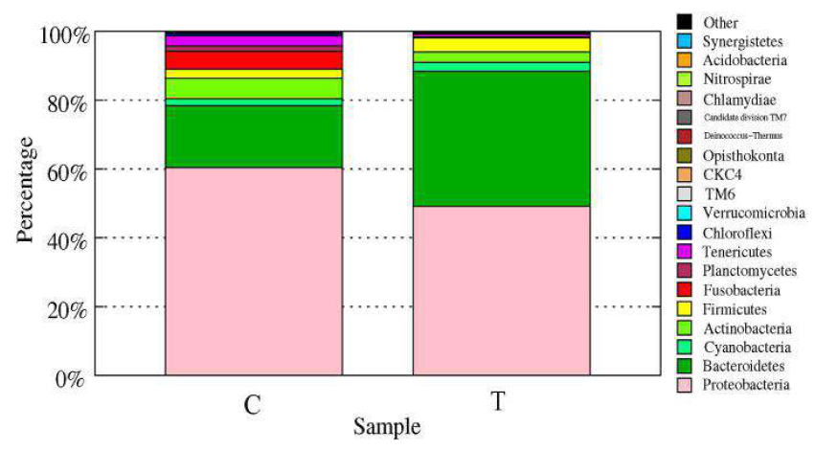
Fig. 3. Distribution of the bacterial phyla between samples. T=T3; C=control. The T3 group was supplemented with 1.8 mg Se-chitosan/kg feed. The control group (C) was not fed Se-chitosan supplements. The x-axis represents the sample group, and the y-axis represents the abundance of the bacterial phyla. Different colors represent different phyla. Floras with low abundance were merged into the ‘other’ group.

Slide 17
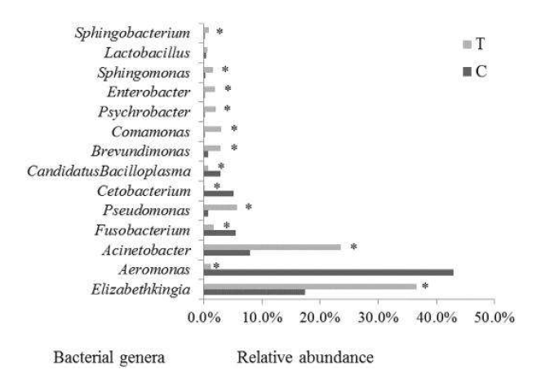
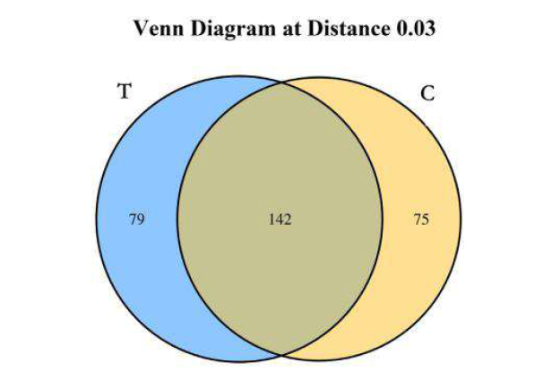
Fig. 4. Venn diagram showing unique and shared OTUs (at 3% distance). T=T3. The T3 group was supplemented with 1.8 mg Se-chitosan/kg feed. The control group (C) was not fed Se-chitosan supplements.
Fig. 5. Composition of bacterial genera in the C and T groups. T=T3. The T3 group was supplemented with 1.8 mg Se-chitosan/kg feed. The control group (C) was not fed Se-chitosan supplements Fisher's exact test was used to analyze differences in rank abundance difference between the two groups.

Slide 18
DISCUSSION
We observed that Se-chitosan had little effect on growth performance based on WG, SGR, and survival rate after 60 days of Se-chitosan treatment.
The immunological parameters evaluated performed better with increasing levels of Se-chitosan supplementation as Se increases LZM cell proliferation and elevating serum lysozyme activity
Se-chitosan regulates the immune response by enhancing innate immunity and modulating pathogen-induced inflammation through Toll-like receptor-regulated signaling pathways.
But also influences the immune function by regulating thyroid hormone metabolism.

Slide 19
Species richness and diversity of the intestinal microflora increased in the T3 group as compared to the control group.
We observed high levels of the beneficial bacteria Lactobacillus in the T3 group (Fig. 5) and was consistent with previous studies
However, we did not observe an obvious pattern in the common pathogenic bacteria. For example, opportunistic pathogenic bacteria Aeromonas was less abundant in the T3 group, while Enterobacter was more abundant.
Most of bacteria that were more common in the T3 group were Proteobacteria, including the genera Acinetobacter, Pseudomonas, Comamonas, Psychrobacter, Sphingomonas, and Brevundimonas.

Slide 20
CONCLUSION
Se-chitosan influences fish intestinal health by stimulating immunological parameters and affecting the diversity of the microflora in the intestine.
However, more studies are needed to further investigate this compound and the associated mechanisms that affect immunity.

Slide 21
REFERENCES
Abu-Elala, N.M., Mohamed, S.H., Zaki, M.M., Eissa, A.E., 2015. Assessment of the immune-modulatory and antimicrobial effects of dietary chitosan on Nile tilapia(Oreochrmis niloticus) with special emphasis to its bio-remediating impacts. Fish Shellfish Immunol. 46 (2), 678–685.AOAC, 1995. Official Methods of Analysis of Official Analytical Chemists International,16th edition. Association of Official Analytical Chemists Inc, Arlington, Virginia,USA.
Berntssena, M.H.G., Sundal, T.K., Olsvik, P.A., Amlund, H., Rasinger, J.D., Sele, V.,Hamre, K., Hillestad, M., Buttle, L., Ørnsrud, R., 2017. Sensitivity and toxic mode ofaction of dietary organic and inorganic selenium in Atlantic salmon (Salmo salar).
Aquat. Toxicol. 192, 116–126. https://doi.org/10.1016/j.aquatox.2017.09.014.
Biller-takahashi.Biller-Takahashi, J.D., Takahashi, L.S., Urbinati, E.C., 2015. The immune system is limited by oxidative stress: dietary selenium promotes optimal antioxidative status and greatest immune defense in pacu Piaractus mesopotamicus. Fish Shellfish Immunol. 47,360–367. https://doi.org/10.1016/j.fsi.2015.09.022.
Chen, L.Y., Subirade, M., 2005. Chitosan/ß-lactoglobulin core-shell nanoparticles as nutraceutical carriers. Biomaterials 26 (30), 6041–6053. https://www.fasebj.org/doi/abs/10.1096/fasebj.29.1_supplement.759.7.
Chen, L., Zhan, Y.S., Wu, Y.R., 2009. Condition optimization in cultivation of selenium enriched yeast. J. Hunan Agric. Univ. (Nat. Sci.) 35 (3), 237–241.
China Fishery Statistical Yearbook, 2017. Bureau of Fisheries of the Ministry of Agriculture. (Beijing, China).
Dananjaya, S.H.S., Godahewa, G.I., Jayasooriya, R.G.P.T., Lee, J., De Zoysa, M., 2016. Antimicrobial effects of chitosan silver nano composites (CAgNCs) on fish pathogenic Aliivibrio (Vibrio) salmonicida. Aquaculture 450, 422–430. https://doi.org/10.1016/j. aquaculture.2015.08.023.
Dong, Z., Li, X., Zhang, X., Ling, Q., Ni, Q., Li, Y., 2014. Development of microsatellite markers for genetic analysis in the large scale loach Paramisgurnus dabryanus. Conserv. Genet. Resour. 6 (1), 151–153. https://doi.org/10.1007/s12686-013-
0030-6.

Slide 22
THANK YOU
专业：建筑学 @ 建筑设计及其理论
浙江大学

