Slide 1
ENGLISH IN SHIP AND OCEAN ENGINEERING
Ge Han
Ocean College, Zhejiang University
Email: gehan@zju.edu.cn

Slide 2
Lecture 7: How to Process data? -Raw data processing
Ref:
https://explorable.com/raw-data-processing

Slide 3
Raw data processing refers to the refining of raw data that has been collected from the experiment.
Statistical data that is used to draw conclusions and inferences should be accurate and consistent. This is important in order to ensure the validity of all the inferences drawn on the basis of the data.
"Raw data is a term for data collected on source which has not been subjected to processing or any other manipulation." (wikipedia.org)

Slide 4
Mathematical functions
MATLAB offers many predefined mathematical functions for technical computing which contains a large set of mathematical functions.

Slide 5
Basic plotting

Slide 6
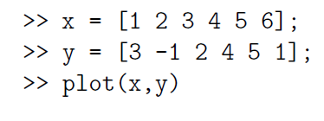
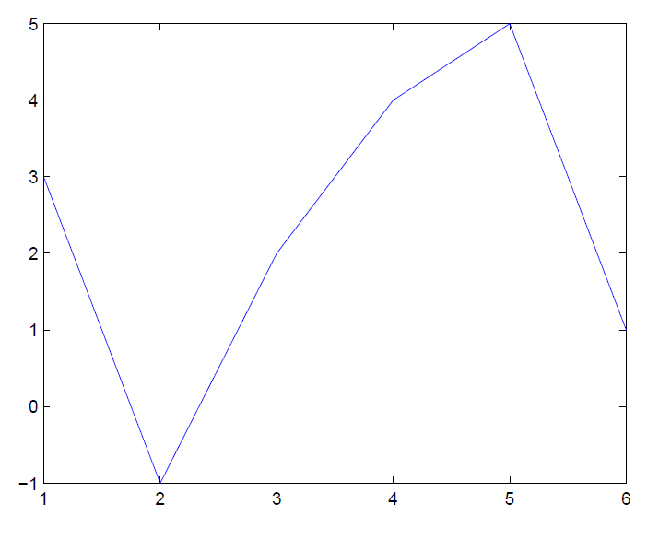
The basic MATLAB graphing procedure, for example in 2D, is to take
a vector of x-coordinates, x = (x₁, …, x_{N}), and
a vector of y-coordinates, y = (y₁, …, y_{N}),
locate the points (x_{i}, y_{i}), with i = 1; 2 , …, n and then join them by straight lines. x and y are both row arrays or column arrays of the same length.

Slide 7
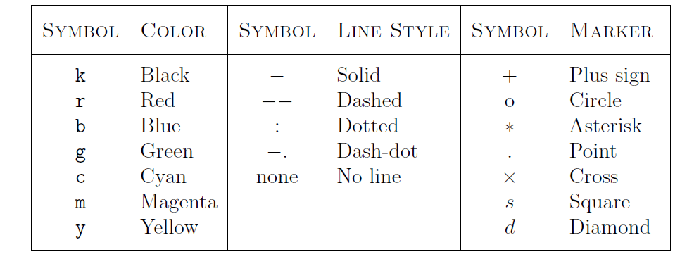
Adding titles, axis labels, and annotations
Specifying line styles and colors

Slide 8
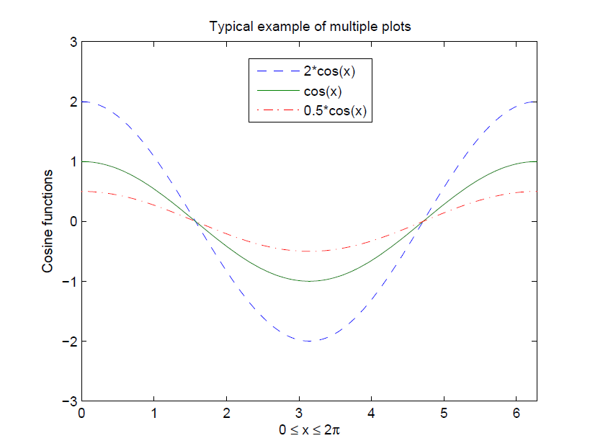
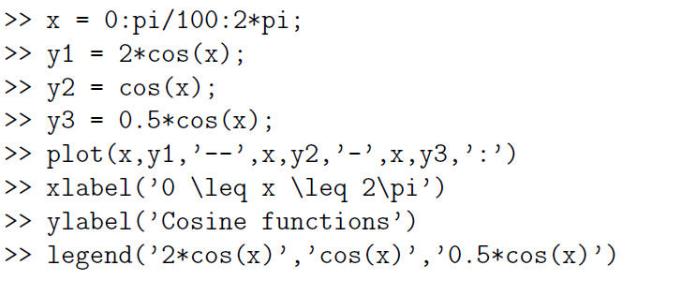
Multiple data sets in one plot

Slide 9
Matrix/vector operation

Slide 10
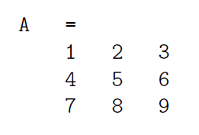
Matrices are the basic elements of the MATLAB environment. A matrix is a two-dimensional array consisting of m rows and n columns. Special cases are column vectors (n = 1) and row vectors (m = 1).
>> load F:\internationalC\dataprocessing\A.mat
>> a=A

Slide 11
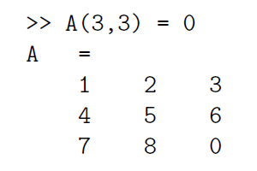
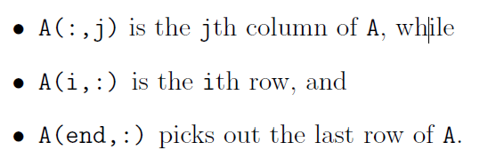
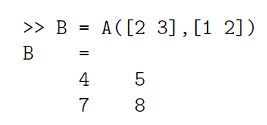
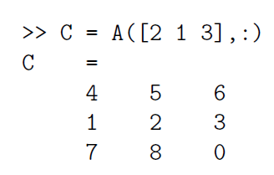
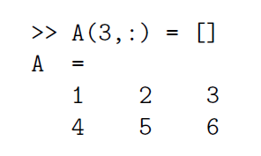
Matrix indexing
The element of row i and column j of the matrix A is denoted by A(i,j). Thus, A(i,j) in MATLAB refers to the element A_{ij} of matrix A. The first index is the row number and the second index is the column number.
Creating a sub-matrix
Interchanging rows
Deleting row or column

Slide 12
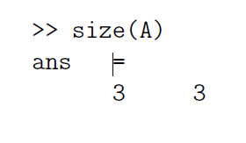
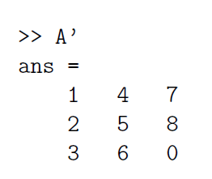
Dimension
To determine the dimensions of a matrix or vector, use the command size.
Transposing a matrix
The transpose operation is denoted by an apostrophe or a single quote ('). It flips a matrix about its main diagonal and it turns a row vector into a column vector.

Slide 13
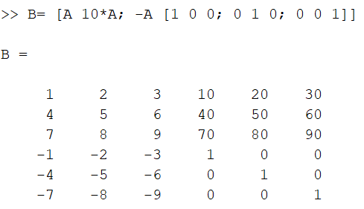
Concatenating matrices

Slide 14
Matrix generators
MATLAB provides functions that generates elementary matrices. The matrix of zeros, the matrix of ones, and the identity matrix are returned by the functions zeros, ones, and eye, respectively.

Slide 15
Special matrices
These matrices have interesting properties that make them useful for constructing examples and for testing algorithms.

Slide 16
Array operations

Slide 17
Matrix arithmetic operations
A+B or B+A is valid if A and B are of the same size
A*B is valid if A's number of column equals B's number of rows
A^2 is valid if A is square and equals A*A
α*A or A*α multiplies each element of A by α
Array arithmetic operations
Array arithmetic operations or array operations for short, are done element-by-element. The period character, ., distinguishes the array operations from the matrix operations.

Slide 18
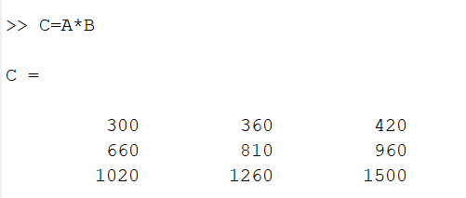
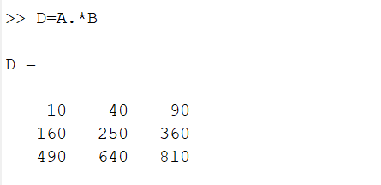

Slide 19
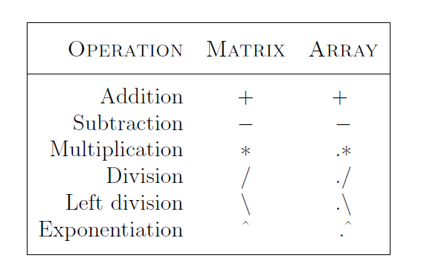

Slide 20
Introduction to programming in MATLAB

Slide 21
A different way of executing repeatedly commands with MATLAB is:
1. to create a file with a list of commands,
2. save the file, and
3. run the file.
This section covers the following topics:
M-File Scripts
M-File Functions

Slide 22
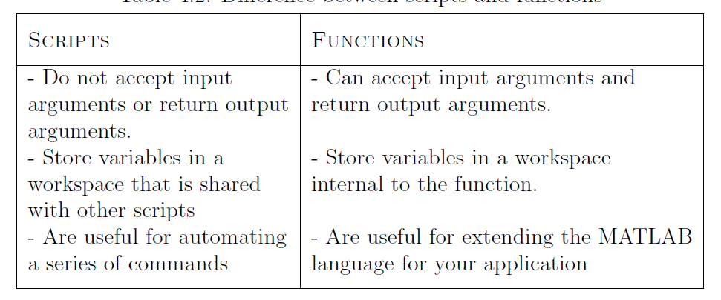

Slide 23
Exercises
Liz buys three apples, a dozen bananas, and one cantaloupe for $2.36. Bob buys a dozen apples and two cantaloupe for $5.26. Carol buys two bananas and three cantaloupe for $2.77. How much do single pieces of each fruit cost?
Write a function file that converts temperature in degrees Fahrenheit (±ºF) to degrees Centigrade (±ºC).
Write a user-defined MATLAB function, with two input and two output arguments that determines the height in centimeters (cm) and mass in kilograms (kg) of a person from his height in inches (in.) and weight in pounds (lb).
Determine in SI units the height and mass of a 5 ft.15 in. person who weight 180 lb.
Determine your own height and weight in SI units.

Slide 24
Descriptive Statistics

Slide 27
Polynomial Models
where n+1 is the order of the polynomial, n is the degree of the polynomial, and 1 ≤ n ≤ 9. The order gives the number of coefficients to be fit, and the degree gives the highest power of the predictor variable.
For example, a third-degree (cubic) polynomial is given by

Slide 28
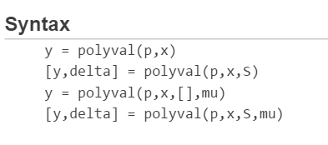
polyval
y = polyval(p,x) returns the value of a polynomial of degree n evaluated at x. The input argument p is a vector of length n+1 whose elements are the coefficients in descending powers of the polynomial to be evaluated.

Slide 29
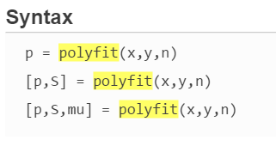
polyfit
Polynomial curve fitting
p = polyfit(x,y,n) returns the coefficients for a polynomial p(x) of degree n that is a best fit (in a least-squares sense) for the data in y. The coefficients in p are in descending powers, and the length of p is n+1

Slide 30
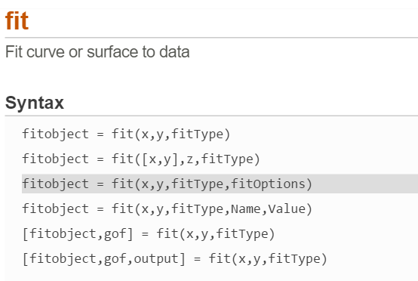
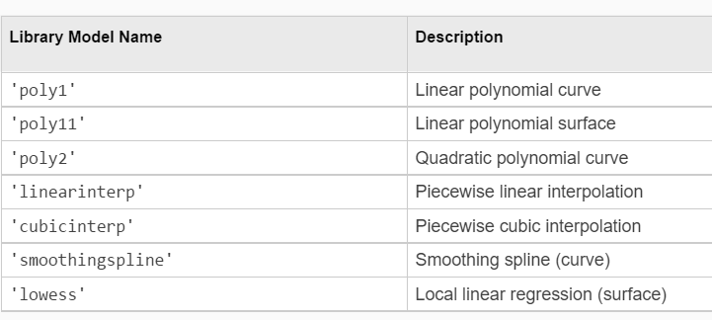
Linear and Nonlinear Regression

