Slide 1
Isolation and identification of novel bacteria from hypersaline and saline lakes of China
Sanjit Chandra Debnath
Supervisor: Dr. Pinmei Wang
Major: Marine Science (Microbiology)
ID: 11934069
December 24, 2019

Slide 2
Introduction
Materials and Methods
Contents
Results
Conclusion

Slide 3
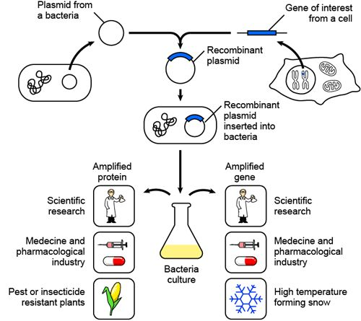
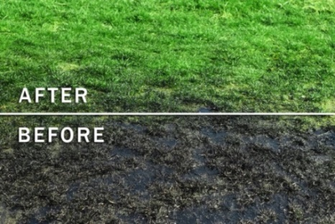
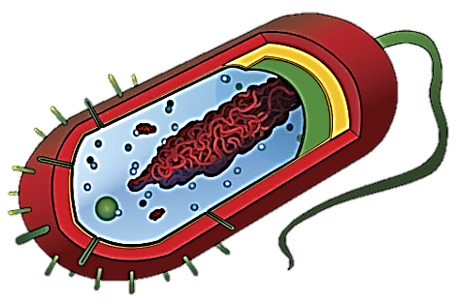
Introduction
Molecular biology, biotechnology
Among the first life forms
Present almost everywhere
Being used since ages
Considered friends and foes
Bioremediation
Pure chemicals for pharmaceuticals use
Therapeutic proteins
Processed food

Slide 4
Introduction
On Earth approximately 4-6×10³⁰ microbial cells (Whitman et al., 1998)
Microbial species on Earth 10¹² (Locey & Lennon, 2016)
Most bacteria have not been characterized yet (Rappé & Giovannoni, 2003)
Only 0.1 to 10% can be cultured (Ranjard et al., 2000)
How many microorganisms have been identified till date?
Microbial species with valid name ~13,000 (Amann & Rosselló-Móra, 2016)
Aim:
Polyphasic identification of novel bacteria
More than 99% remained undiscovered

Slide 5
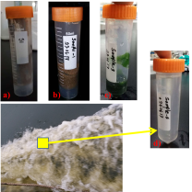
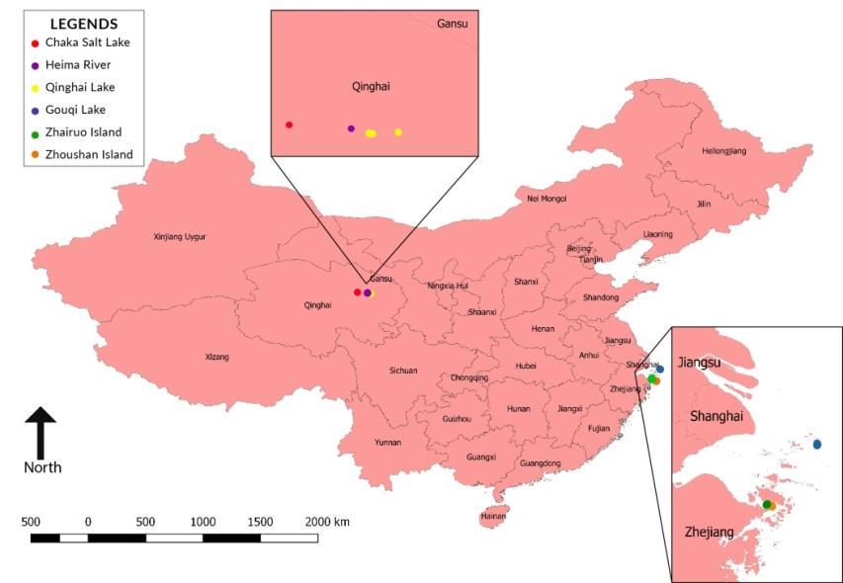
Materials and Methods
Minimal media
Isolation
(409 strain)
Purification
Compared with Genebank
Amplified
16S rRNA
Preliminary
identification
Serial dilution Repeated streaking
PCR
Possible novel
species
(58 strains)
≤ 98.5% 16S rRNA similarity
Flavobacterium
Genotypic
Phenotypic
Chemotaxonomic
Taxonomic
position
Polyphasic approach

Slide 6
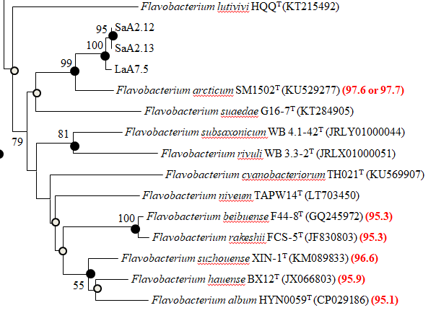
Results – Polyphasic identification
1. Phylogenetic analysis
≤ 98.5% 16S rRNA similarity
Fig. Neighbor-joining phylogenetic tree of strain SaA2.12,
SaA2.13, LaA7.5 with the most closely related members

Slide 7
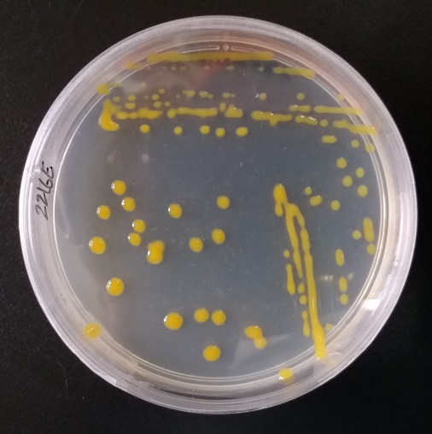
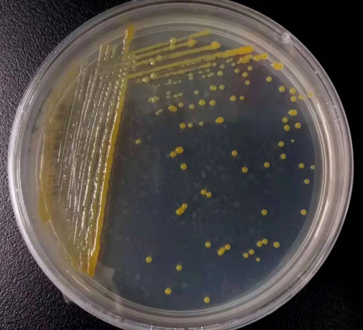
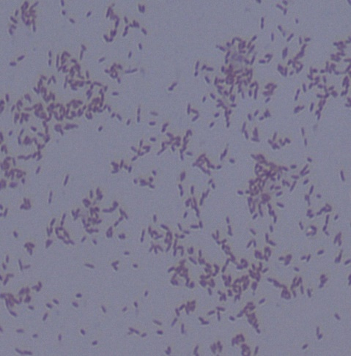
2. Morphological characteristics
SaA2.12, SaA2.13 are yellow, smooth, circular and 2-4 mm in diameter
LaA7.5 is bright yellow, smooth,
circular and 1-2 mm in diameter
SaA2.12
LaA7.5
Gram-negative

Slide 8
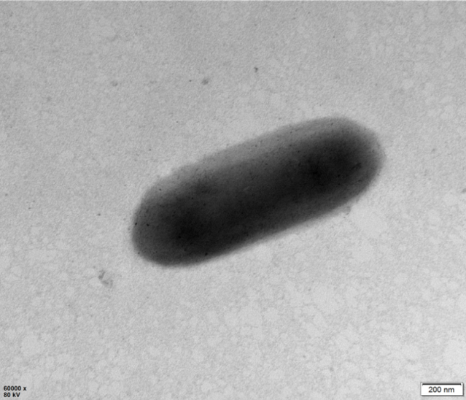
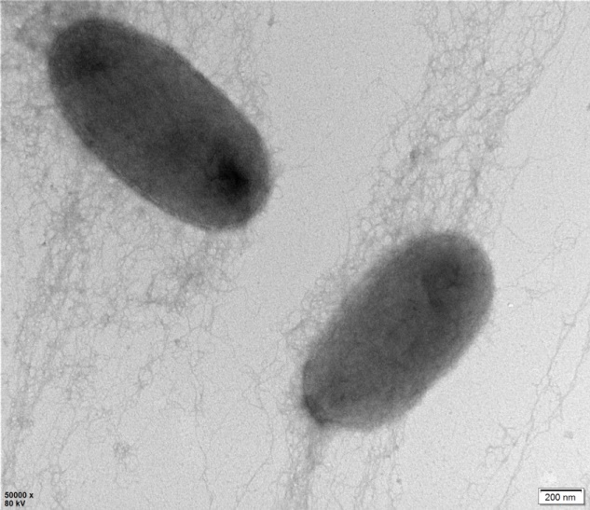
Results – Con…
Cells of SaA2.12, SaA2.13, LaA7.5 were non-flagellated, non-spore forming rods
Size of SaA2.12, SaA2.13 and LaA7.5 are 0.5-0.6 µm × 1.2-1.4 µm, 0.5-0.7 µm × 1.1-1.5 µm, 0.4-0.6 µm × 0.8-1.5 µm
SaA2.12
SaA2.13
LaA7.5

Slide 9
3. Biochemical characteristic
1. SaA2.12^{T}
2. SaA2.13^{T}
3. LaA7.5^{T}
4. Flavobacterium arcticum KCTC 42668^{T}
5. F. aquatile JCM 20475^{T}
Description | 1 | 2 | 3 | 4 | 5
Isolation source | Water, Chaka Salt Lake | Water, Chaka Salt Lake | Sediment, Qinghai Lake | Arctic surface seawater | Deep well
Colony pigmentation | Yellow | Yellow | Bright yellow | Bright yellow | Pale yellow
Temperature range for growth, °C (optimum) | 4-40 (28-30) | 4-40 (28-30) | 20-37 (28-35) | 10-40 (25) | 10–35 (25-28)
pH range for growth (optimum) | 5.0-8.5 (5.0-7.5) | 5.0-8.5 (5.0-7.5) | 5.5-7.5 (5.5-7.0) | 6.0-7.5 7.0-(7.5) | 6.5–8.0 (7)
NaCl range for growth, % w/v (optimum) | 0-8.0 (0-5.5) | 0-8.0 (0-5.5) | 0-5.5 (0-2.5) | 0-8 (0) | 0–1 (0)
Gliding motility | + | + | + | + | −
Hydrolysis of:
Starch | + | + | − | w | −
Tween 20 | + | + | + | − | −
Tween 60 | + | + | + | − | −
Tween 80 | − | − | + | − | −
Methyl Red | + | + | − | − | −

Slide 10
4. Chemotaxonomic characterization
Respiratory quinone: Menaquinone 6 (MK-6)
Fatty acids | % of total fatty acids
 | 1 | 2 | 3 | 4 | 5
Branched chain
iso-C_{15:0} | 21.6 | 22.8 | 39.5 | 22.1 | 23.4
iso-C_{15:0} 3-OH | 4.9 | 4.1 | tr | 3.6 | 4.8
iso-C_{15:1} G | 11.2 | 12.0 | tr | 10.1 | 6.3
iso-C_{16:0} 3-OH | 3.0 | 2.8 | tr | 1.8 | tr
iso-C_{16:1} H | 1.4 | 2.9 | - | tr | -
iso-C_{17:0} 3-OH | 14.8 | 12.2 | tr | 8.2 | 2.3
iso-C_{17:1} ω10c | - | - | 2.1 | - | -
anteiso-C_{15:0} | 5.2 | 5.3 | 34.1 | 4.2 | 6.3
anteiso–C_{17:0} | - | - | 4.0 | - | -
Summed Feature*
3 | 4.8 | 5.6 | tr | 4.5 | 5.9
9 | 13.3 | 15.1 | - | - | 3.5
Major Fatty acids (>10%) : iso-C_{15:0},
iso-C_{15:1} G, iso-C_{17:0} 3-OH,
anteiso-C_{15:0} and summed feature 9
(iso-C_{17:1} ω9c and/or C_{16:1} 10-methyl)
1. SaA2.12^{T}
2. SaA2.13^{T}
3. LaA7.5^{T}
4. F. arcticum KCTC 42668^{T}
5. F. aquatile JCM 20475^{T}
−, Not found, tr, trace amount (<1%)

Slide 11
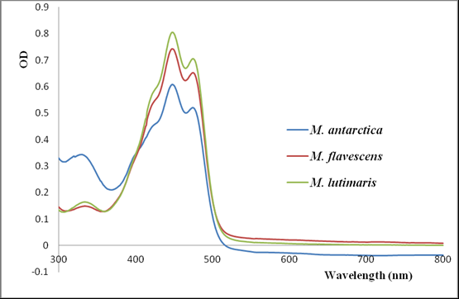
4. Chemotaxonomic characterization – carotenoids (UV-spectrophotometer)
Wu et al., 2013

Slide 12
Delineation of bacterial species
DDH (DNA-DNA Hybridization) < 70%
ANI (Average Nucleotide Identity) < 95%
Meier-Kolthoff et al., 2014
5. Genomic Relatedness
DDH value below 79-80% = Subspecies
Member of genus Flavobacterium | GenBank accession No. | G+C % content | Genome size (Mbp) | DDH (%) | ANI (%)
SaA2.12^{T} | SKBP00000000 | 38.0 | 3.0 | - | -
LaA7.5^{T} | - | 38.0 | 3.3 | 75.9 | 97.2
F. arcticum KCTC 42668^{T} | SKBO00000000 | 34.9 | 3.0 | 25.3 | 82.8
F. subsaxonicum DSM 21790^{T} | AUGP00000000 | 41.6 | 4.6 | 18.3 | 73.1
F. beibuense F44-8^{T} | JRLV00000000 | 37.7 | 3.8 | 17.9 | 73.4
F. album HYN0059^{T} | CP029186 | 44.5 | 4.0 | 18.1 | 72.7
F. rivuli DSM 21788^{T} | ARKJ00000000 | 39.6 | 4.5 | 19.2 | 73.3
F. cyanobacteriorum TH021^{T} | NOXV00000000 | 41.7 | 3.2 | 16.4 | 71.5
F. aquidurense DSM 18293^{T} | MUGR00000000 | 33.8 | 5.4 | 18.2 | 70.2
F. lacus CGMCC 1.12504^{T} | QLSV00000000 | 34.9 | 3.5 | 17.5 | 69.9
F. cucumis DSM 18830^{T} | FRYK00000000 | 33.1 | 2.9 | 17.0 | 69.8
F. piscis CCUG 60099^{T} | MUHC00000000 | 34.1 | 5.9 | 18.8 | 70.6
F. johnsoniae UW101^{T} | CP000685 | 34.1 | 6.1 | 18.4 | 70.3
F. terrae DSM 18829^{T} | FQZI00000000 | 31.8 | 3.2 | 16.7 | 70.3
F. sharifuzzamanii A7.6^{T} | QJGZ00000000 | 33.6 | 5.3 | 18.5 | 70.3
F. aquatile LMG 4008^{T} = JCM 20475^{T} | JRHH00000000 | 32.2 | 3.5 | 18.4 | 69.8

Slide 13
Conclusion
16S rRNA similarity ≤ 98.5%
Distinct cultural, morphological, biochemical characteristics
Distinct chemotaxonomic characteristics
Significantly lower DDH, ANI value and distinct G+C content
Novel strain SaA2.12^{T}, SaA2.13^{T}
Name: Flavobacterium chakense sp. nov.
Deposition No: KCTC 72220^{T} = MCCC 1K03618^{T}
Accession No.: MN864570, MN864572 (16S rRNA)
Confirm strain SaA2.12^{T} and SaA2.13^{T} as same strain but novel species
LaA7.5 is a novel subspecies of SaA2.12^{T} and SaA2.13^{T}
Novel strain LaA7.5^{T}
Name: Flavobacterium chakense subsp. qinghaiense supsp. nov.
Deposition No.: KCTC 72806^{T} = MCCC 1K04372
Accession No.: MN864568 (16S rRNA)

Slide 14
References
Whitman, W. B., Coleman, D. C., & Wiebe, W. J. (1998). Prokaryotes: the unseen majority. Proceedings of the National Academy of Sciences, 95(12), 6578-6583.
Locey, K. J., & Lennon, J. T. (2016). Scaling laws predict global microbial diversity. Proc Natl Acad Sci U S A, 113(21), 5970-5975. doi:10.1073/pnas.1521291113
Rappé, M. S., & Giovannoni, S. J. (2003). The uncultured microbial majority. Annual Review of Microbiology, 57, 369-394. doi:10.1146/annurev.micro.57.030502.090759
Ranjard, L., Poly, F., & Nazaret, S. (2000). Monitoring complex bacterial communities using culture-independent molecular techniques: application to soil environment. Research in Microbiology, 151(3), 167-177.
Amann, R., & Rosselló-Móra, R. (2016). After All, Only Millions? mBio, 7(4), e00999-00916. doi:10.1128/mBio.00999-16
Wu, Y. H., P. S. Yu, Y. D. Zhou, L. Xu, C. S. Wang, M. Wu, A. Oren and X. W. Xu (2013). "Muricauda antarctica sp. nov., a marine member of the Flavobacteriaceae isolated from Antarctic seawater." Int J Syst Evol Microbiol 63: 3451-3456.
Meier-Kolthoff, J. P., Hahnke, R. L., Petersen, J., Scheuner, C., Michael, V., Fiebig, A., . . . Klenk, H.-P. (2014). Complete genome sequence of DSM 30083T, the type strain (U5/41T) of Escherichia coli, and a proposal for delineating subspecies in microbial taxonomy. Stand Genomic Sci, 9(1), 2. doi:10.1186/1944-3277-9-2

Slide 15
Thank you

