Slide 1
TECHNICAL READING AND WRITING
Ge Han
Ocean College, Zhejiang University
Email: gehan@zju.edu.cn
Office: Rm.324, Ocean Engineering Building
Web: http://ocedu.zju.edu.cn/lxspy/wx

Slide 2
Assessment
Attendance (16 marks): Totally 16 times (28), 1 for each attendance;
Class participation (14 marks): Ask and Answer questions in class;
Homework/Exercise (30 marks): Totally 3 times, 10 for each time (The homework should be completed on time. Each time, 3 or 4 outstanding ones will be invited to show their homework in class);
Finals (40 marks):
Poster (20 marks): Present your own research work;
Presentation (20 marks): Thesis proposal defense
Rewards (up to 2 marks): Valued suggestions for this course.

Slide 3
Introduction
This course mainly includes four parts:
How to do literature survey;
How to read technical literatures;
How to write a scientific article (journal articles), especially the abstract;
How to present research results in a conference: Presentation & Poster.

Slide 4
After this course, you should
Acquire the skills of searching for related literatures;
Acquire reading skills. Be able to find, sort and summarize the related literatures;
Acquire the basic principles of writing Abstract of a paper;
Acquire the skills of preparing a poster;
Acquire the skills of giving a technical report.

Slide 5
Lecture 1: Doing Literature Survey

Slide 6
Why?

Slide 7
First context(the mentor and yourself)
A review of existing knowledge can be a preliminary step in a large research project.(required for a thesis or dissertation proposal)
To make sure the proposed research question has not already been answered.
To situate your proposed project in relation to existing knowledge. (Enable you to address to concept of a “contribution to knowledge”)
Help to stimulate your own thinking.
Notes:
If an existing study convincingly answers the questions you want to address, it is better to find out before you get stared than when you are in the middle of a research project.

Slide 8
Second context
Reviewing existing knowledge can itself be the end goal if one simply wants to ascertain the current “state of the art” on a particular subject or problem.
It is not to simply summarize the available research, but also to evaluate it critically.
It should not be exclusively negative; it is also important to identify positive results to take away from the existing work.

Slide 9
Third context(yourself)
A literature review can be a component of a finished research report.
Help to show how your final conclusions relate to the prior wisdom about your subject.

Slide 10
The Purpose
To choose and evaluate current literature, print and electronic, relevant to your topic.
To demonstrate the quality of your own research.
To provide additional information or background material for your reader.
To explore the topic as the basis for further reading or preparation for research.
To give your research historical perspective or context.
To place your project into the context of established work in the field.
Notes:
To synthesize and evaluate it according to the guiding concept you have determined.

Slide 11
Where?

Slide 12
Sources
Books (library/electronic books)
Journals and Periodicals
Research Oriented Dissertations
Others: government agencies, international governmental organizations, non-governmental organizations, think tanks and independent, freelance researchers (from internet).
Be careful to consider whether the items are credible and meet at least minimal standards of scholarly research.
Notes:
Scholarly journals are the primary types of periodicals used for literature survey.

Slide 13
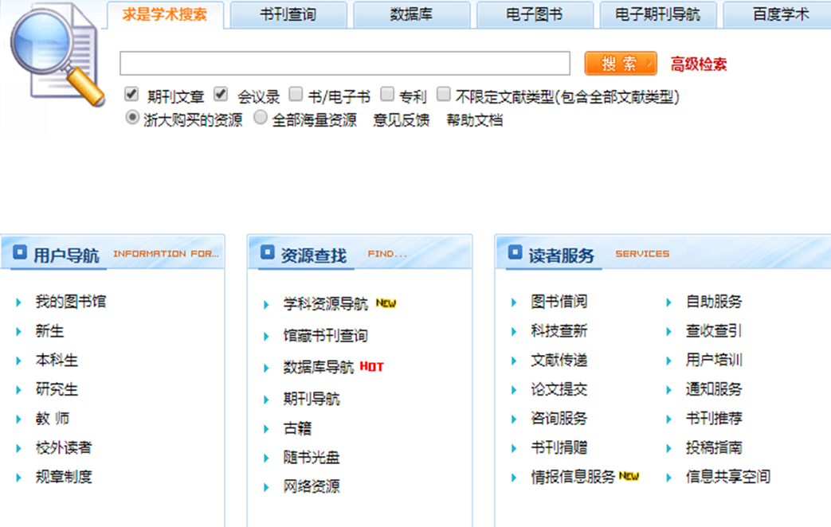
http://libweb.zju.edu.cn/

Slide 14
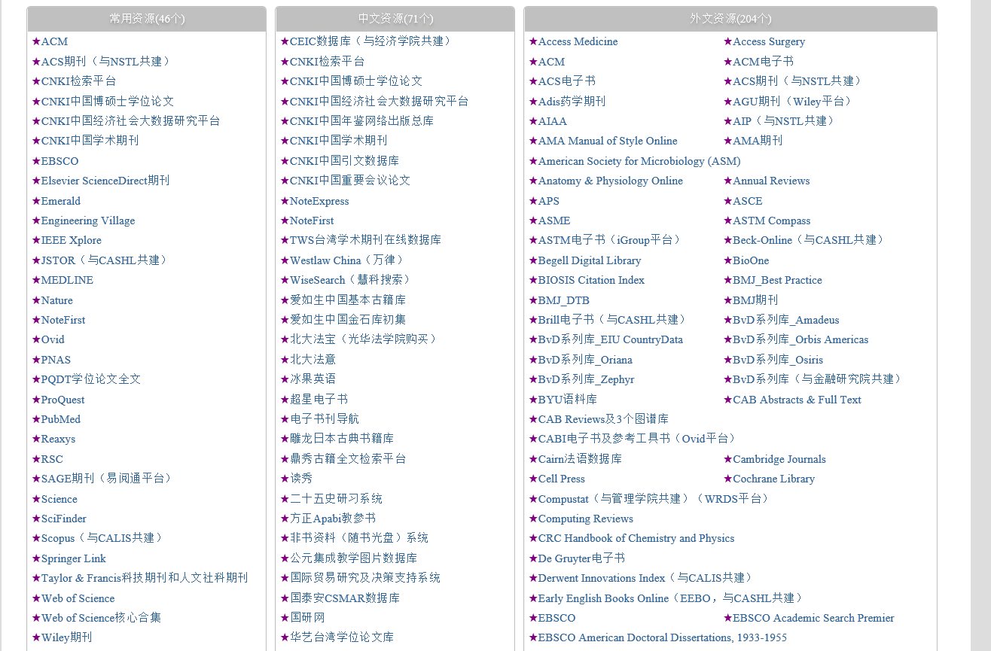
Engineering Village
Web of Science

Slide 15
Web of Science/Web of Knowledge
Journal Index:
Science Citation Index Expanded (SCI-EXPANDED) –1900~
Social Sciences Citation Index (SSCI) – 1998~
Arts & Humanities Citation Index (A&HCI) – 1998~
Conference Index：
Conference Proceedings Citation Index - Science (CPCI-S) – 1998~
Conference Proceedings Citation Index - Social Science & Humanities (CPCI-SSH) – 1998~
Chemistry Index：
Current Chemical Reactions (CCR-EXPANDED) – 1986~
Index Chemicus (IC) – 1993~

Slide 16
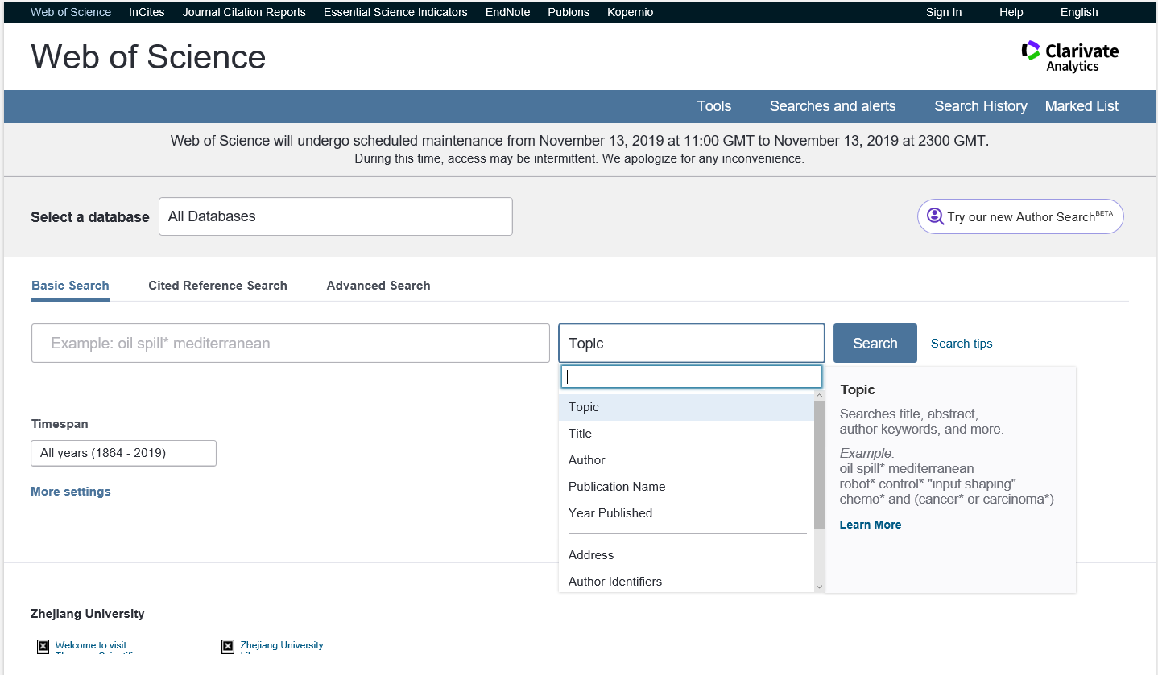
https://apps.webofknowledge.com/UA_GeneralSearch_input.do?product=UA&search_mode=GeneralSearch&SID=6E6RsGkp3ltCCFIxBD8&preferencesSaved=

Slide 17
Engineering Village
Engineering Village takes engineering research to the next level with a comprehensive database that includes the most authoritative engineering resources available to answer today’s most timely questions—from theoretical to applied, and basic to complex.
Engineering Index

Slide 18
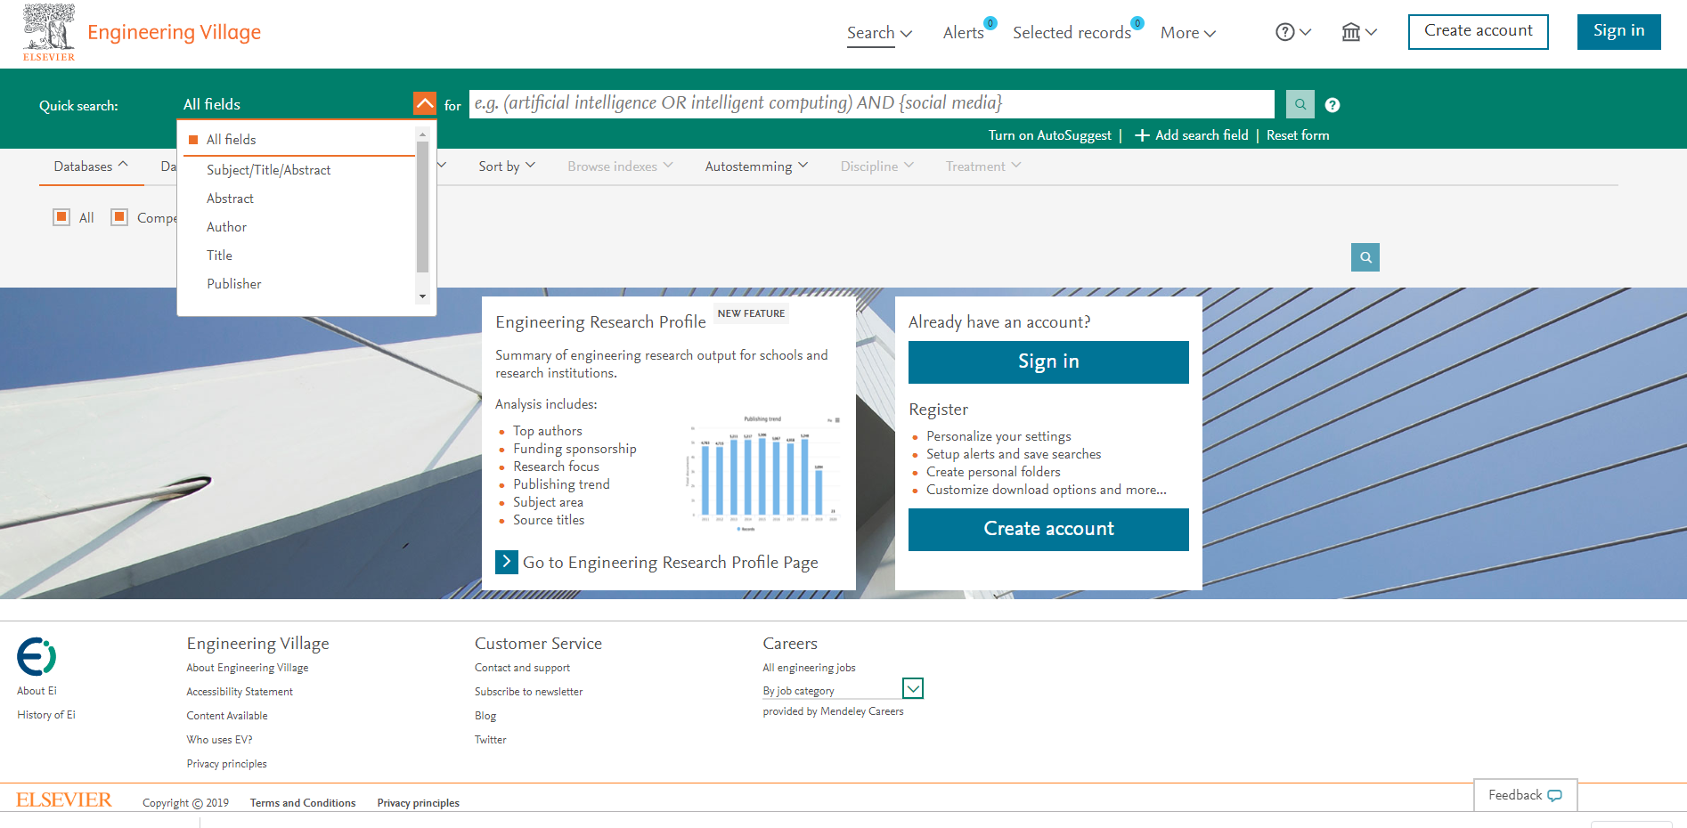

Slide 19
How?
Doing literature survey

Slide 20
Types of search
By Keywords/Topic
By Title
By Author
By Publication
By DOI (Digital Object Identifier)
Notes:
This will provide results based on any of the words specified; hence, they are the cornerstone of an effective search.
Combining two words using ‘AND’ will fetch articles that mention both the words. Using ‘OR’ will widen the search and fetch more articles that mention either subject. While using the term ‘NOT’ to combine words will fetch articles containing the first word but not the second, thus narrowing the search.

Slide 21
Skills of search
Translating research question to keywords
Synonyms/alternate terms should be considered to elicit further information
Spellings should also be taken into account.
Phrase search
This will provide pages with only the words typed in the phrase, in that exact order and with no words in between them.
Notes:
This will provide results based on any of the words specified; hence, they are the cornerstone of an effective search.
Combining two words using ‘AND’ will fetch articles that mention both the words. Using ‘OR’ will widen the search and fetch more articles that mention either subject. While using the term ‘NOT’ to combine words will fetch articles containing the first word but not the second, thus narrowing the search.

Slide 22
Skills of search
Boolean operators
AND, OR and NOT are the three Boolean operators named after the mathematician George Boole.
Filters
Filters can also be used to refine the search, for example, article types, text availability, language, and journal categories.

Slide 23
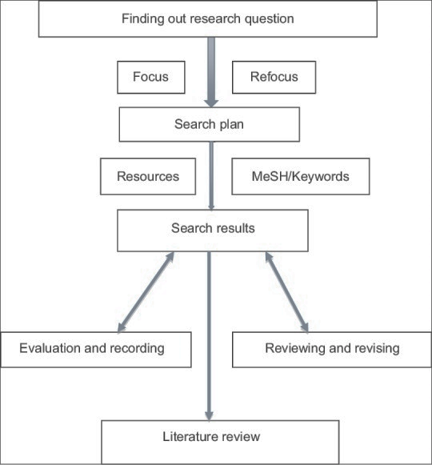
Process
Identify keywords and use them to search articles from library and internet resources as described above;
Search several databases to search articles related to your topic
Find an article that is similar to your topic; then look at the terms used to describe it, and use them for your search
Use databases that provide full-text articles (free through academic libraries, Internet or for a fee) as much as possible so that you can save time searching for your articles
Notes:
Identify keywords and use them to search articles from library and internet resources as described above
Search several databases to search articles related to your topic
Use thesaurus to identify terms to locate your articles
Find an article that is similar to your topic; then look at the terms used to describe it, and use them for your search
Use databases that provide full-text articles (free through academic libraries, Internet or for a fee) as much as possible so that you can save time searching for your articles
If you are examining a topic for the first time and unaware of the research on it, start with broad syntheses of the literature, such as overviews, summaries of the literature on your topic or review articles
Start with the most recent issues of the journals, and look for studies about your topic and then work backward in time. Follow-up on references at the end of the articles for more sources to examine
Refer books on a single topic by a single author or group of authors or books that contain chapters written by different authors
Next look for recent conference papers. Often, conference papers report the latest research developments. Contact authors of pertinent studies. Write or phone them, asking if they know of studies related to your area of interest
The easy access and ability to capture entire articles from the web make it attractive. However, check these articles carefully for authenticity and quality and be cautious about whether they represent systematic research.

Slide 24
Tips
If you are examining a topic for the first time and unaware of the research on it, start with broad syntheses of the literature, such as overviews, summaries of the literature on your topic or review articles.
Start with the most recent issues of the journals, and look for studies about your topic and then work backward in time. Follow-up on references at the end of the articles for more sources to examine
Next look for recent conference papers. Often, conference papers report the latest research developments. Contact authors of pertinent studies. Write or phone them, asking if they know of studies related to your area of interest.
The easy access and ability to capture entire articles from the web make it attractive. However, check these articles carefully for authenticity and quality and be cautious about whether they represent systematic research.

Slide 25
Organize

Slide 26
Chronology of Events
If your review follows the chronological method, you could write about the materials according to when they were published.
Thematic [“conceptual categories”]
Thematic reviews of literature are organized around a topic or issue, rather than the progression of time.
Methodological
A methodological approach focuses on the methods utilized by the researcher.
Notes:
Other Sections of Your Literature Review Once you've decided on the organizational method for your literature review, the sections you need to include in the paper should be easy to figure out because they arise from your organizational strategy. In other words, a chronological review would have subsections for each vital time period; a thematic review would have subtopics based upon factors that relate to the theme or issue. However, sometimes you may need to add additional sections that are necessary for your study, but do not fit in the organizational strategy of the body. What other sections you include in the body is up to you but include only what is necessary for the reader to locate your study within the larger scholarship framework.

Slide 27
Tools
EndNote
Mendeley
NoteExpress
Paper 3

Slide 28
Write

Slide 29
Literature review surveys books, scholarly articles, and any other sources relevant to a particular issue, area of research, or theory, and by so doing, provides a description, summary, and critical evaluation of these works in relation to the research problem being investigated.
Literature reviews are designed to provide an overview of sources you have explored while researching a particular topic and to demonstrate to your readers how your research fits within a larger field of study.

Slide 30
Use Evidence
A literature review section is, in this sense, just like any other academic research paper. Your interpretation of the available sources must be backed up with evidence [citations] that demonstrates that what you are saying is valid.
Be Selective
Select only the most important points in each source to highlight in the review. The type of information you choose to mention should relate directly to the research problem, whether it is thematic, methodological, or chronological.

Slide 31
Use Quotes Sparingly
Some short quotes are okay if you want to emphasize a point, or if what an author stated cannot be easily paraphrased.
Sometimes you may need to quote certain terminology that was coined by the author, not common knowledge, or taken directly from the study.
Do not use extensive quotes as a substitute for your own summary and interpretation of the literature.
Summarize and Synthesize
Remember to summarize and synthesize your sources within each thematic paragraph as well as throughout the review.
Recapitulate important features of a research study, but then synthesize it by rephrasing the study's significance and relating it to your own work.
Notes:
Recapitulate vi. 概括；重述要点；摘要

Slide 32
Avoid

Slide 33
Sources in your literature review do not clearly relate to the research problem;
You do not take sufficient time to define and identify the most relevant sources to use in the literature review related to the research problem;
Relies exclusively on secondary analytical sources rather than including relevant primary research studies or data;
Uncritically accepts another researcher's findings and interpretations as valid, rather than examining critically all aspects of the research design and analysis;
Only includes research that validates assumptions and does not consider contrary findings and alternative interpretations found in the literature.

Slide 34
References
Auju Grewal, Hanish Kataria, and Ira Dhawan. Literature search for research planning and identification of research problem. Indian J Anaesth, 2016, 60(9): 635-639.
Pautasso M. Ten simple rules for writing a literature review. PLoS Comput Biol. 2013;9:e1003149.
Harvard, L. How to conduct an effective and valid literature search. Nursing Times, 2007, 103: 45, 32-33.
http://libguides.usc.edu/writingguide/literaturereview.
Fink, Arlene. Conducting Research Literature Reviews: From the Internet to Paper. Fourth edition. Thousand Oaks, CA: SAGE, 2014.

Slide 35
First:
Translate your subject into keywords, and use an academic search engine, such as Web of science, to find three to five recent highly-cited papers in the area. Do one pass on each paper to get a sense of the work, then read their related work sections.
You will find a thumbnail summary of the recent work, and perhaps, if you are lucky, a pointer to a recent survey paper.

Slide 36
Second:
Find shared citations and repeated author names in the bibliography. Go to the websites of the key researchers and see where they have published recently.
That will help you identify the top conferences in that field because the best researchers usually publish in the top conferences.

Slide 37
Third:
Go to the website for their top conferences and look through their recent proceedings. A quick scan will usually identify recent high-quality related work.
Often, conference papers report the latest research developments. Contact authors of pertinent studies. Write or phone them, asking if they know of studies related to your area of interest.
Notes:
Pertinent adj. 相关的，相干的；中肯的；切题的

Slide 38
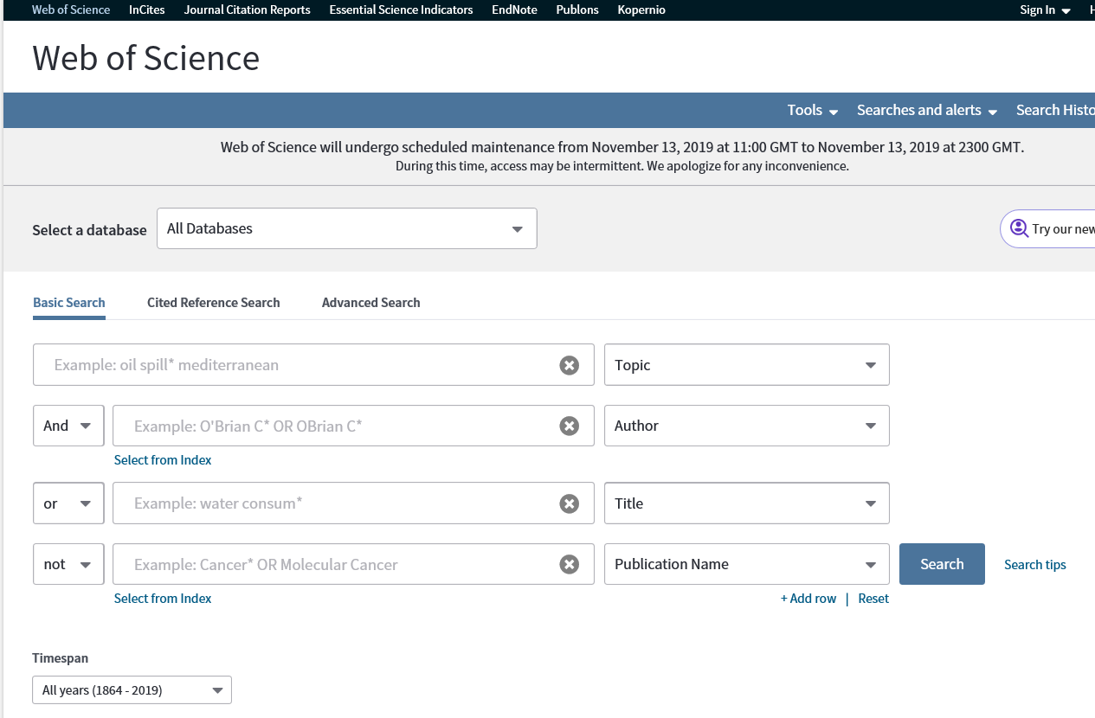

Slide 39
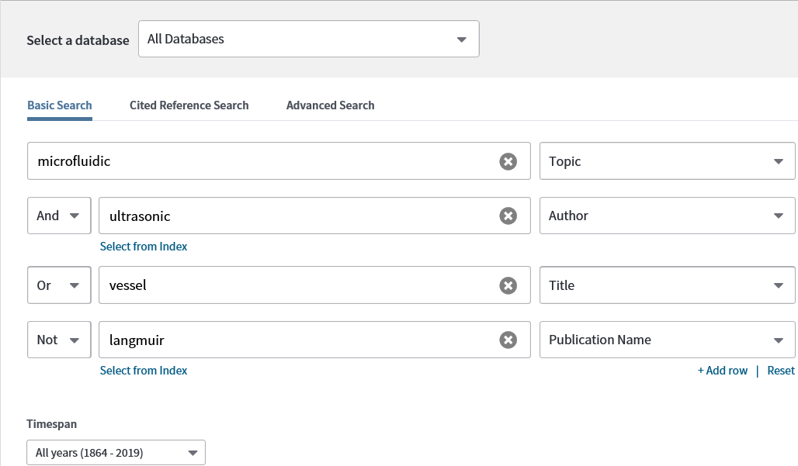

Slide 40
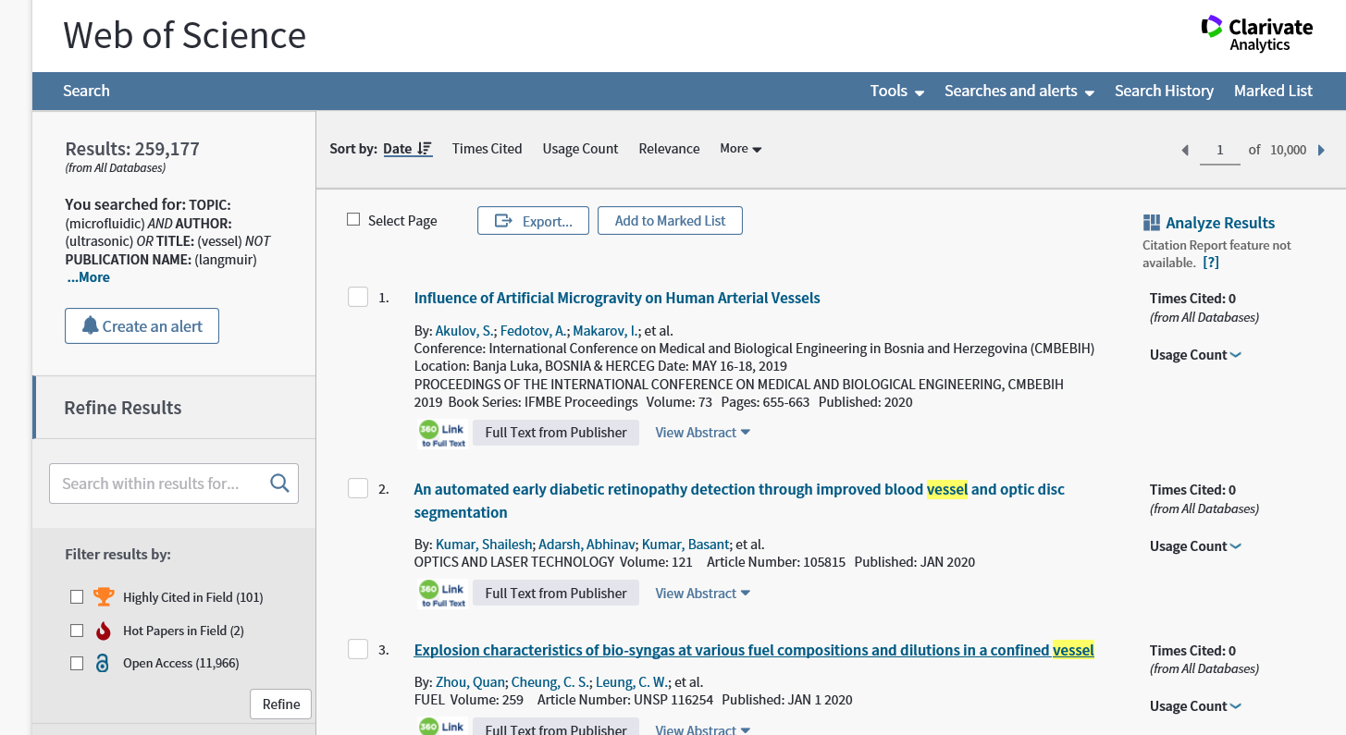

Slide 41
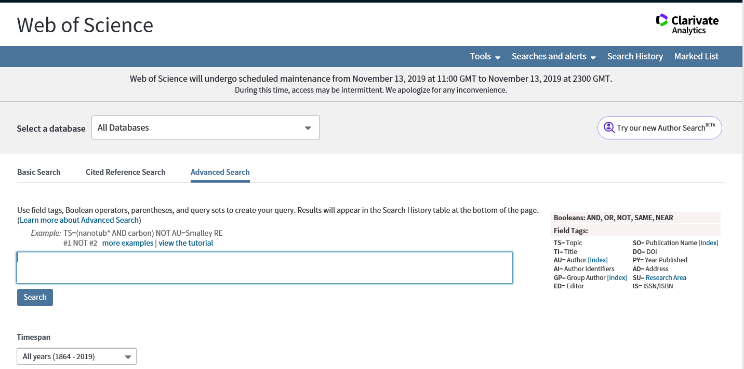
Use field tags, Boolean operators, parentheses, and query sets to create your query. Results will appear in the search history table at the bottom of the page.

Slide 43
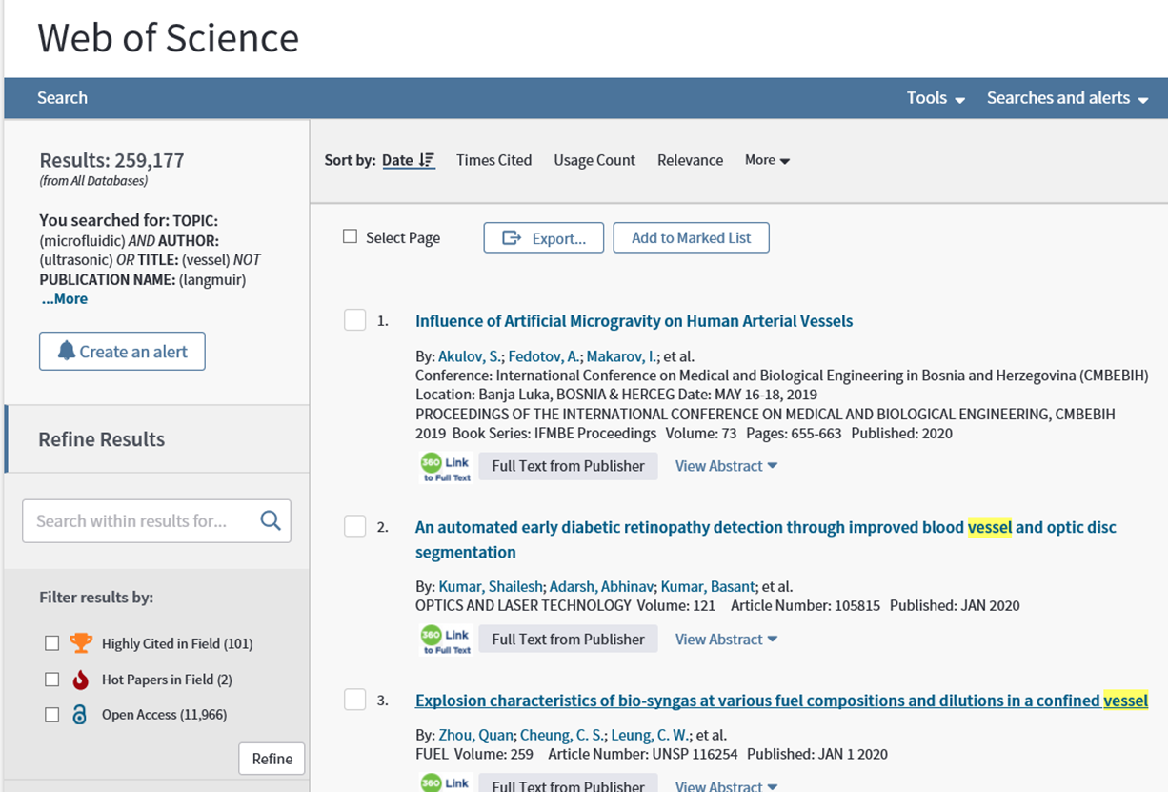
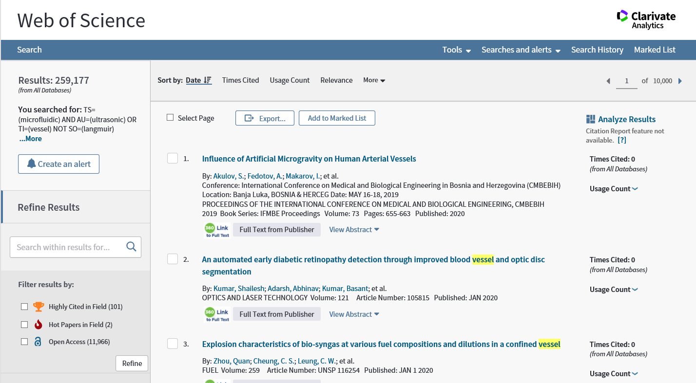

Slide 44
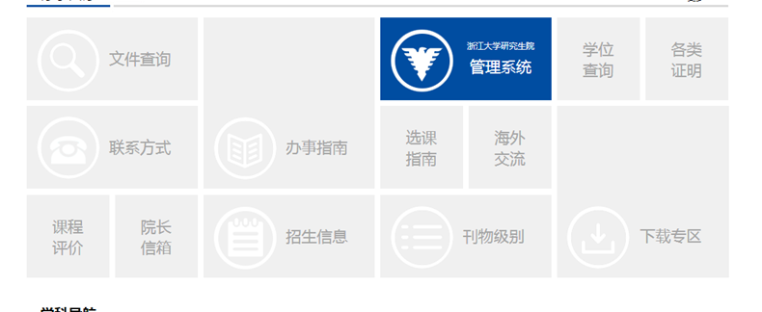
http://grs.zju.edu.cn/

Slide 45
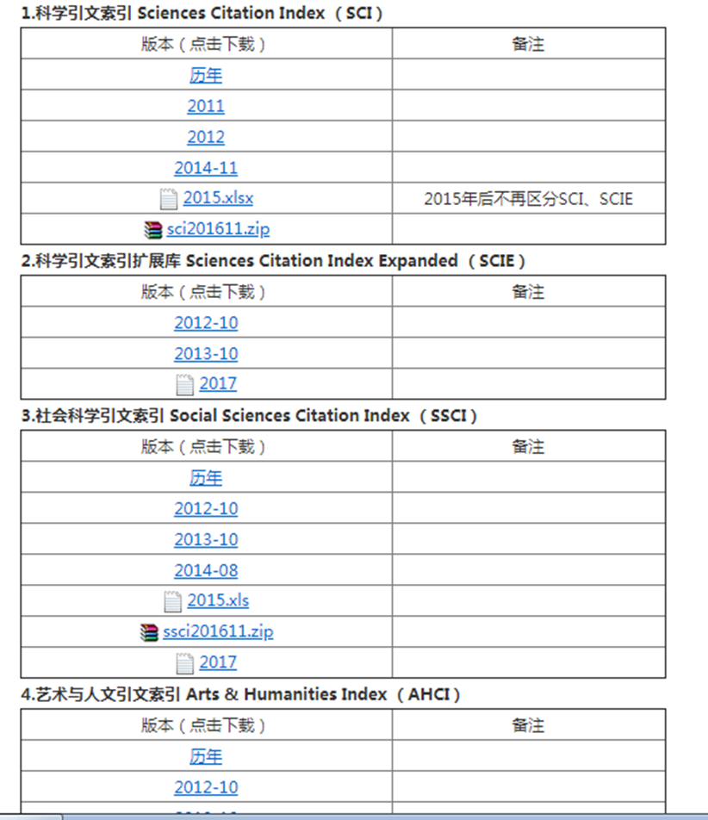

Slide 46
Citations

Slide 47
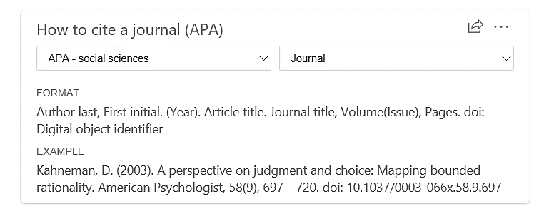

Slide 48
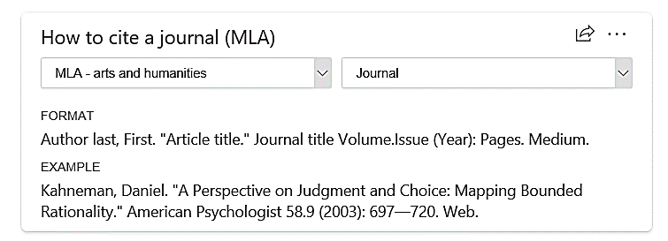

Slide 49
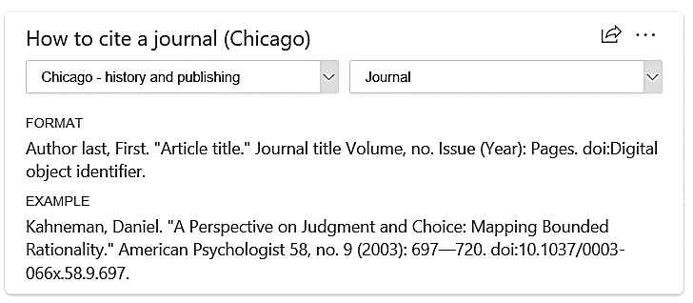

Slide 50
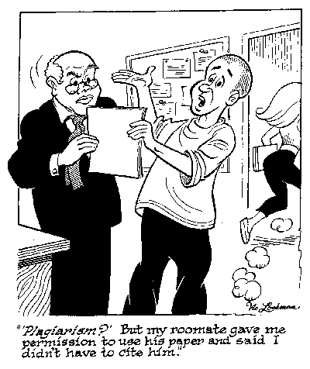
Academic misconduct

Slide 51
Academic dishonesty or academic misconduct is any type of cheating that occurs in relation to a formal academic exercise.
fabrication
falsification
plagiarism
altering academic documents or transcripts
gaining access to materials before they are intended to be available

Slide 52
Fabrication or Falsification
Northern Illinois University
Fabrication or falsification involves unauthorized creation, alteration or reporting of information in an academic activity.
Examples of fabrication or falsification include the following:
•Artificially creating data when it should be collected from an actual experiment
•Unauthorized altering or falsification of data, documents, images, music, art or other work
•Unauthorized omission of data, information, or results in documents, reports and presentations
•Hiding data, results, or information using inappropriate scales, magnification and representation in charts, graphs and other forms of representation
https://www.niu.edu/academic-integrity/students/cheating/fabrication-or-falsification.shtml

Slide 53
Fabrication or Falsification
Northern Illinois University
Falsifying information pertaining to the subjects participating in an experiment
•Falsely recruiting subjects for experiments without revealing the purpose of the experiments or receiving institutional approval for involving subjects in the experiment
•Fabricating sources of information
•Unauthorized impersonation of another person to complete an academic activity
•Unauthorized use of another individual's computer login ID and password
•Unapproved deviation from a predetermined experimental procedure
https://www.niu.edu/academic-integrity/students/cheating/fabrication-or-falsification.shtml

Slide 54
https://scai.uncc.edu/academic-integrity/academic-misconduct-policies-examples-0#faq2
Plagiarism
Plagiarism is taking someone else’s ideas and making them look like your own. By using the words someone else said or wrote in a paper and not giving them the credit we are plagiarizing another writer. Plagiarism is one of the most common (and worse) ways of academic misconduct.
•directly quoting from a source without citation
•paraphrasing or summarizing another's work without acknowledging the source
•using facts, figures, graphs, charts or information without acknowledgement of the source
◦It may involve computer programs and files, research designs, distinctive figures of speech, ideas and images, or generally any "information" which belongs to another.

Slide 55
https://scai.uncc.edu/academic-integrity/academic-misconduct-policies-examples-0#faq2
Multiple Submission
Submitting academic work or substantial portions of the same academic work (including oral reports) in more than one academic exercise without Authorization.
Examples
•submitting the same paper for credit in two courses without instructor permission
•making minor revisions in a credited paper or report (including oral presentations) and submitting it again as if it were new work. ◦Different aspects of the same work may receive separate credit; e.g., a report in History may receive credit for its content in a History course and for the quality of presentation in a Speech course.

