Slide 1
Analysis of gas hydrates using Raman Spectroscopy
RARIVOHARINONY ANDO

Slide 2
Summary
Introduction
RAMAN SPETRSCOPY
Structural study of hydrates by Raman spectroscopy
Raman spectroscopic measurements of synthetic gas hydrates in the ocean
Useful information on the study of hydrate related to Raman technology
Conclusion

Slide 3
Introduction
While the molecular and isotopic composition of gases in hydrates brings many about their origins, the study of the molecular structure of hydrates contributes to the understanding of their formation process but also to the prediction of their conditions of stability. Raman spectroscopy or are commonly used tools for structural analysis of gas hydrates.

Slide 4
RAMAN SPECTROSCOPY
Raman spectroscopy is one of the vibrational spectroscopic techniques used to provide information on molecular vibrations and crystal structures. This technique uses a laser light source to irradiate a sample, and generates an infinitesimal amount of Raman scattered light, which is detected as a Raman spectrum using a CCD camera. The characteristic fingerprinting pattern in a Raman spectrum makes it possible to identify substances including polymorphs and evaluate local crystallinity, orientation and stress.

Slide 5
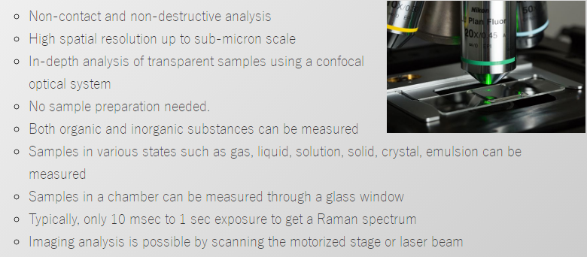
Advantage:

Slide 6
How does it works?
Raman spectroscopy is based on the phenomenon of vibration of the atomic bonds, and more particularly on the response of these bonds to a light excitation. In Raman spectrometry, the analysis is done by excitation of the material. Brought to a virtual energy level by a powerful monochromatic light source of the laser type, the electrons then emit a radiation which is collected and analyzed by a suitable detector.

Slide 7
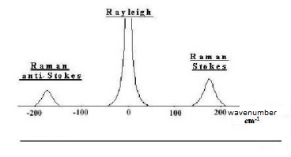
Nanophoton https://www.nanophoton.net/raman/raman-spectroscopy.html
Physical and geochemical characterization of gas hydrates of different geological environments. Christophe Bourry 2008

Slide 8
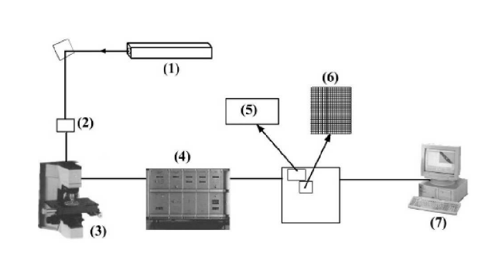
Physical and geochemical characterization of gas hydrates of different geological environments. Christophe Bourry 2008.
Experimental method:
(1) The laser source, which delivers, in a beam of very small divergence, a polarized monochromatic radiation.
(2) Transfer optics charged to direct the excitatory light to the microscope
(3) The microscope, in which the objective is responsible for the optimum illumination of the sample and the most efficient collection of the Raman scattered light and its transfer to the spectrometer inlet.
(4) The spectrometer, which performs the spectral analysis of the radiation. The spectrometer has a premonochromator that very effectively eliminates reflected or scattered radiation at the wavelength of the laser.
(5) The photomultiplier that translates photons into an electrical signal
(6) The photoelectric detector consisting of a CCD (charge coupled device) type mosaic cooled with liquid nitrogen
(7) Computer processing of electrical signals from detectors.

Slide 9
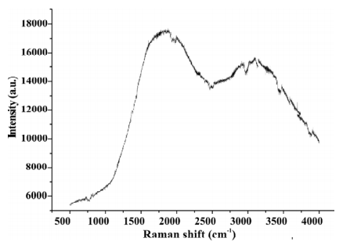
Parasite effect
Certain parasitic phenomena, such as fluorescence, may represent major problems for Raman spectroscopy since this fluorescence can mask the Raman signal. This phenomenon can be avoided by using a source excitation in the UV, thus allowing the acquisition of Raman spectrum without fluorescence effect.
Example of Raman spectrum masked by a fluorescence effect for the hydrates of the Marmara Sea (excitation wavelength: 514.5 nm). Physical and geochemical characterization of gas hydrates of different geological environments. Christophe Bourry 2008

Slide 11
Structural study of hydrates by Raman spectroscopy
The structure of the gas hydrates is dependent on the conditions of pressure and temperature of the medium, but also on the overall composition of the gas used for their formation. The main purpose of the work here is to find in which structure types the hydrates belong by comparing the result from the Raman of the studied hydrates to another synthetic hydrates where the setting and structure is already known or by the observation only of the Raman of the hydrate and their ration.

Slide 12
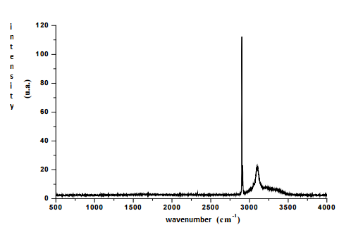
Characterization of hydrates of bacterial origin:
Raman spectrum characteristic of the hydrates of the Hakon Mosby mud volcano obtained at -140 ° C and at atmospheric pressure. Physical and geochemical characterization of gas hydrates of different geological environments. Christophe Bourry 2008
Two fine and intense peaks are observable at about 2900 cm-1 in the spectral range of vibration of the C-H bonds, while the broad observable peak at about 3100 cm-1 corresponds to the symmetrical elongations of the O-H bonds of the ice.

Slide 13
Comparison of Raman spectra of HMMV hydrate and synthetic hydrate. The 2902 and 2914 cm-1 bands correspond respectively to the stretching of C-H bonds of methane in large cages and in small cages. Physical and geochemical characterization of gas hydrates of different geological environments. Christophe Bourry 2008
Two fine and intense peaks are observable at about 2900 cm-1 in the vibrational spectral range of the C-H bonds, whereas the broad observable peak at about 3100 cm-1 corresponds to the symmetrical elongations of the O-H bonds of the ice. The two bands of intensities IL and IS at 2902 and 2914 cm-1 respectively are characteristic of the stretching of the C-H bonds (mode ν1) of the methane in a hydrate structure. The ratio of the integrated intensities of the two methane peaks, IL / IS, makes it possible to differentiate the different hydrate structures. This ratio, which is of the order of 3.6 for hydrates of HMMV, is the typical signature of crystallizing hydrates in the cubic structure I. In this structure, there are three times more large cages than small cages. Thus, the ideal IL / IS ratio of a type I structure is 3. The ratio slightly higher than 3 obtained for HMMV hydrates shows that small cages are slightly less occupied by methane than large cages. The band at 2902 cm-1 corresponds to the stretching of C-H bonds of methane in the large cages of structure I, while the band at 2914 cm-1 is attributed to the same vibrations of methane, but in small cages .

Slide 14
Comparison of Raman spectra of Congo-Angola (GH-ZaiAngo), Niger (GH-NerisII) and HMMV (GH-HMMV) margins hydrates. Also represented are the Raman spectra of synthetic hydrate and gaseous methane (Chazallon et al., 2007)

Slide 15
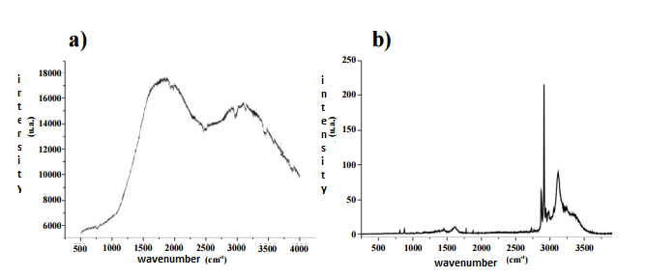
Characterization of hydrates of thermogenic origin:
a) Raman spectrum of a sea salt of Marmara obtained at 514.5 nm, masked by the phenomenon of fluorescence. b) Raman spectrum of the same hydrate obtained at 266 nm (UV), without fluorescence problem. Physical and geochemical characterization of gas hydrates of different geological environments. Christophe Bourry 2008
Although more complex than those obtained for bacterial hydrates, the Raman spectra of the hydrates of the Marmara Sea have an intense peak at about 2913 cm-1, characteristic of the methane vibration. However other lower peaks are observable at different wave numbers, and are due to the presence of compounds other than methane, in sufficient quantity to be detected.

Slide 16
Details of the Raman spectrum of Marmara hydrates in the spectral range 2800-3000 cm-1. The bands at 2903 and 2913 cm-1 respectively correspond to the elongations of the C-H bonds of methane in large cages and in small cages (512) of hydrates of structure II. Asterisks correspond to the extension of C-H bonds of heavier hydrocarbons (C2H6, C3H8 and i-C4H10) Physical and geochemical characterization of gas hydrates of different geological environments. Christophe Bourry 2008
The figure represents the portion of the Raman spectrum of hydrates in the Marmara Sea between 2800 and 3000 cm-1, corresponding to the spectral range of C-H elongations of hydrocarbons. Like the spectra obtained for the African and Norwegian hydrates, the hydrate spectrum of the Marmara Sea has two peaks at ~ 2903 and ~ 2913 cm-1. These bands correspond to the vibrations of the methane in the hydrate, but the intensities of the two bands are reversed with respect to the hydrates of bacterial origin. The ratio of the integrated intensities of the two peaks (2903: 2913 cm-1), equal to 0.3, allows us to affirm that these hydrates crystallize in a type II structure. Whereas for a type I structure, this ratio is of the order of 3, for a type II structure it must be less than 0.5. Indeed, in this structure there are twice as many small cages as large cages. The ratio of the integrated intensities of the two peaks (2903/2913 cm-1) should therefore be 0.5 for a methane hydrate of structure II, a purely theoretical view since methane alone only forms hydrates of structure I. On the other hand in natural hydrates, methane is trapped with heavier hydrocarbons, such as ethane, propane or iso-butane.

Slide 17
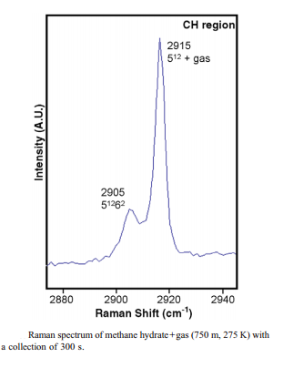
Raman spectroscopic measurements of synthetic gas hydrates in the ocean
K.C. Hester et al. / Marine Chemistry 98 (2006) 304–314

Slide 19
K.C. Hester et al. / Marine Chemistry 98 (2006) 304–314

Slide 20
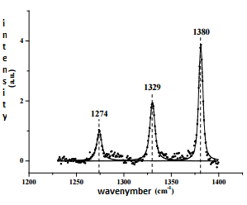
Some useful information on the studies of hydrates
Raman strips at ~ 1274 and ~ 1380 cm-1 characteristics of carbon dioxide vibrations Physical and geochemical characterization of gas hydrates of different geological environments. Christophe Bourry 2008

Slide 21
Part of the Raman spectrum corresponding to the C-C elongations of iso-butane (812 cm-1), propane (876 cm-1) and ethane (992 cm-1). Physical and geochemical characterization of gas hydrates of different geological environments. Christophe Bourry 2008

Slide 23
Conclusion
The Raman technology has got a lot of success in different disciplines of sciences. The vibrational spectroscopic techniques used to provide information on molecular vibrations and crystal structures combined with laser technologies has given the Raman Spectroscopy a very efficient tools analysis considering its preservation of the matter studied. For the study of hydrates the Raman enabled us to find in which structure belong a gas of hydrates that is an important information about the origin of the gas hydrates and the methane gas within and its formation itself. Synthetic hydrate gas has even been held under the real condition in the ocean for comparative analysis using the Raman. At same time the Raman has helped us to collect and to compile a lot of data about other molecule such as dioxide of carbon and even more that could be used in the study of hydrates as well as other field.

Slide 24
Reference
A unified equation for calculating methane vapor pressures in the CH4–H2O system with measured Raman shifts Wanjun Lu a,b,*, I-Ming Chou c , R.C. Burruss c , Yucai Song d
Determination of methane concentrations in water in equilibrium with sI methane hydrate in the absence of a vapor phase by in situ Raman spectroscopy Wanjun Lu a,b,*, I. Ming Chou c , Robert C. Burruss c
Physical and geochemical characterization of gas hydrates of different geological environments. Christophe Bourry 2008
Raman spectroscopic measurements of synthetic gas hydrates in the ocean K.C. Hester a , S.N. White b , E.T. Peltzer c , P.G. Brewer c , E.D. Sloan a, *
https://www.nanophoton.net/raman/raman-spectroscopy.html

Slide 25
谢谢
谢谢

